Slide 1
OME 2017 Team Training Pattern and Screen files
Sébastien Besson
OME

Slide 2
Talk Outline
The Problem
Pattern files
Screen files
Limitations and next steps

Slide 3
The Problem

Slide 4
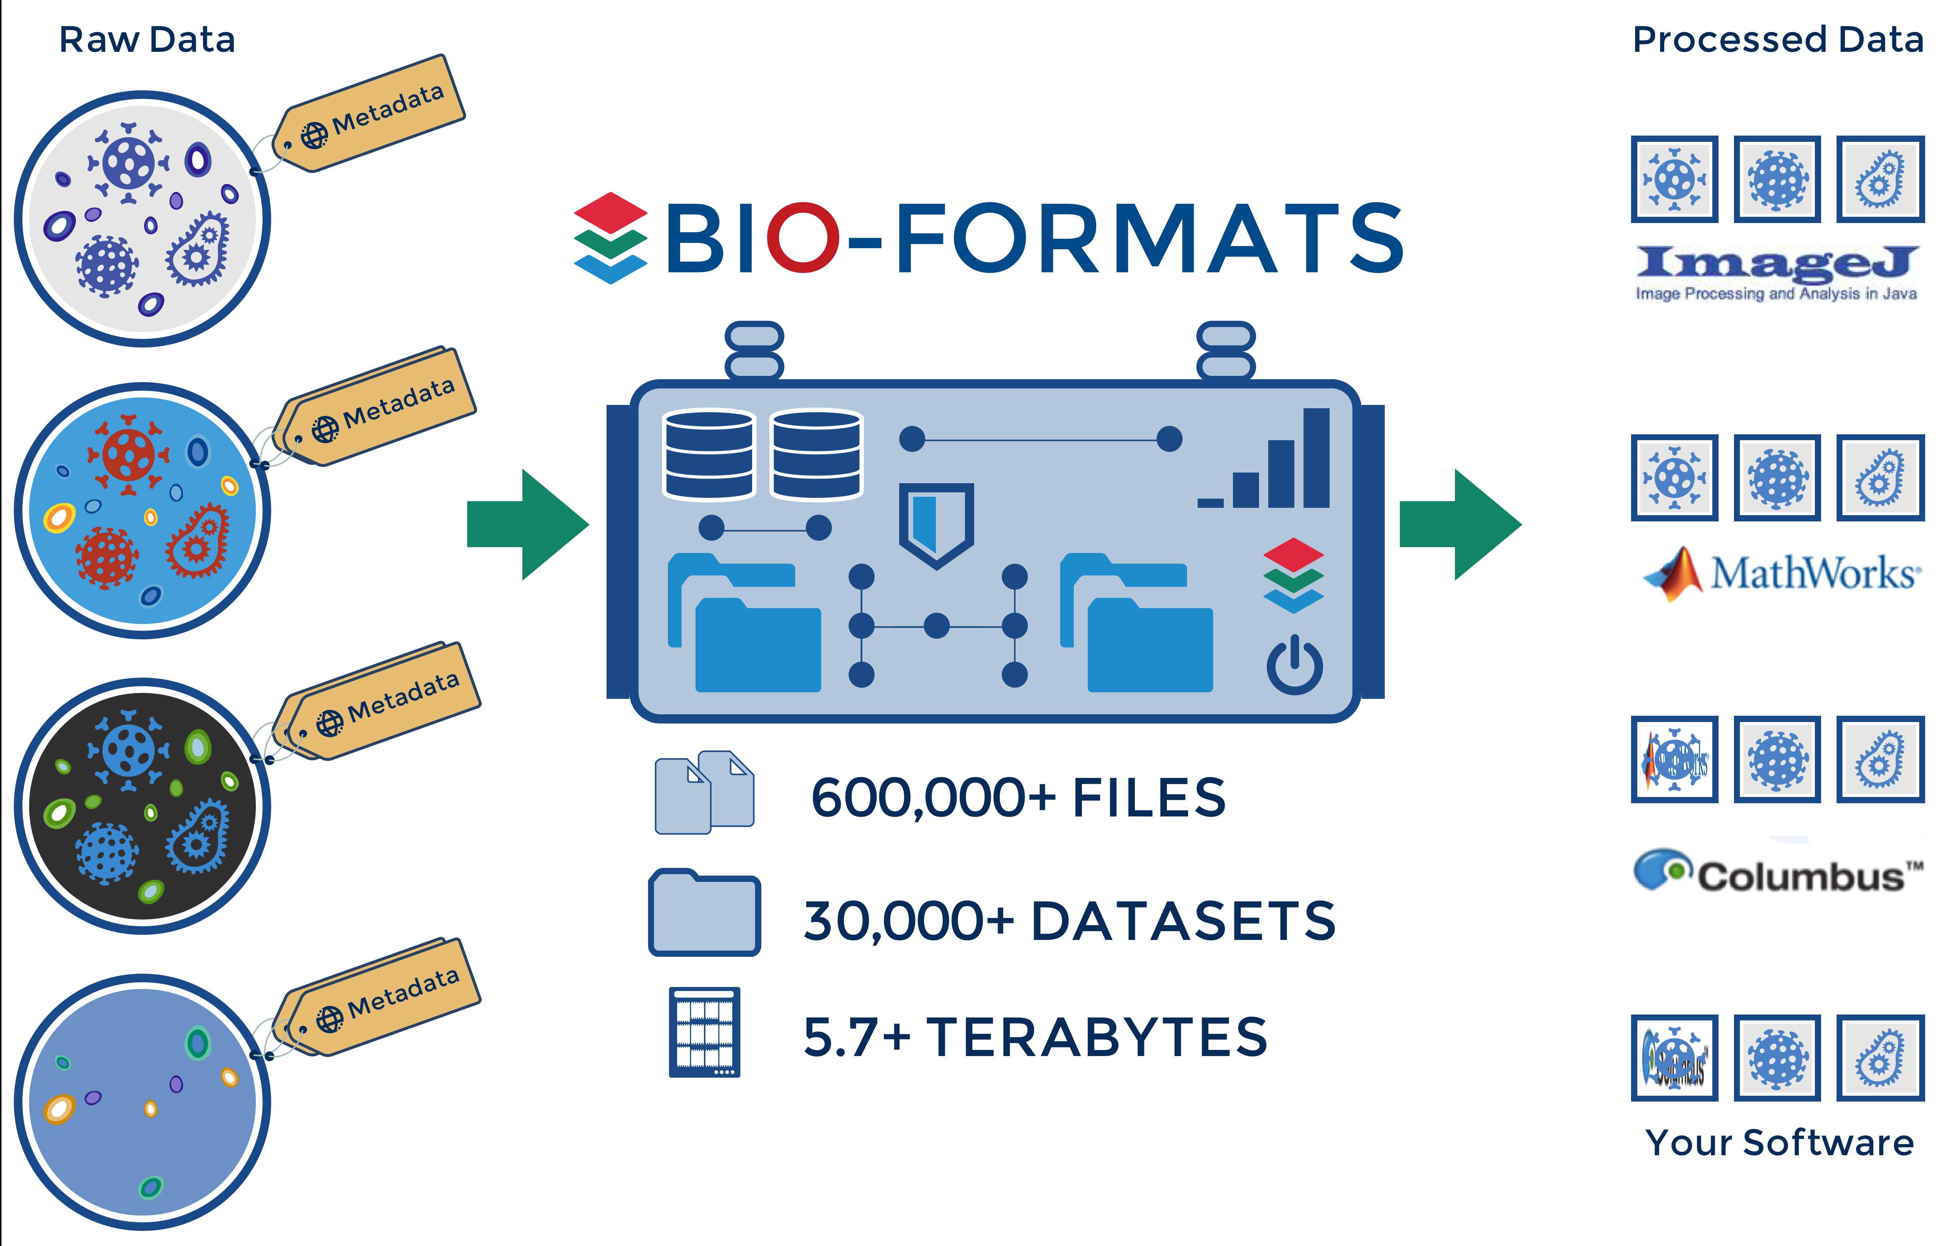
BIO-FORMATS: Proprietary File Conversion
→ Apps using Bio-Formats were started >100,000 times per day in 2015 ←

Slide 5
Multi-file imaging formats
Bio-Formats for imaging formats composed of multiple files
Reader initialization includes the detection of all files required for the metadata and pixel data
IFormatReader.getUsedFiles()
IFormatReader.getSeriesUsedFiles(boolean)
File grouping implemented per reader based on:
the information from a file header (OME-TIFF)
the information from a metadata file (Operetta)
The file format specification

Slide 6
Patterns & screens: overview
Problem: acquired data with missing format metadata/specification and implicit file grouping conventions based on the folder hierarchy and file names
Requires additional metadata to 1- determine the image metadata (core dimensions, HCS) 2- map the files required for accessing the pixel data
Current solutions: pattern and screen files and their associated readers
Used in practice by a third of the current production IDR studies

Slide 7
Pattern files: introduction
Applications: multi-series multi-dimensional (ZCT) imaging data
Goal: group files based on their filename
Library: Bio-Formats 5.1.0 and above
Reader: FilePatternReader
Format specification: see documentation page
Generalized to any format supported by Bio-Formats, most typically TIFF or PNG files

Slide 8
Pattern files: examples
See https://github.com/sbesson/idr0000-lastname-example/tree/screens_training/patterns
Requires Bio-Formats 5.x (command-line tools, ImageJ/Fiji…)
Time-series experiment
Multi-channel experiment
Multi-dimensional experiment

Slide 9
Pattern files: format specification
See https://docs.openmicroscopy.org/bio-formats/5.7.1/formats/pattern-file.html
Single file ending with .pattern containing a single line of text
Patterns must be grouped between <> symbols
Range of integers incl. step increments e.g. <0-10>, <0-10:2>
List of values e.g. <red,green,blue>
Assumes dimensions (XYZCT) can be concatenated
Pattern prefix forces the dimension - see AxisGuesser
Channel: c, ch, w, wavelength
Timepoint: t, tl, tp, time
Z sections: fp, sec, z, zs, focal, focalplane
Series: s, series, sp

Slide 10
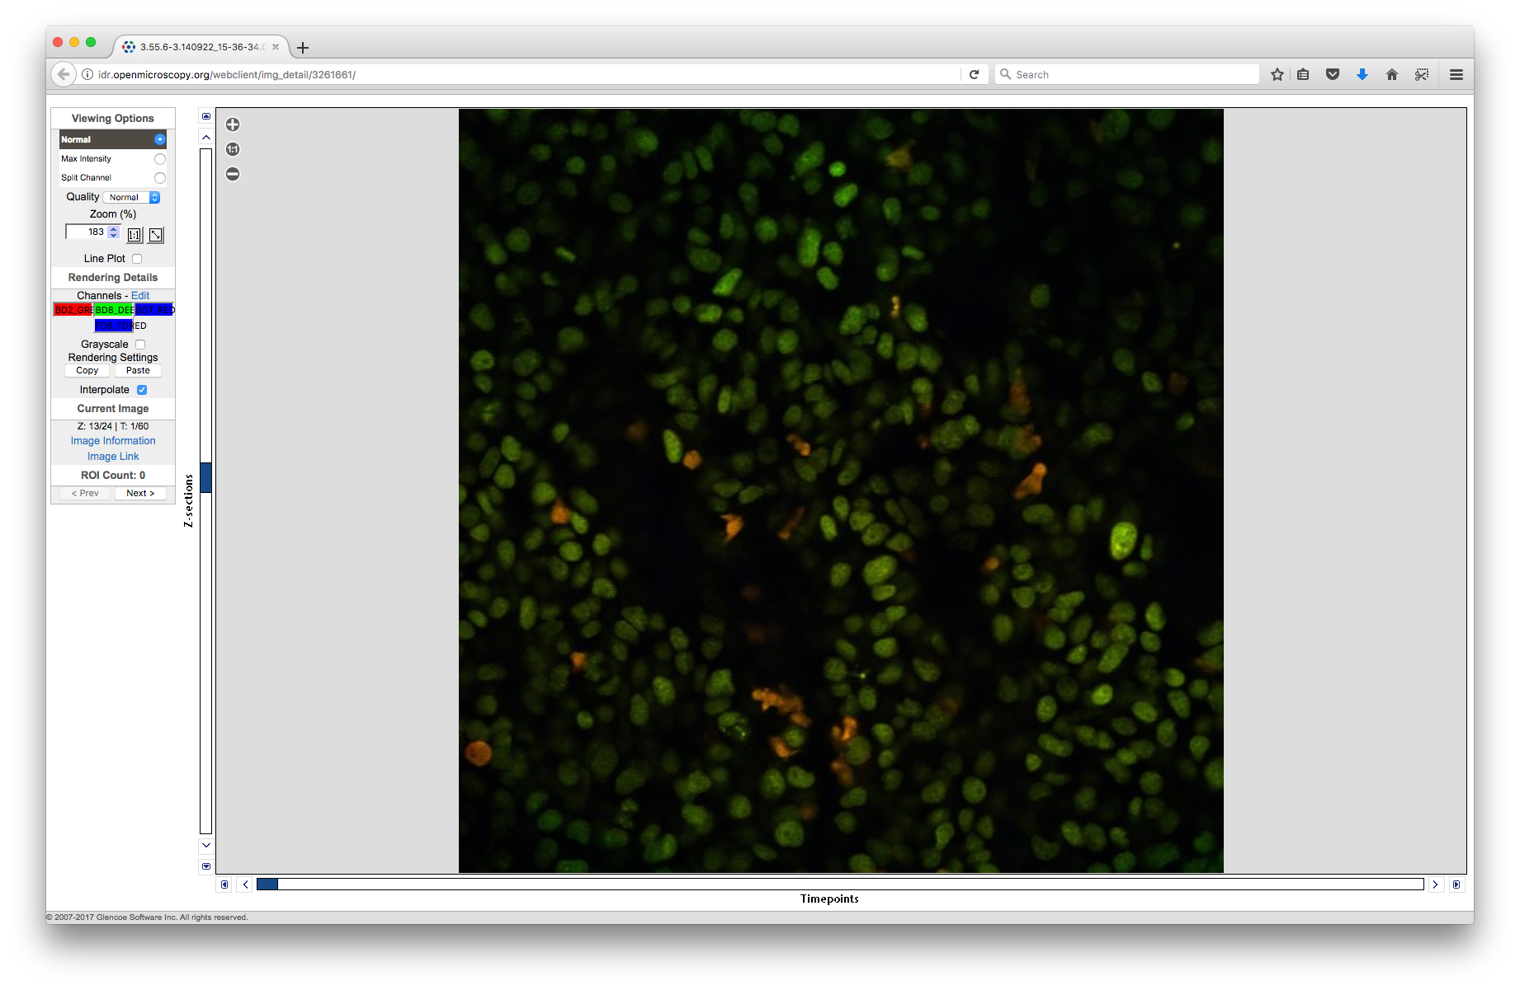
Pattern files in production (IDR 0026)
https://idr.openmicroscopy.org/webclient/?show=image-3261661
4 channels, 60 timepoints, 24 Z-sections distributed across 240 TIFF files
Pattern file

Slide 11
Screen files: introduction
Application: High-Content Screening datasets e.g.https://data.broadinstitute.org/bbbc/BBBC021/
Goal: specify the HCS layout in machine-readable format
Library: IDR Bio-Formats (metadata branches)
Reader: ScreenReader
Format specification: see README.md for a minimal description of the format and some minimal examples

Slide 12
Screen file: examples
See https://github.com/sbesson/idr0000-lastname-example/tree/screens_training/screens
Use IDR Bio-Formats (0.4.1) JAR with the existing clients (command-line tools, ImageJ/Fiji)
1 well, 1 field
4 wells, 1 field
4 wells, 2 fields
48 wells, 2 fields, sparse
BBBC021

Slide 13
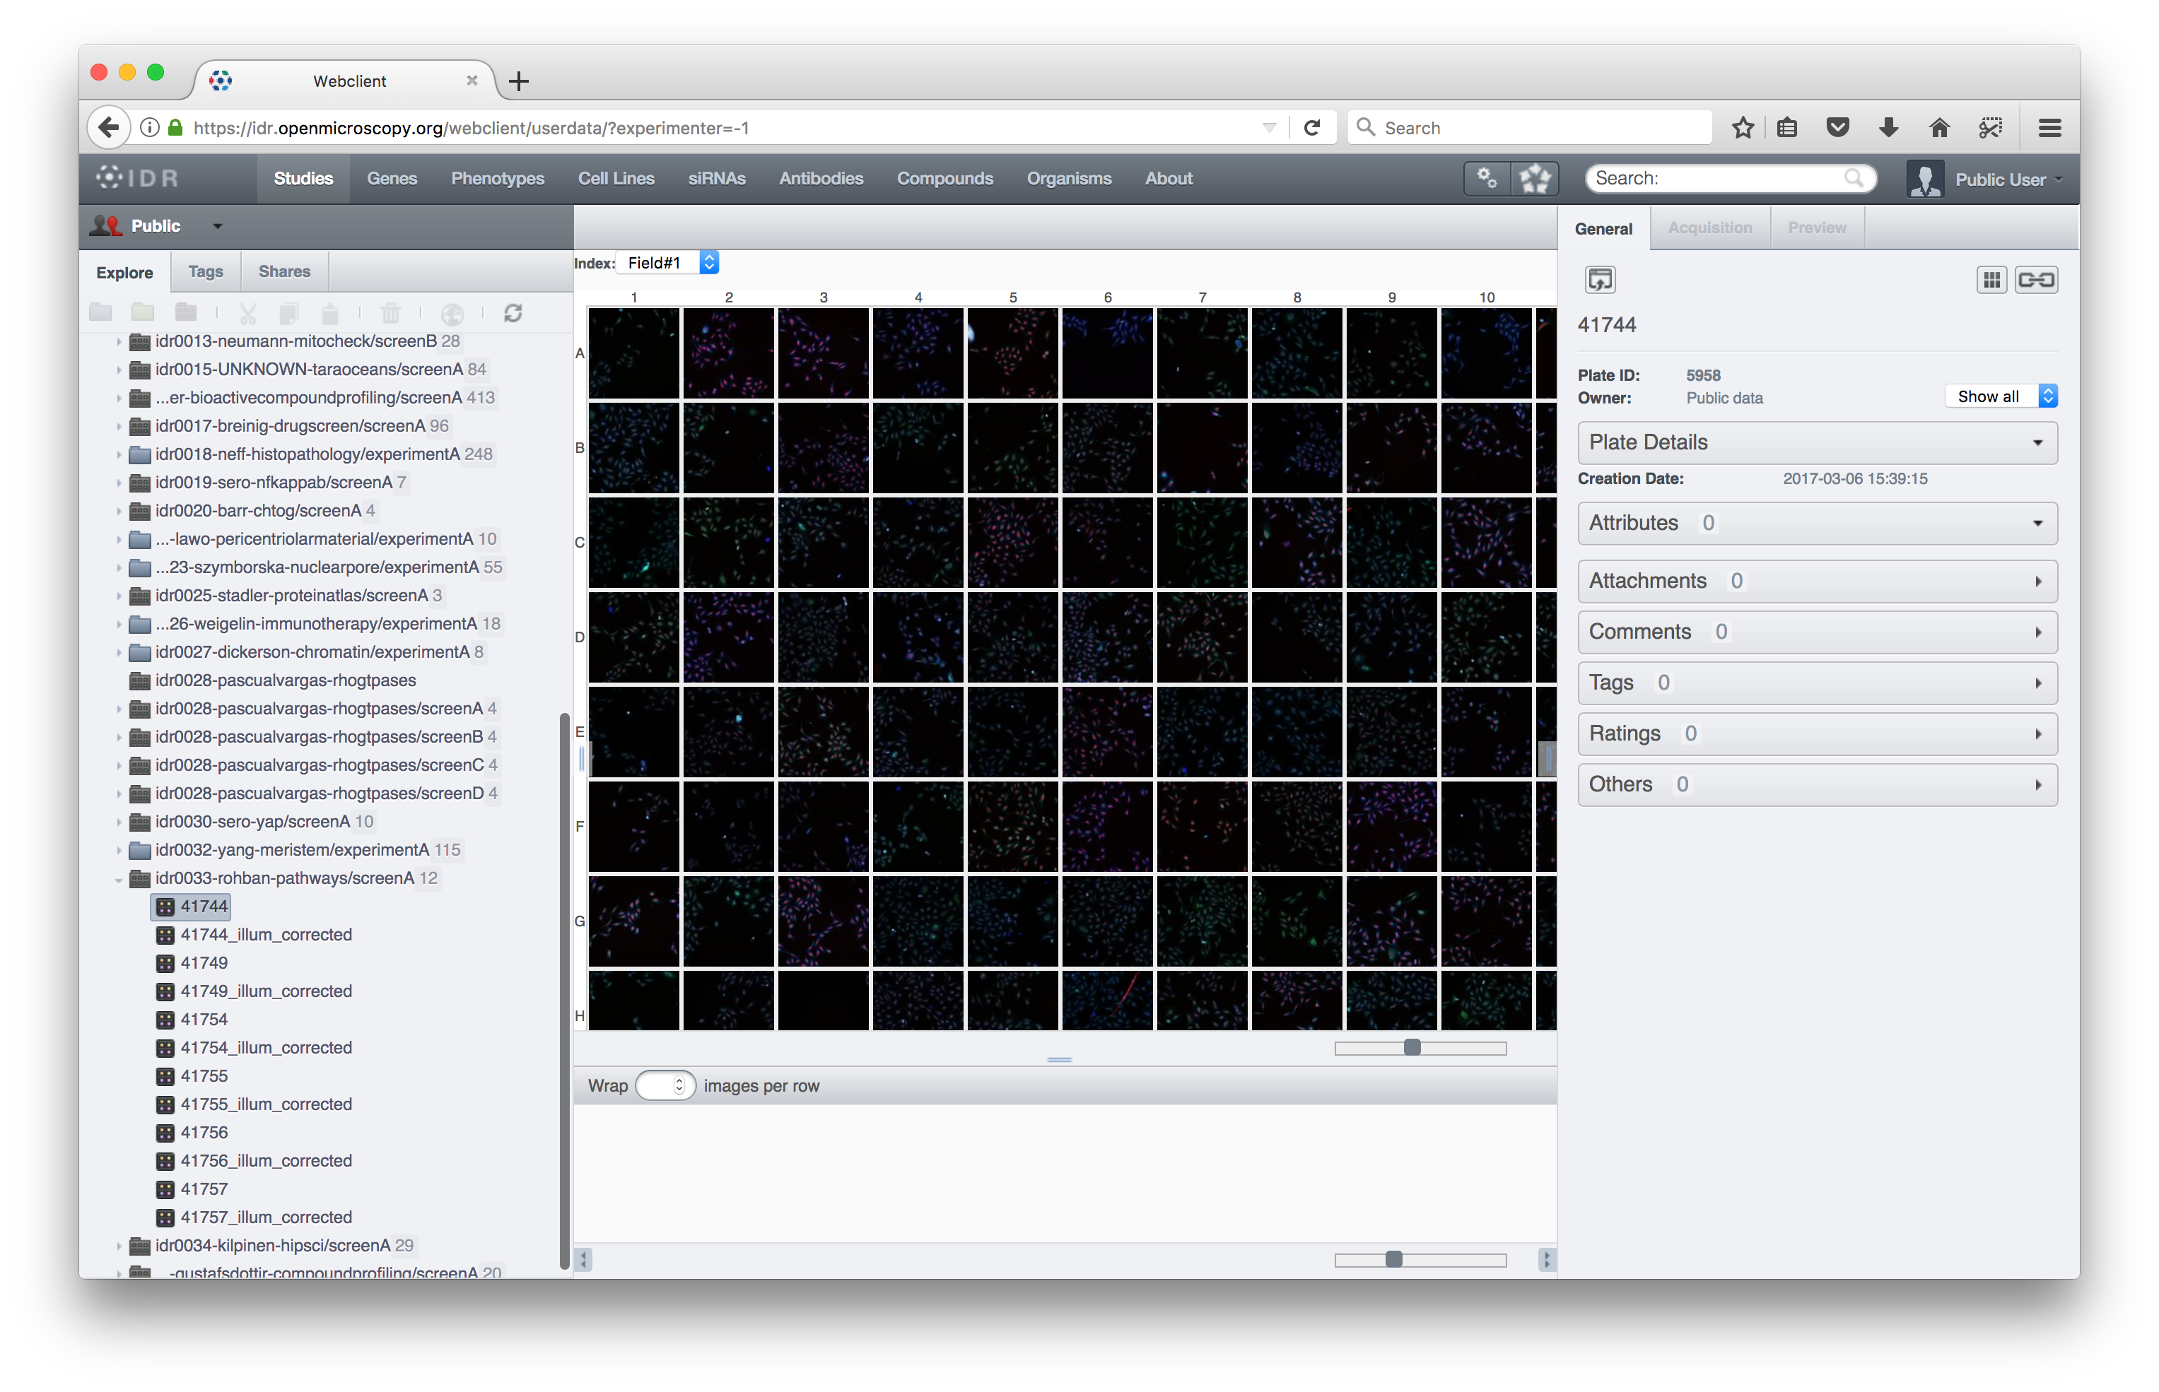
Screen files in production (IDR 0033)
https://idr.openmicroscopy.org/webclient/?show=plate-5958
16 rows, 24 columns, 9 fields (each field image is a pattern file)
Screen file

Slide 14
Screen & pattern files: generation at scale
idr-metadata repository contains both the tools/scripts and the metadata files
1.3 K screen files, 150 pattern files (0.4.3 tag)
Tools
Top-level Python library: pyidr.file_pattern, pyidr.screenio
Per-study file generation scripts: make_patterns.py, generate_screens/
Screen format validation script: check_screen.py
screenY/idrXXX-screenY-plates.tsv: additional level for grouping plate specified by screen files in a screem for each study
IDR import step

Slide 15
Next steps
Screen reader/format currently IDR-only
Solution for real-life multi-dimensional HCS datasets
Existing reader + utility library/scripts
Cost of maintained a Bio-Formats fork/branch
Backporting ScreenReader to the mainline
Another metadata file format to support
Based on poorly specified INI format
Versioning
Licensing
Performance issues

Slide 16
Next steps
ScreenReader translates .screen metadata into OME-XML
IDR: most of the pixel data is expressed in TIFF or HDF5 format
Possibility: convert .screen files into companion OME-XML files
Current limitations of the OME companion format
only works with strict OME-TIFF file
metadata file must be suffixed as .companion.ome
binary files must link back to the companion file
Design requirements
Relaxed version of the companion OME file specification – initial investigation by Simone
Support for HDF data at the model level

