Slide 1
Annotating phenotypes in the Image Data Repository
Eleanor Williams, PhD
University of Dundee & EMBL-EBI
exwilliams@dundee.ac.uk

Slide 2
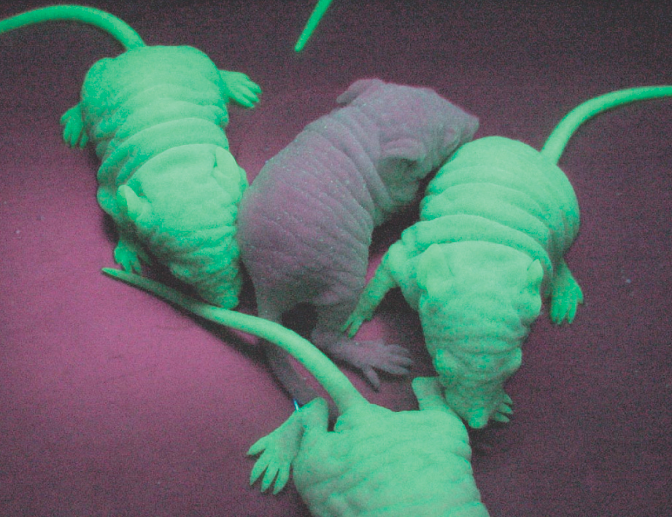
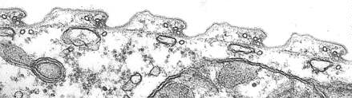
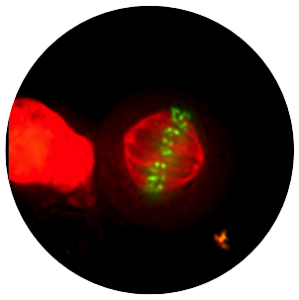
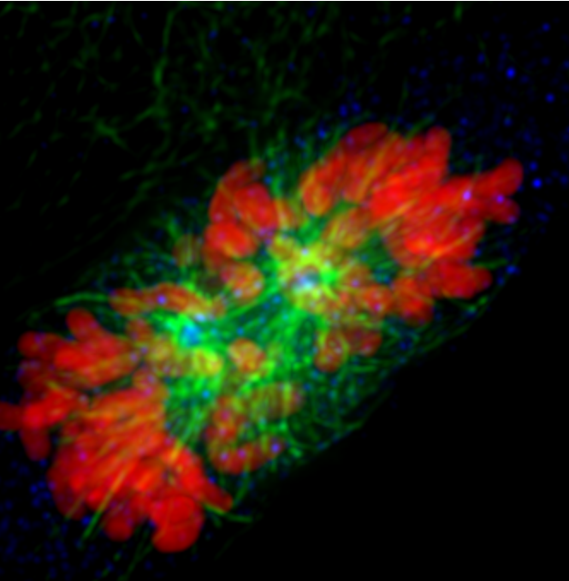
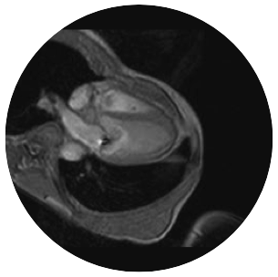
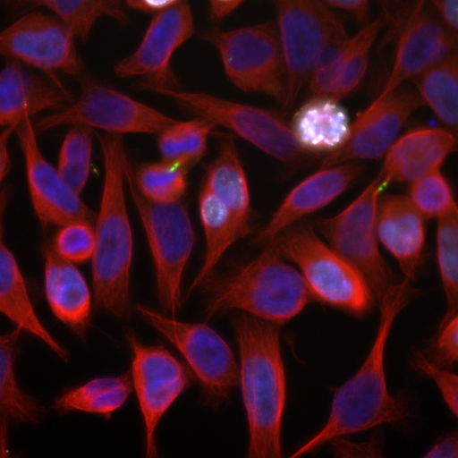
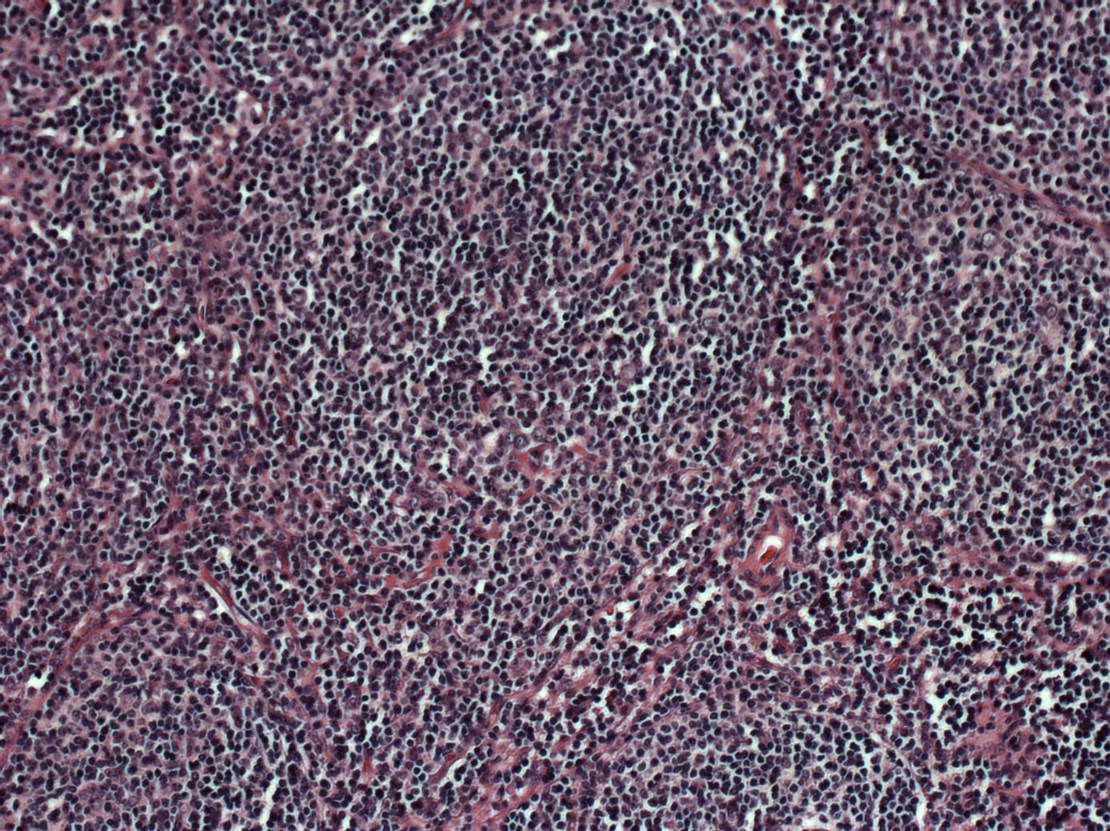
The image problem…is ubiquitous
Physiology
Organelles
Dynamics
Cells
A pretty picture?
A measurement?
A resource?
Lead Discovery Target Validation
In Vivo
Pathology
2
Notes:
Scientific imaging covers a multitude of fields including cell dynamics, physiology, target validation and of course pathology. Imaging data is incredibly rich, in terms of measurements associated with the image and metadata associated with both images and assays. familiar with the repositories available for genetic sequences, gene expression data and proteomics but there is no repository which covers the wide spectrum of image data shown here..

Slide 3



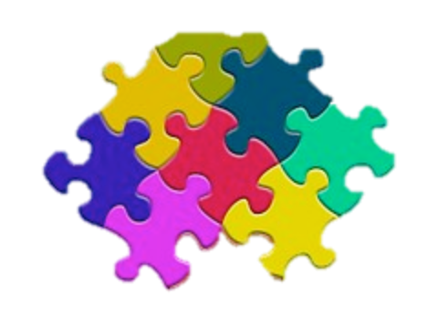
Motivation for an image data repository
Data transparency and re-usability
Benchmark datasets
Data integration
Discovery
Notes:
The motivation for an Image Data Repository is 4 fold:
Data transparency and re-usability - Raw data related to publications can be made available
Benchmark datasets - establishing good design, protocols and standards
Integration of datasets - allow cross dataset querying of genes and phenotypes
Discovery – enabling novel analyses and combining of datasets

Slide 4


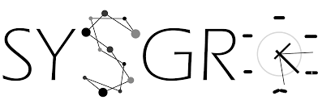















IDR Structure
Super-resolution microscopy dataset
Light sheet microscopy
dataset
Notes:
The OME team along with EBI and a group in Cambridge are working on a BBSRC project to build a prototype IDR. IDR is built upon OMERO server system and bioformats image reader software , both established, actively developed and open source. We are obtaining published datasets, mainly high content screens. The data will go through EBI’s BioStudies database and into the IDR. The images and curated metadata are stored in OMERO and then they will be available for analysis in a cloud enviornment or for querying by gene or phenotype through a web interface. The Cambridge group, led by Rafael Carazo are developing a tool for visual data exploration. Euro-BioImaging will be able to consume the data from the IDR.

Slide 5
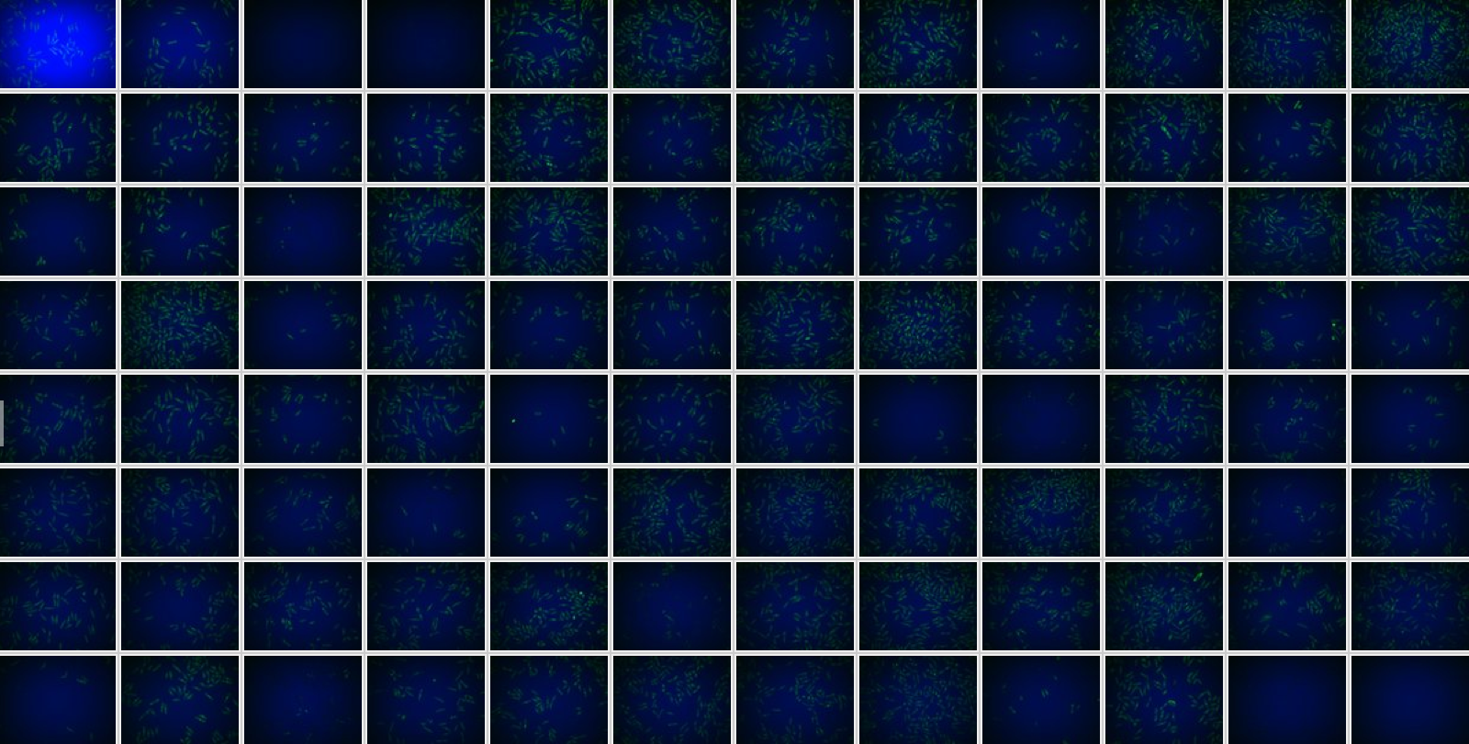
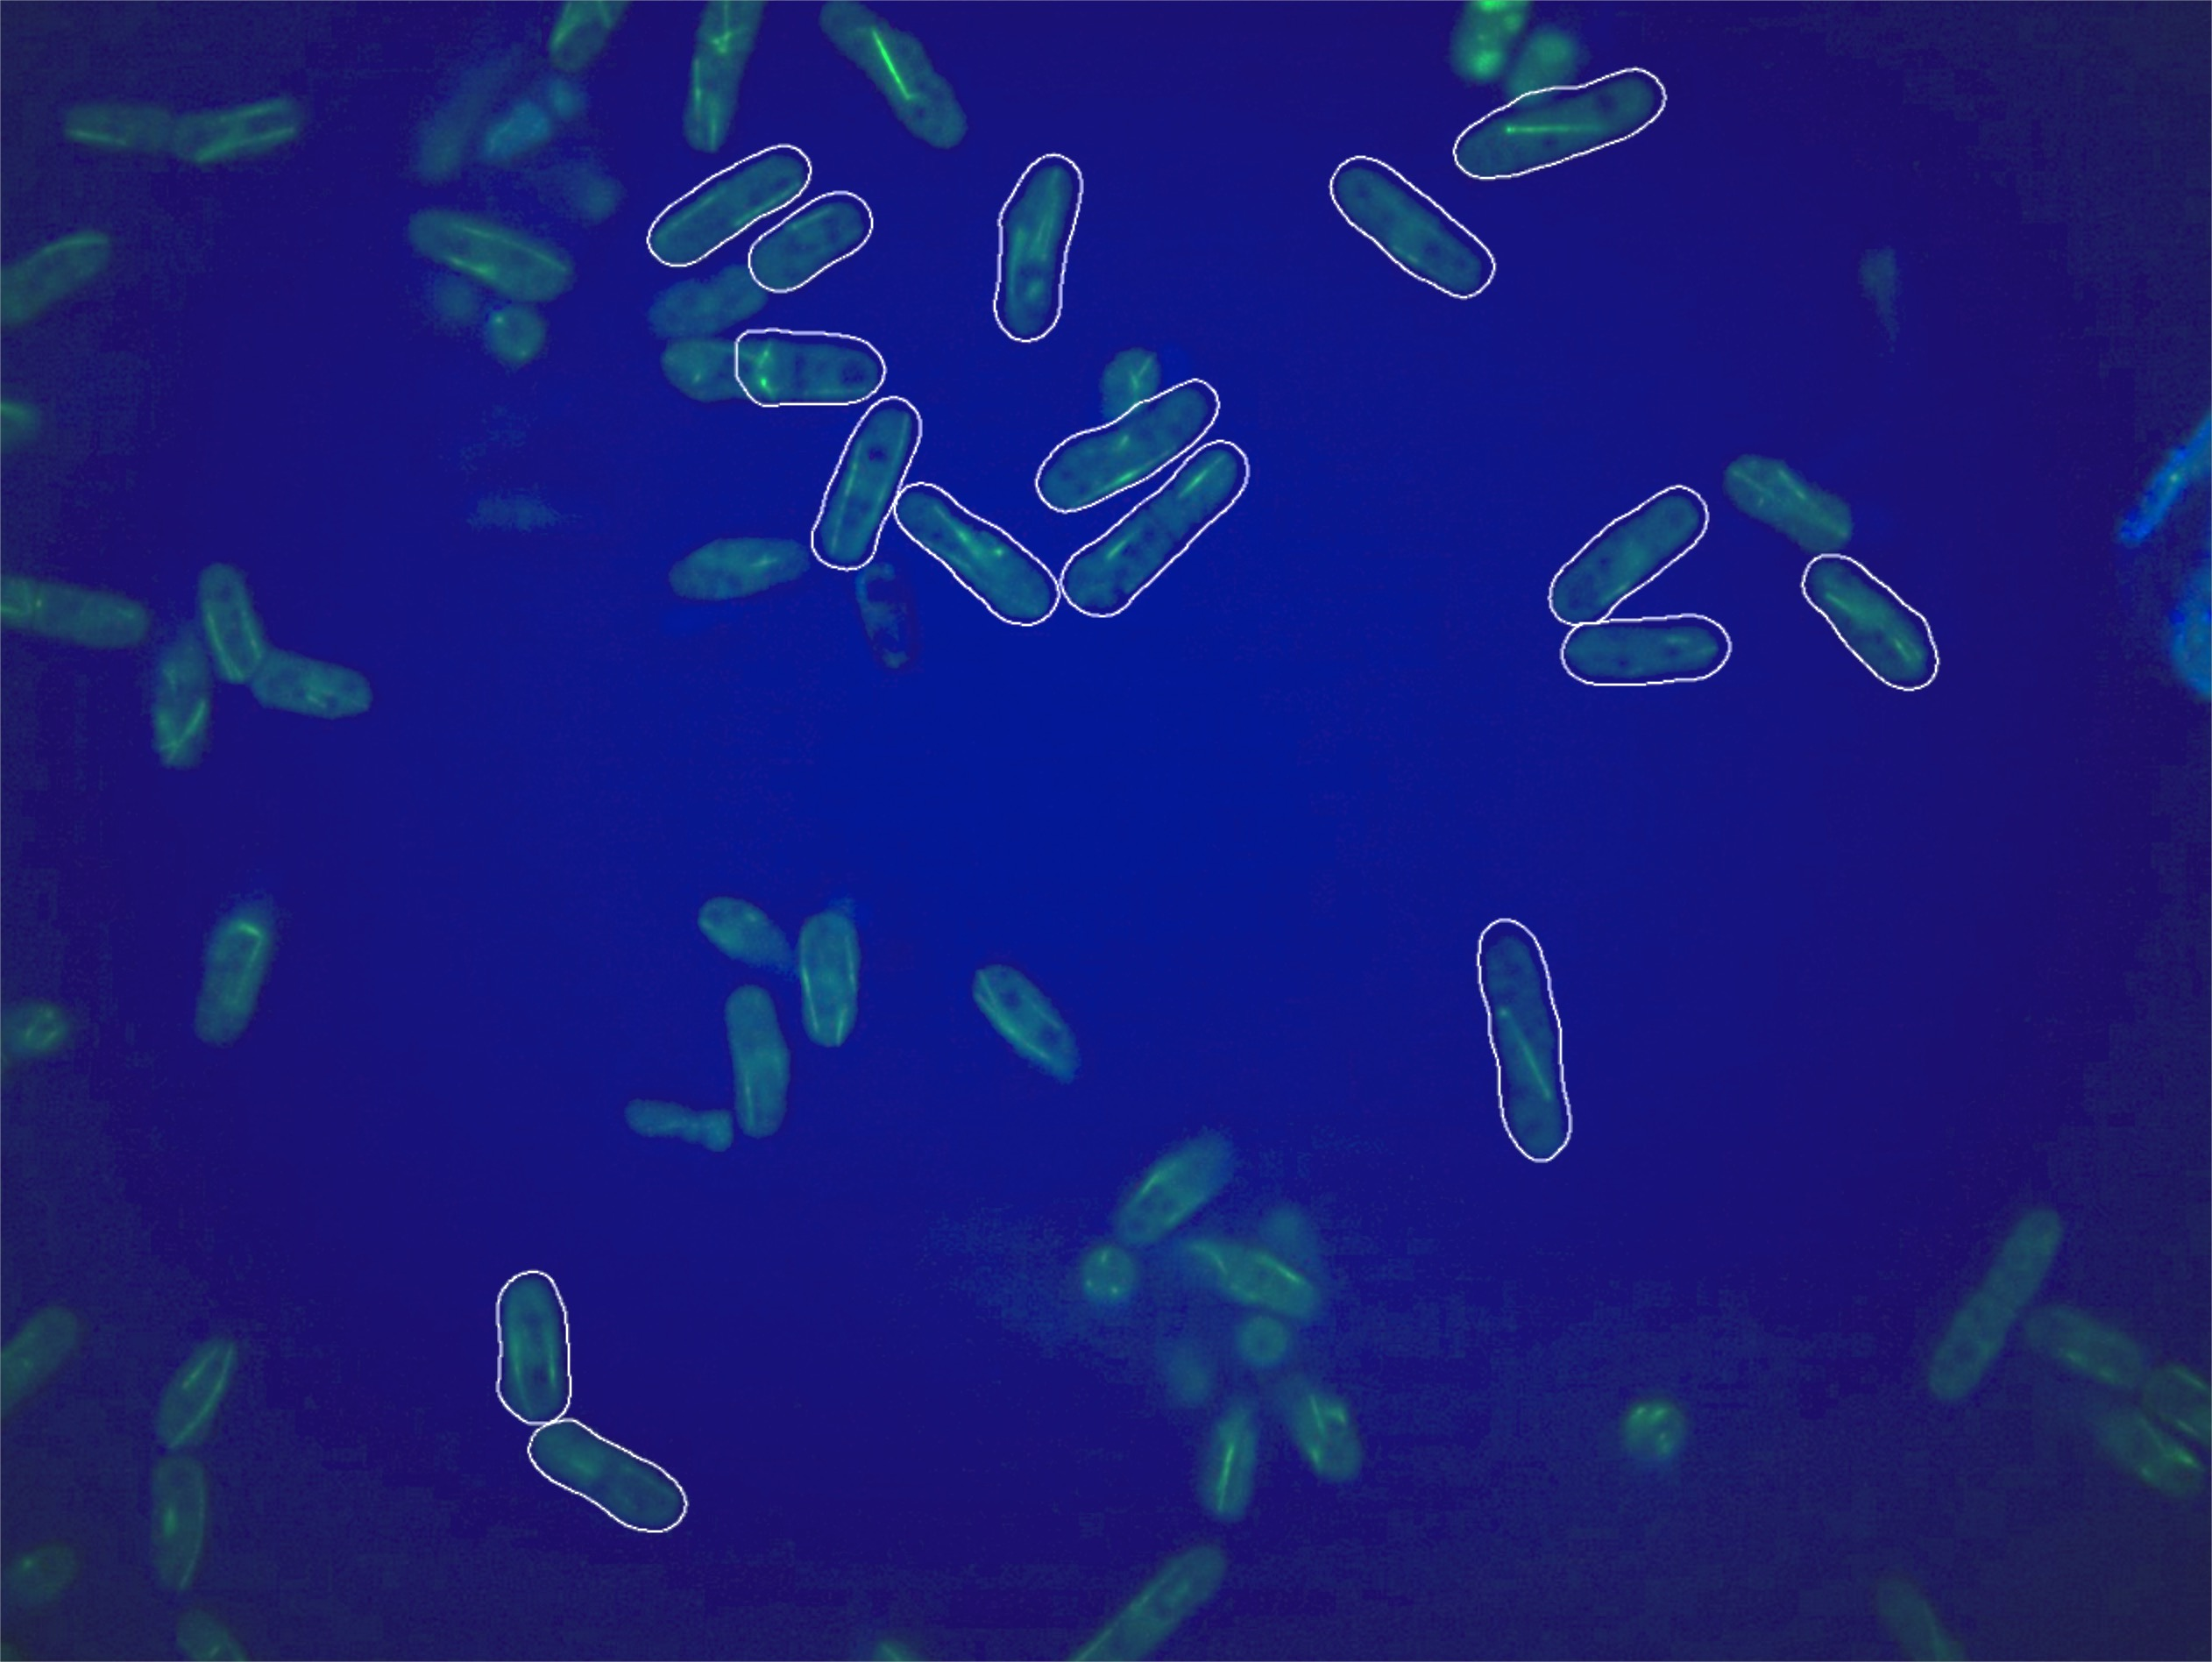
High Content Screen Data
Genome wide or targeted
Manual or automated analysis
image
segmentation
feature extraction and classification
From: Graml et al, Dev. Cell 2014
Notes:
Starting with HCS data. This type of imaging study is particularly rich in metadata and analytical results. Briefly, many genes in parallel are knocked down by RNAi, knocked out or modified so that the proteins they produce are tagged and can be visualized. Studies are carried out in plates where each well contains cells with a different knocked down or tagged gene and then the effect is studied under a certain condition such as cell division.
The effect on the cells can be looked at manually or using software analysis tools. The cells or structures such as nuclei are first identified using a process called segmentation and then different measurements, called features, can be taken of the cells. From this cells can be classified into different groups and phenotypes such as elongated cells, or longer time spent in metaphase, or protein localization to a particular subcellular structure can be determined. Here is an image from a dataset in IDR showing cells identified by segmentation.

Slide 6
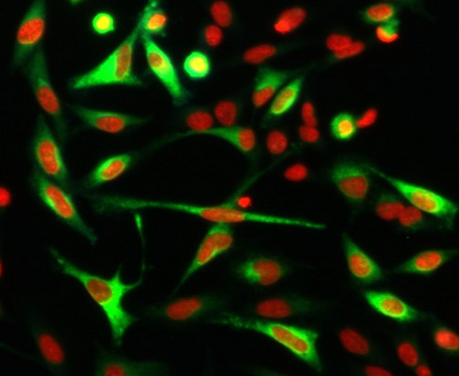
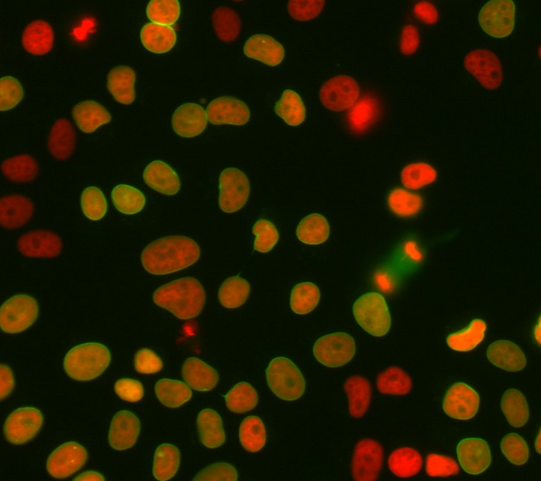
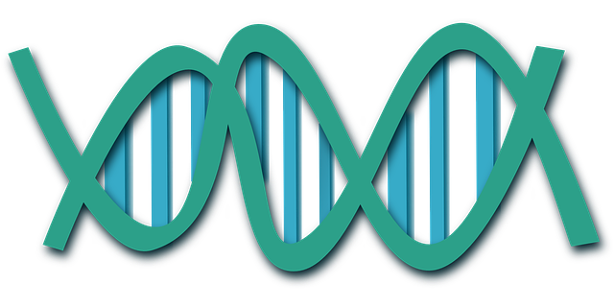
The quest for similarity
study 1
study 2
features
phenotypes
genes
Notes:
A lot of different HCS studies have been performed and each have their own publication, but its difficult to compare results between them. We know that studies can be compared at the gene level, we think that they can be compared at the phenotype level and this is what I’m going to talk to you about today. The IDR will also give a platform for exploring whether meaningful analyses can be made using feature level data. So one of the main reasons behind the IDR is to capture all of this metadata and store it in a coherent way so that it can be a resource for data comparison and exploration.

Slide 7
Data collection so far
 | Current | Future
Raw image data | 10.7 TB | 80.44 TB
Total image files | 4.9 million | 23 million
Notes:
In first 9 months how much data have we collected ..

Slide 8
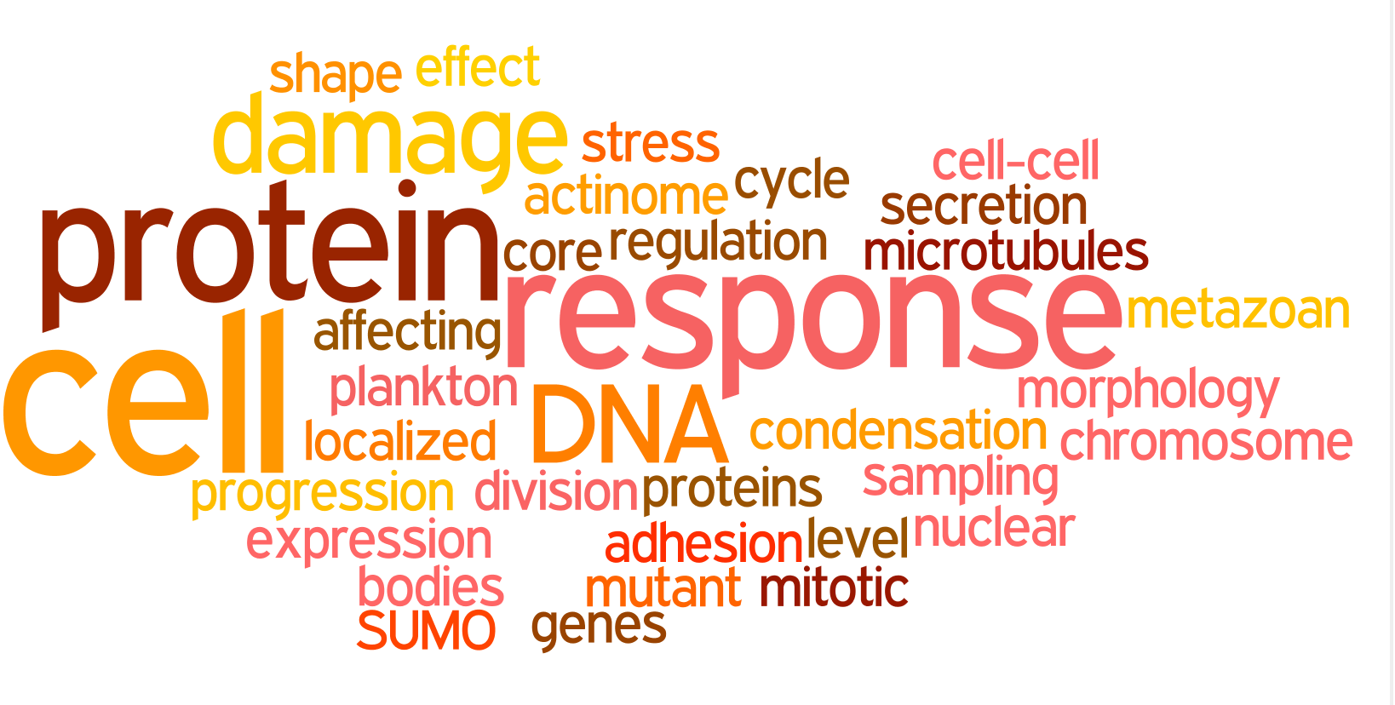
What kinds of studies?
Notes:
The studies we are working on are quite diverse. 3 look at the DNA damage response, 3 involve looking at protein expression patterns but in very different situations, others are looking at chromosome condensation, the conservation of the actinome in Drosophila and humans, the cell secretory pathways and genes that affect cell morphology.

Slide 9

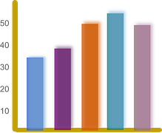
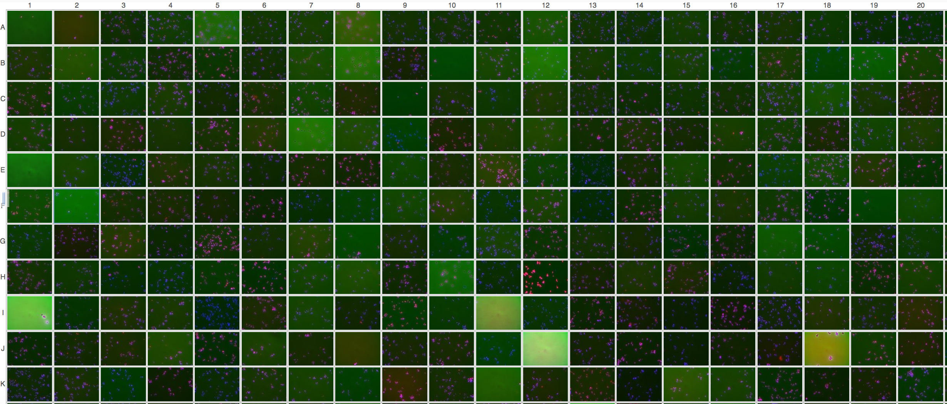
Information collected
Study information
Results
Library layout

Slide 10
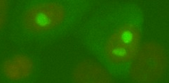
What kinds of phenotypes?
Over 130 different phenotypes
protein localized to nucleolus
Fong et al JCB 2013
Notes:
11 of the studies looked at so far. There are 133 different phenotypes and they can be divided into 13 categories ranging from the most common of protein localization, to cytoskeletal phenotypes, nuclear morphology, regulation of cell size and so on.
Number of different phenotypes per study ranges from 1 to 38, mean of 12
6 studies (more than half) have phenotypes in just one of these categories. But 3 studies are broad ranging and have phenotypes in 5 or 6 different categories.
NOTE: Could break this down by study – try to show that sysgro has phenotypes across several groups

Slide 11
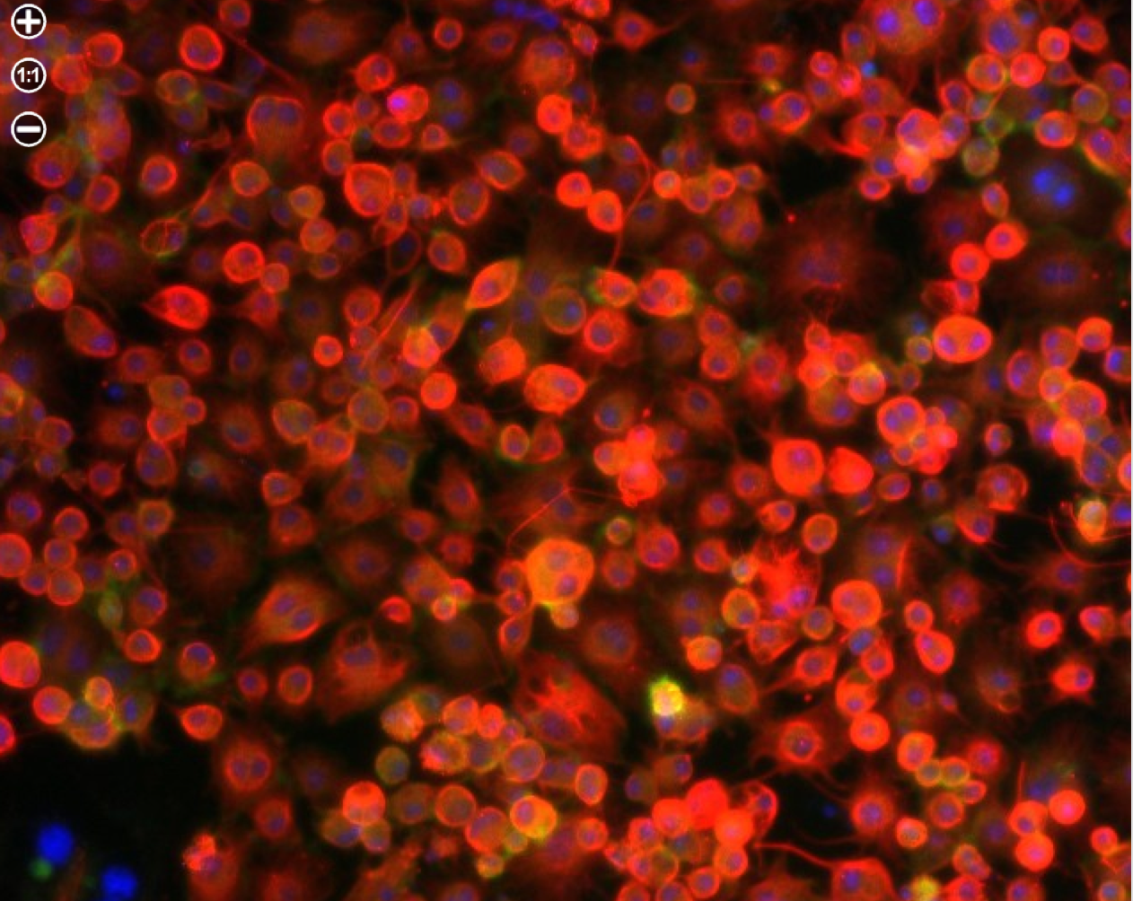
Same concept but different names
cell shape round or non-adherent
orb
low eccentricity
circular
Rohn et al, 2011
siRNA knockdown of Act5C
spheroid
round cell phenotype
CMPO_0000118
Notes:
But how can we search across studies for similar phenotypes, there are many ways to say the same thing?

Slide 12
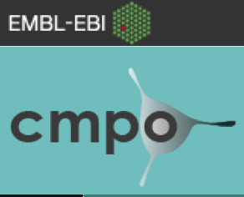
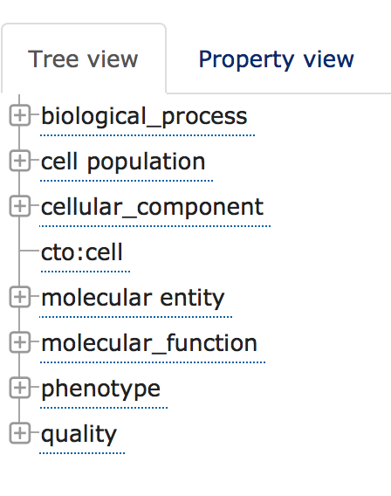
Cellular Microscopy Phenotype Ontology
              designed specifically for this type of data
              some studies already annotated with CMPO e.g. Mitocheck
      actively being developed

Slide 13
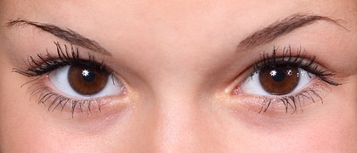


Manual annotation
      look to see if there is an appropriate term, if not request term
      input from authors
      in some cases wait to see if get another similar term before adding

Slide 14

Challenges
      Very specific phenotypes
increased level of spontaneous Rad52-YFP foci
cell response to DNA damage phenotype CMPO_0000415
      What phenotypic descriptions actually mean?
big cell
?
large cell
Notes:
Talk to you in detail now about what occupies my waking hours. How do we go about tagging these phenotypes.

Slide 15
Challenges
      Complex phenotypes
IP2 increased
“postmitotic interphase microtubule array, likely reflective of G1-S phases “
more cells with G1 phase microtubule arrays phenotype
CMPO_0000412
more cells with S phase microtubule arrays phenotype
CMPO_0000412
Notes:
How do we go about tagging these phenotypes.

Slide 16
What we haven’t mapped
      Species specific
the smt3allR mutant has a population of cells that contain GFP signals between mother and daughter cells
      Vague phenotype descriptions
the smt3allR mutant displays GFP foci not detected in WT cells
      Technical issues
ambiguous
below threshold
technical problem
Notes:
Species neutral

Slide 17

How many phenotypes have a mapping?
Every study curated has some phenotypes mapped to an ontology term, 9/11 have all mapped
84% of phenotypes mapped to ontology term
7 phenotypes in more than one study
Notes:
84% have ontology mapping, this is probably at the maximum that it is appropriate to give an ontology tag
So far we have 7 phenotypes than are found in more than 1 study, showing that already there is value in cross study searching

Slide 18
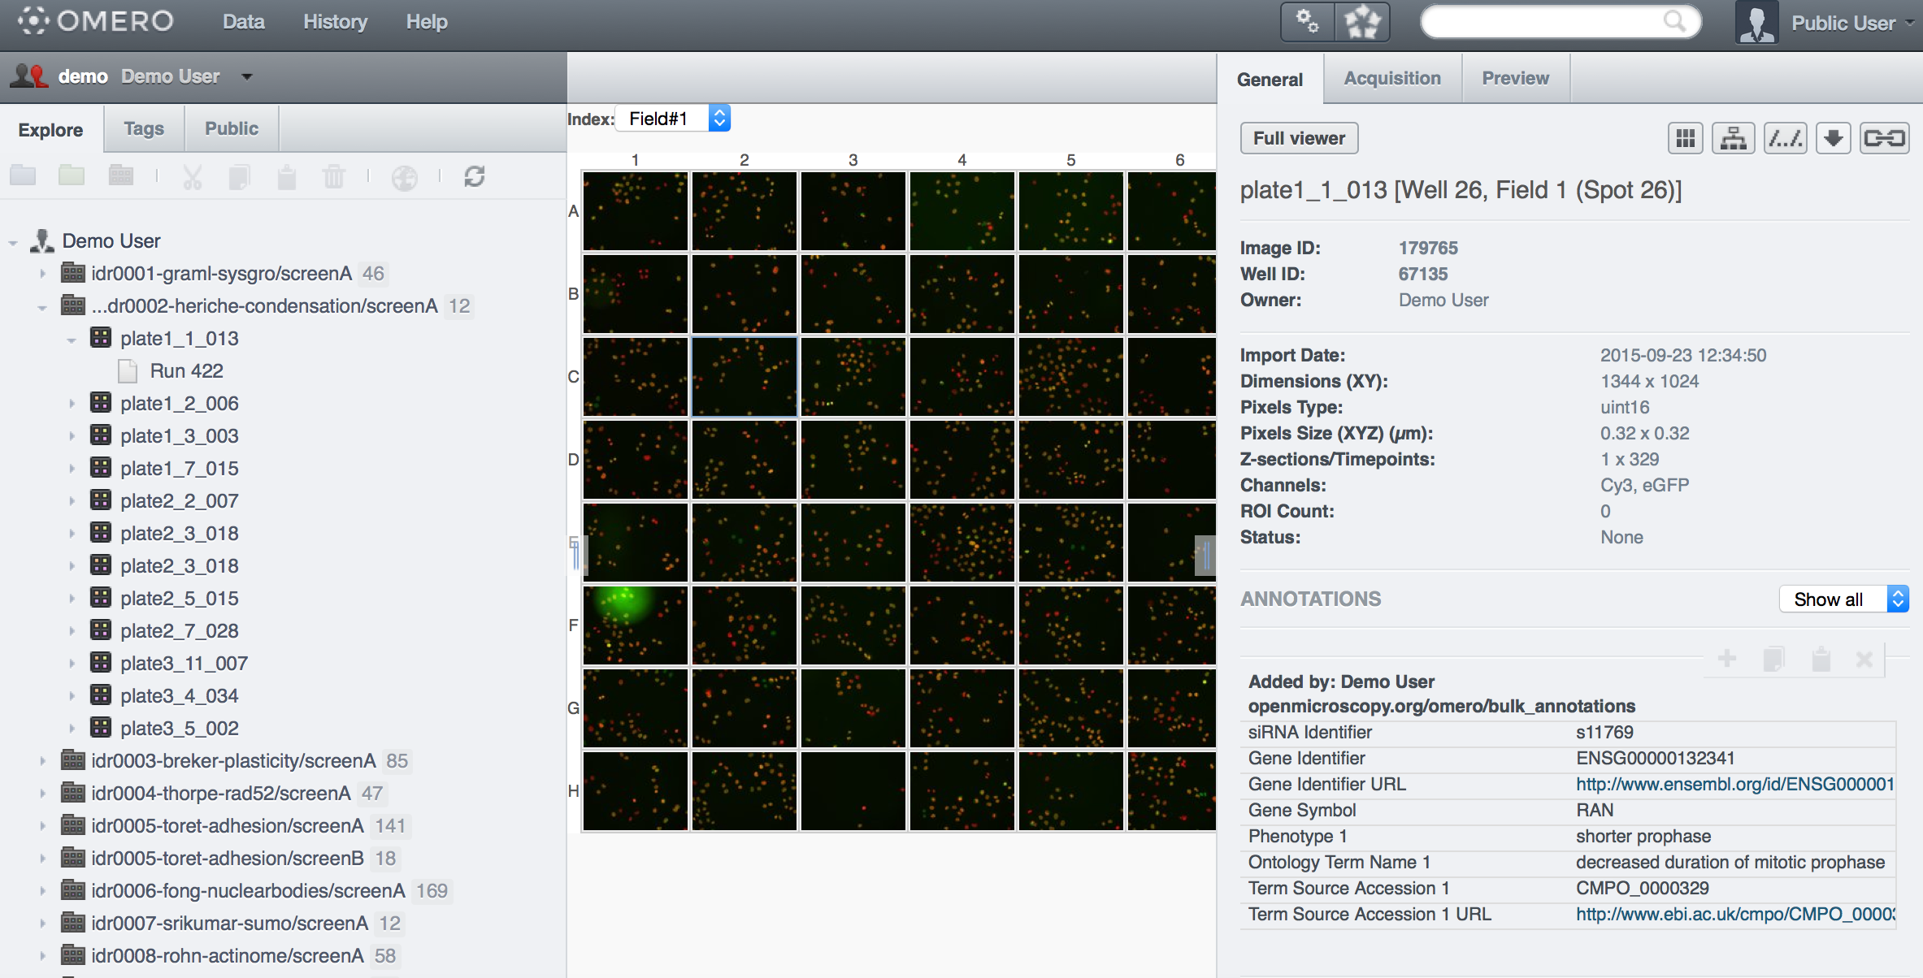
Future plans
Build query interface to utilize ontologies
graped micronucleus
CMPO_0000156
Notes:
- screens listed
- select and plate and see images
- can zoom in on an image
- metadata here – what gene was knocked down, what phenotype
- can search here for genes, phenotypes and ontology terms

Slide 19
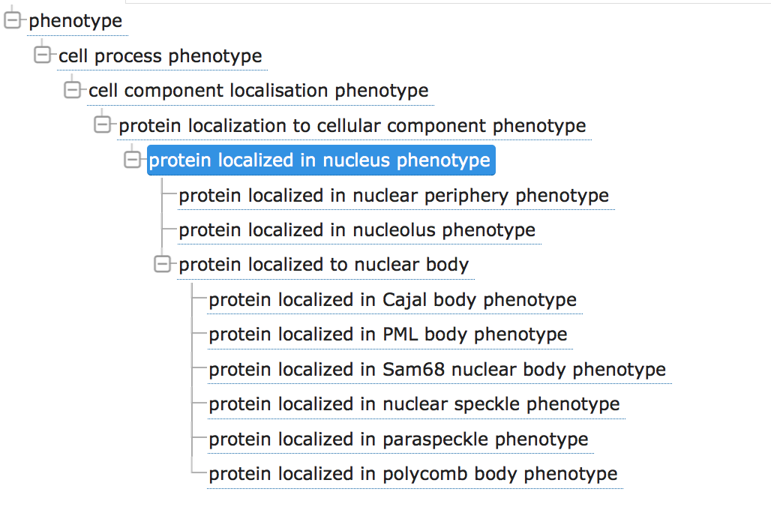
Term suggestion and query expansion
Notes:
Use ontologies in the interface and will be using the new OLS 3.0 which is to be soon released by EBI for this. We will also be using the BioJS widgets for searching and showing the ontology tree.

Slide 20
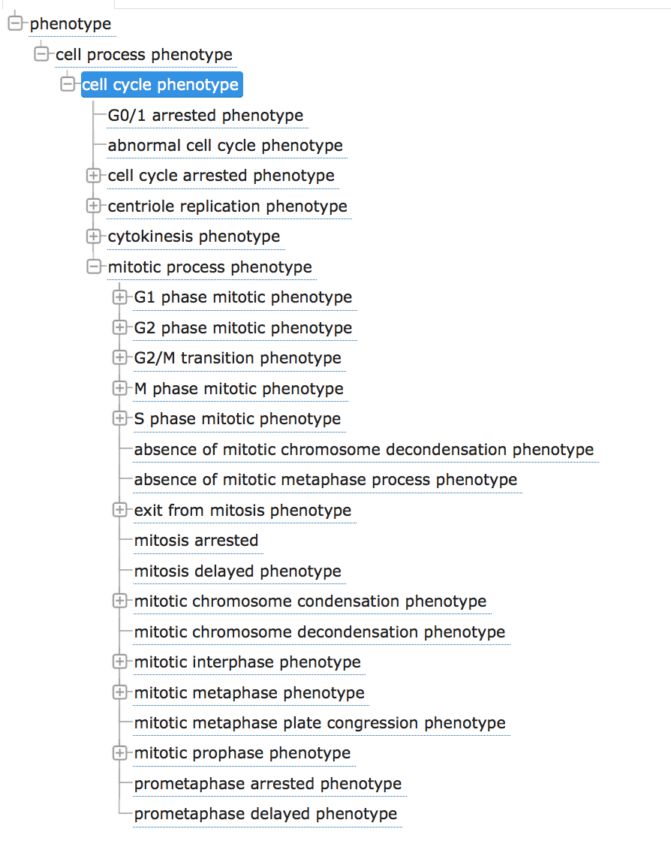
Use ontology hierarchy
I’m interested in the cell cycle
cell cycle
phenotype
Show all the genes that affect cell cycle
I’m interested in this set of genes
Show the associated phenotypes and group them by phenotype category
Notes:
The ontology branch structure can help to group phenotypes into meaningful categories.

Slide 21

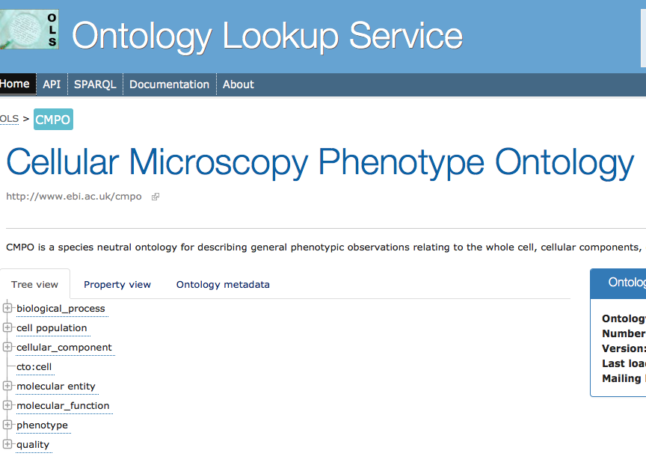
Future plans
Build query interface to utilize ontologies
Data submitters to do more of the work
Template spreadsheets
graped micronucleus
CMPO_0000156
Notes:
When we scale up the amount of data we will make use of tools such as zooma which can suggest appropriate ontology terms based on previous mappings

Slide 22
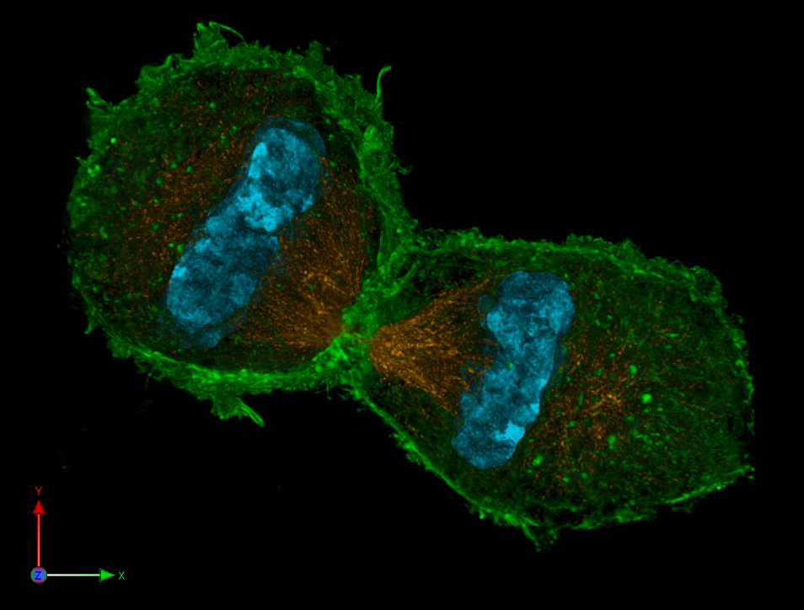
Future plans
Build query interface to utilize ontologies
Data submitters to do more of the work
Expand to include studies other than HCS
light sheet microscopy
super-resolution microscopy
Philipp Keller, Stelzer Group, EMBL
"3D-SIM-4 Anaphase 3 color" by Lothar Schermelleh
Notes:
Light sheet microscopy - less damaging, embryos developing, Open Microscopy Environment deveopment team is currently working on improving the tools for annotating regions of interest which will be useful for these images.
Super-Resolution Microscopy - visualize organelles and molecules
"3D-SIM-4 Anaphase 3 color" by Lothar Schermelleh - Lothar Schermelleh. Licensed under CC BY-SA 3.0 via Commons - https://commons.wikimedia.org/wiki/File:3D-SIM-4_Anaphase_3_color.jpg#/media/File:3D-SIM-4_Anaphase_3_color.jpg

Slide 23

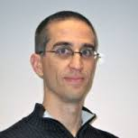
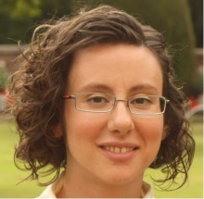
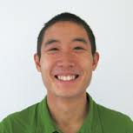
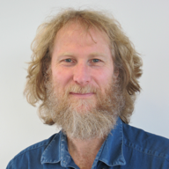
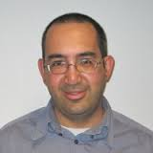

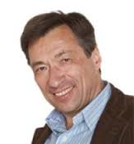
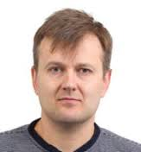
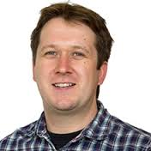
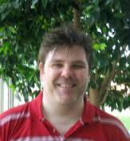


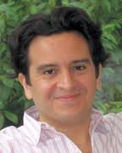
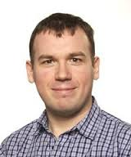
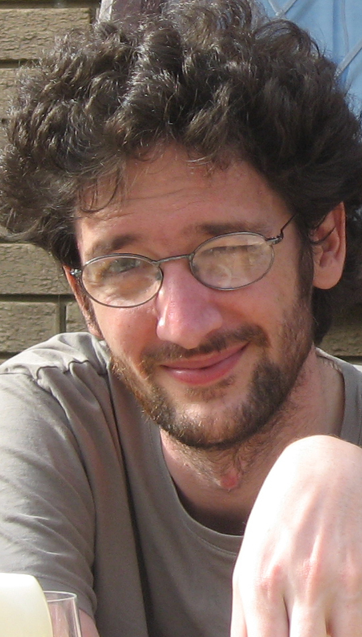



IDR team
Jason Swedlow
Josh Moore
Gabriella Rustici
Gus Ferguson
Simone Leo
Simon Li
Alvis Brazma
Ugis Sarkans
Simon Jupp
Tony Burdett
Rafael Carazo-Salas
Balint Antal
Anatole Chessel

Slide 24
How to access IDR
https://idr-demo.openmicroscopy.org/
https://idr-demo.openmicroscopy.org/mito/
https://idr-demo.openmicroscopy.org/tara/

