Slide 1
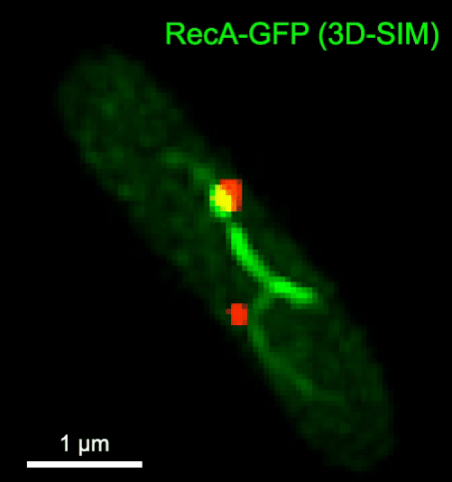
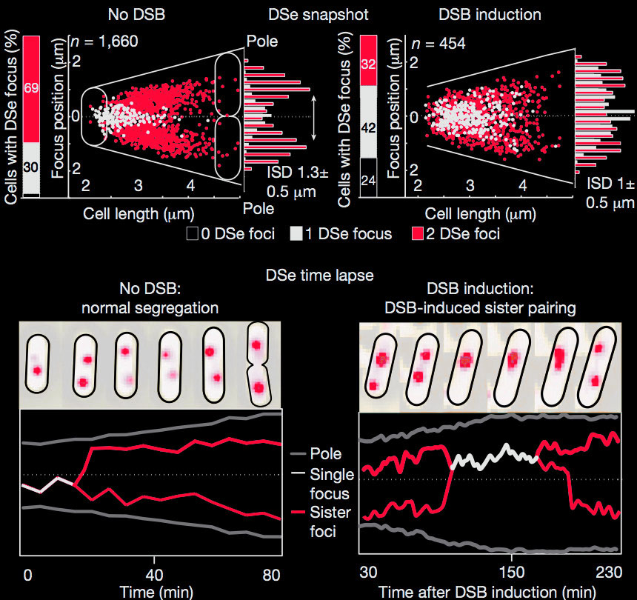
Graeme Ball Dundee Microscopy Image Analyst
Lesterlin C, Ball G, Schermelleh L, Sherratt DJ. RecA bundles mediate homology pairing between distant sisters during DNA break repair. Nature (2013) doi: 10.1038/nature12868.

Slide 3
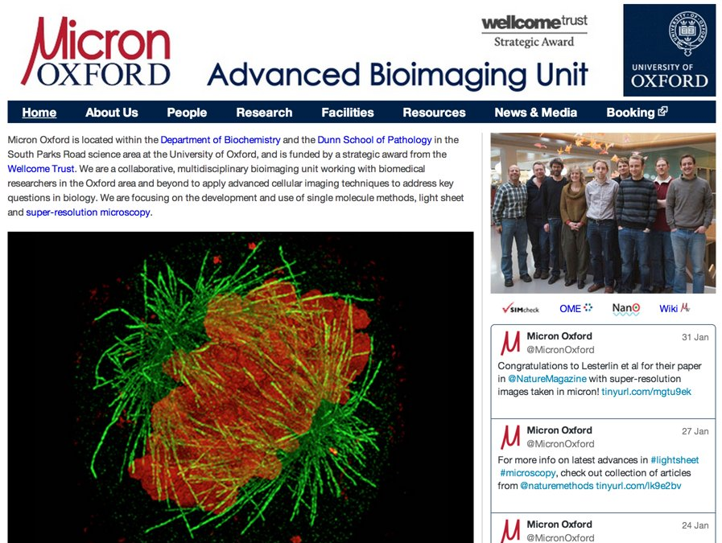

Slide 4
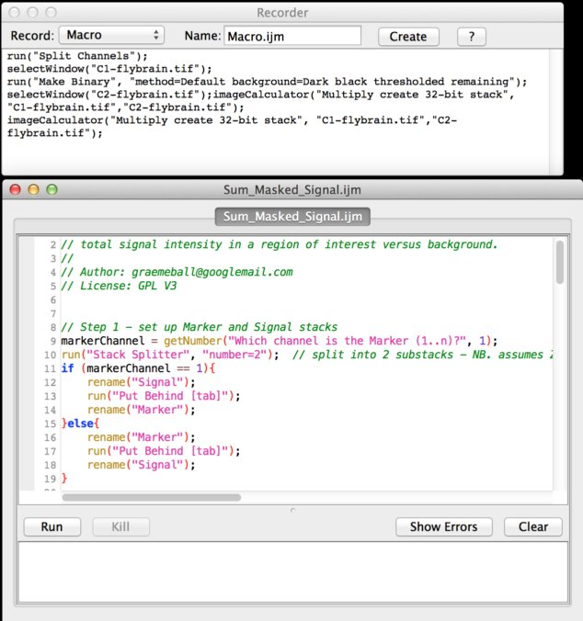
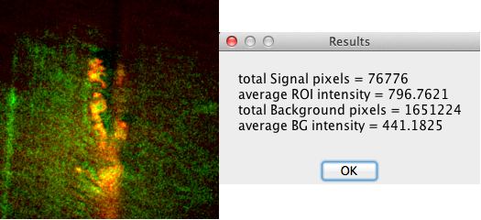
ImageJ: e.g. 3D Quantification
ImageJ and ImageJ scripts are very versatile
Typical example of ImageJ macros I write: quantify intensity in a 3D region defined by a marker channel

Slide 5
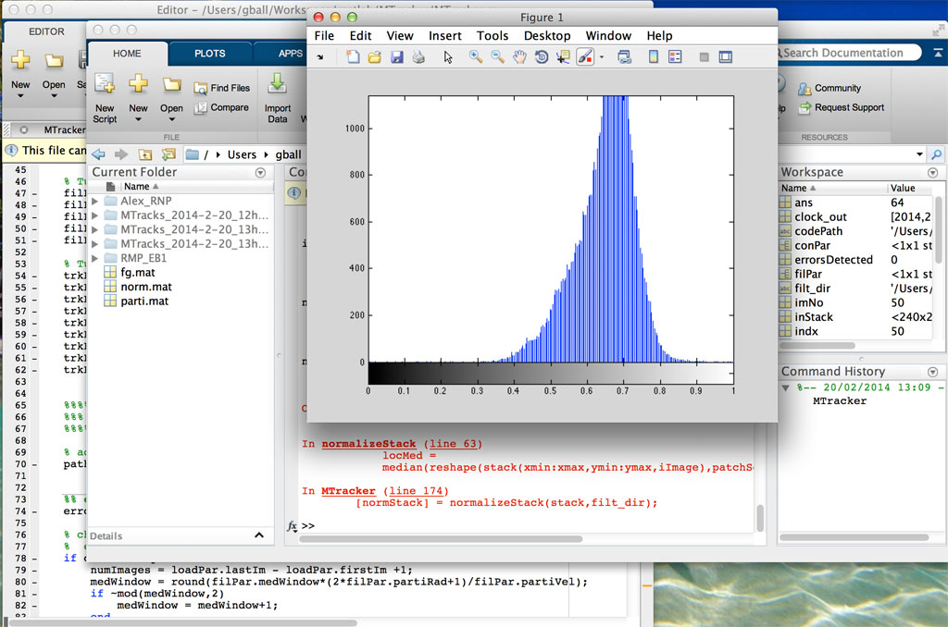
Studying Cell Polarity: MATLAB Tracker
1. MATLAB tracking tool for growing MT +ends (EB1)
(MATLAB for interactive data analysis, prototyping)

Slide 6
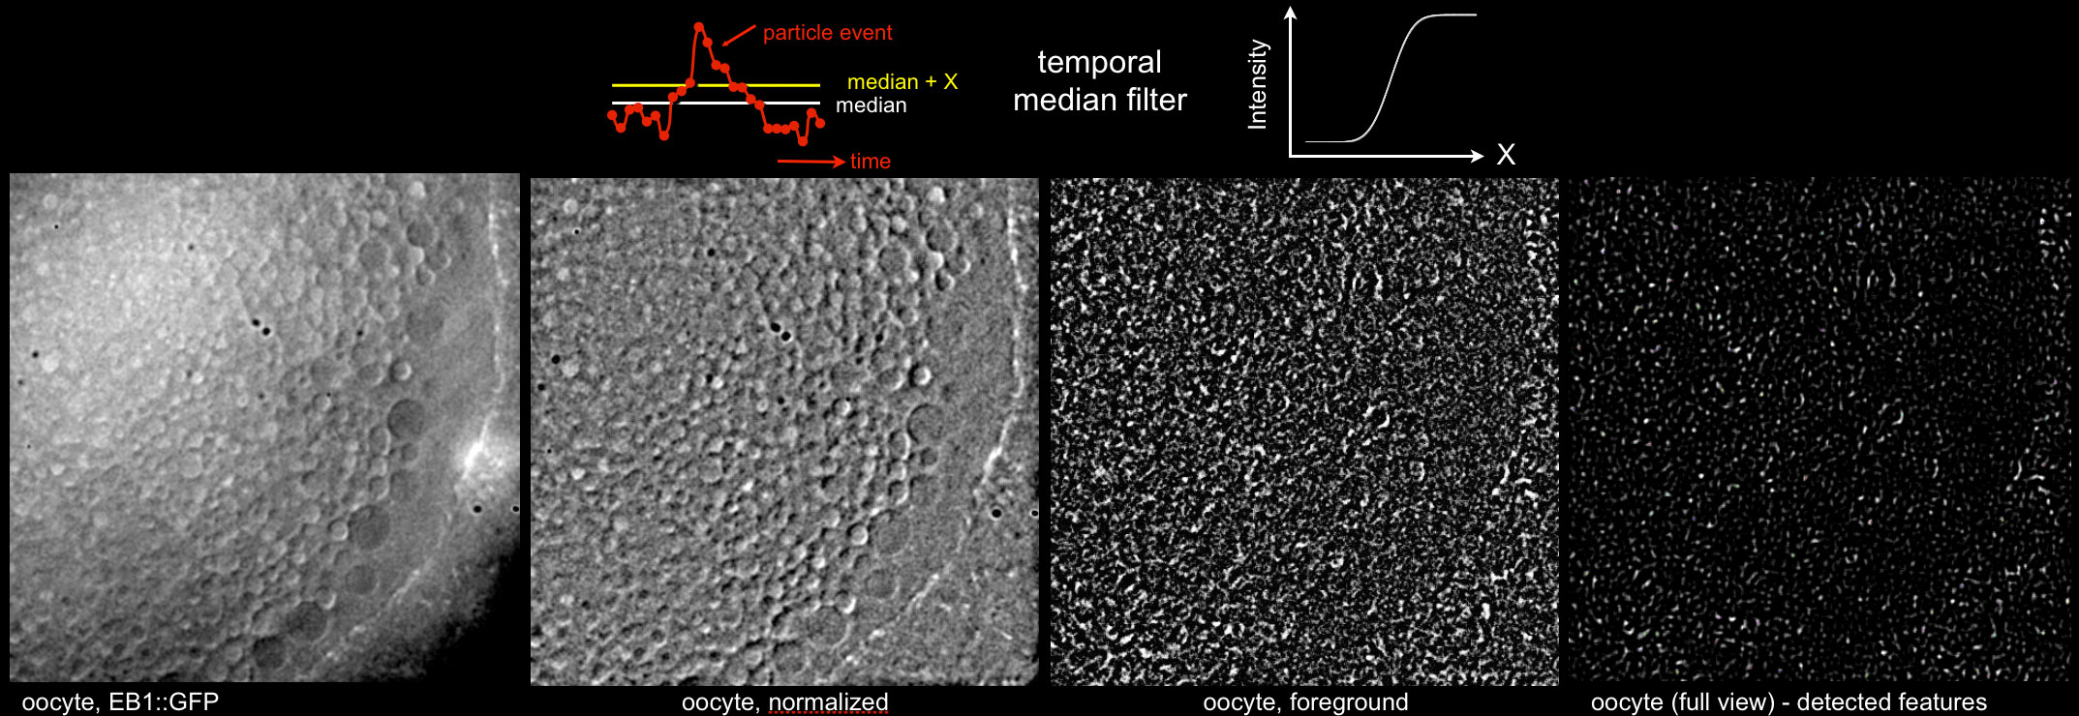
Studying Cell Polarity: MATLAB Tracker
1. MATLAB tracking tool for growing MT +ends (EB1)

Slide 7
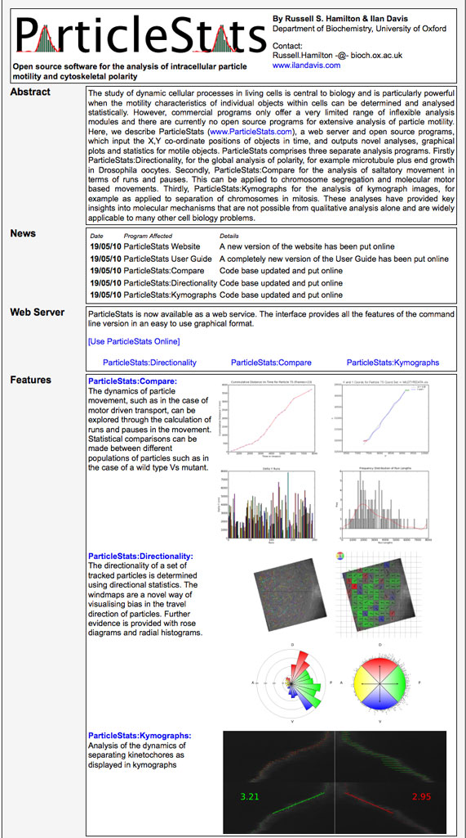
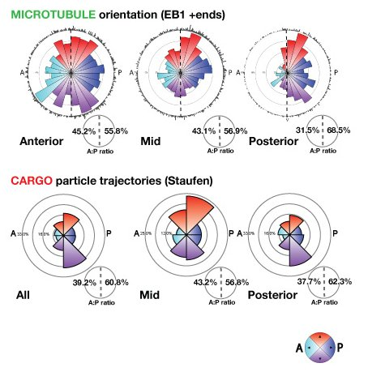
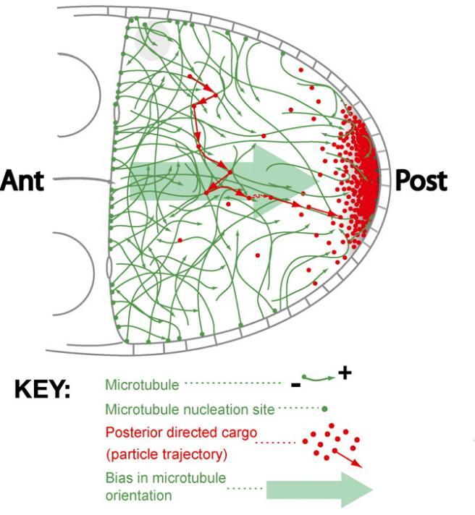
Studying Cell Polarity: directionality stats
2. “ParticleStats” extended to summarise directionality
Parton RM, Hamilton RS, Ball G, Yang L, Cullen CF, Lu W, Ohkura H, Davis I. A PAR-1-ependent orientation gradient of dynamic microtubules directs posterior cargo transport in the Drosophila oocyte. JCB 2011; 194(1):121-135.

Slide 8
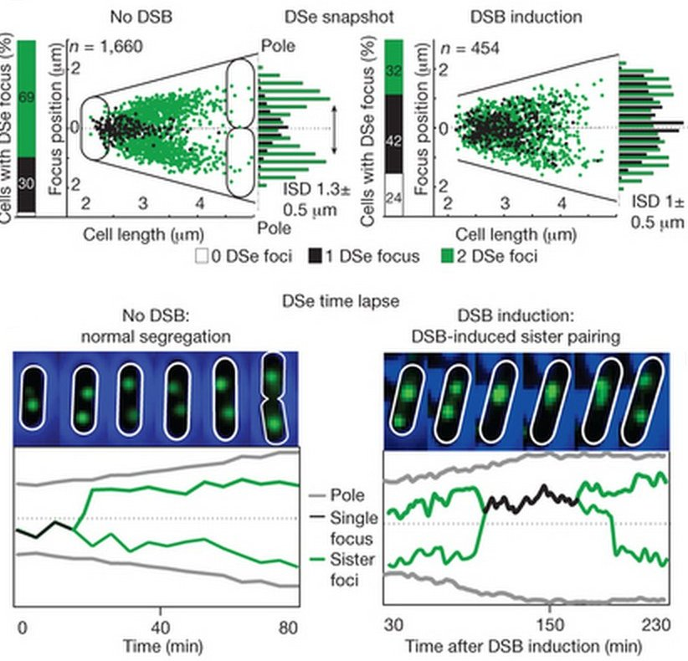
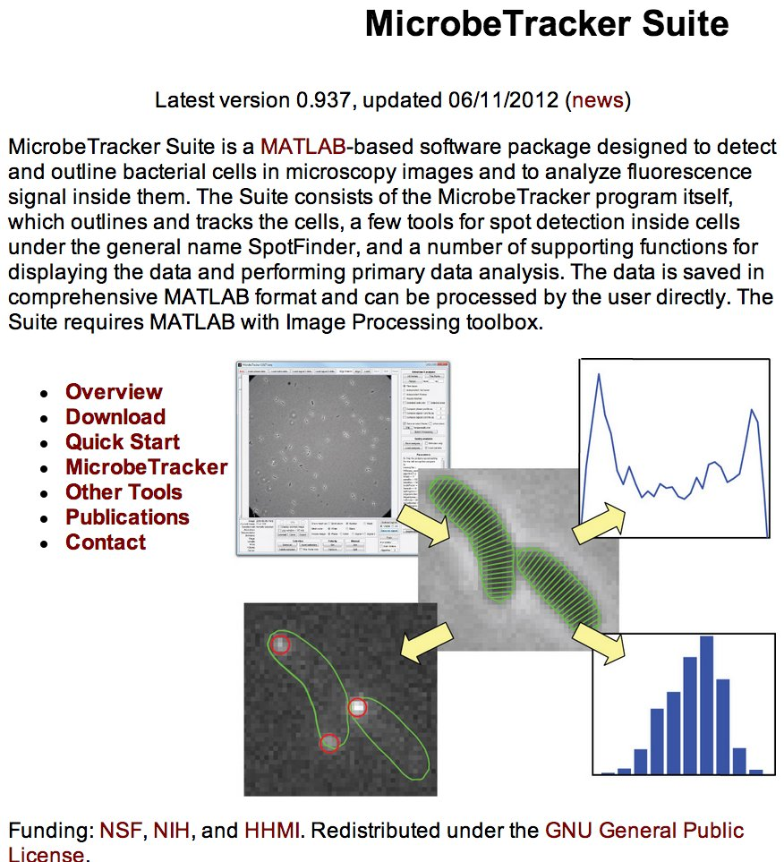
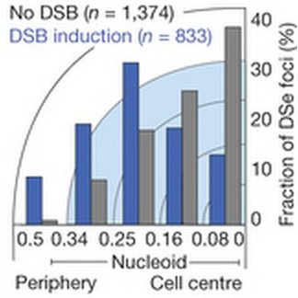
MicrobeTracker Extensions to Study DNA DSB Repair
Lesterlin C, Ball G, Schermelleh L, Sherratt DJ. RecA bundles mediate homology pairing between distant sisters during DNA break repair. Nature (2013) doi: 10.1038/nature12868.

Slide 9
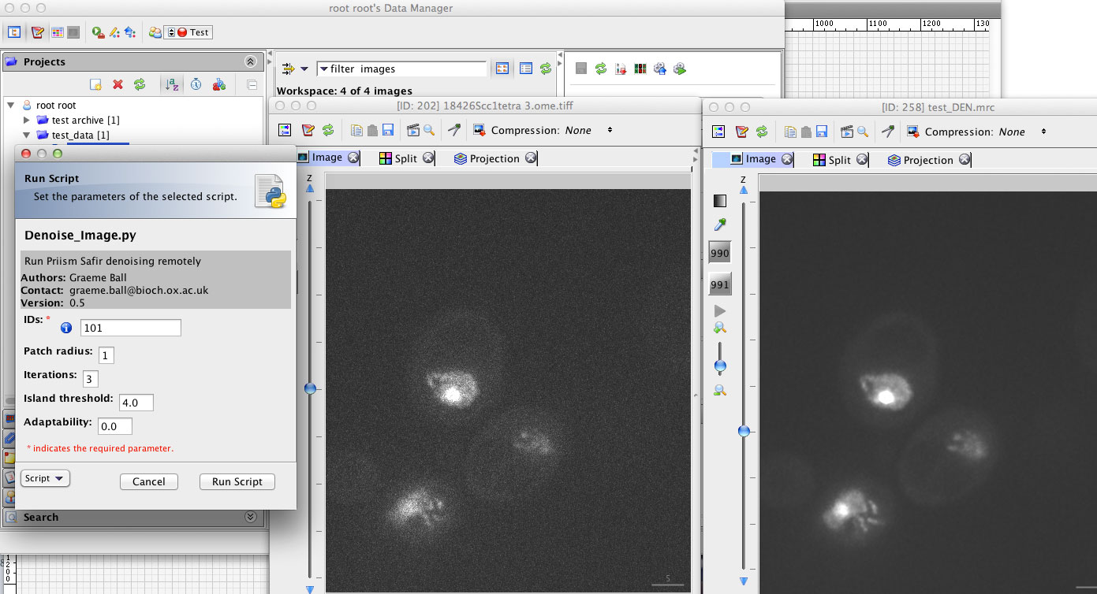
OMERO Scripts for Batch Processing

Slide 10
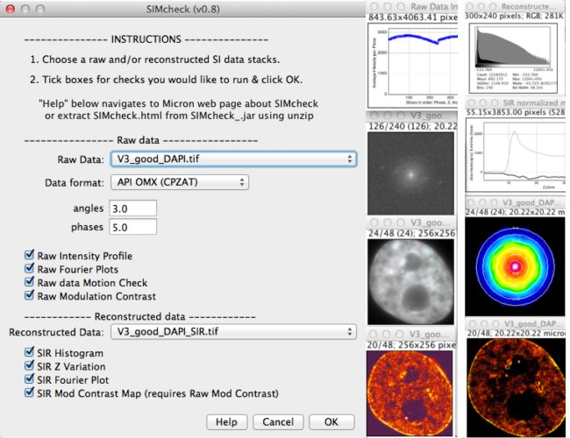
SIMcheck ImageJ Plugin Suite for SIM Data

Slide 11
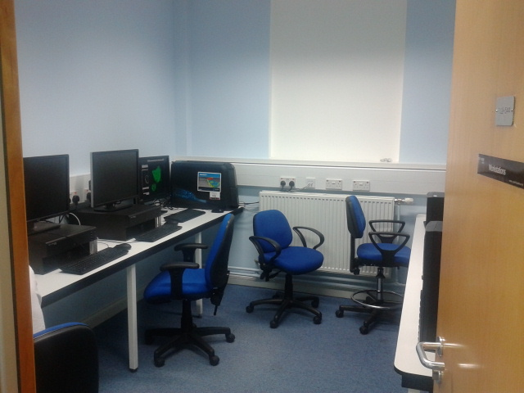
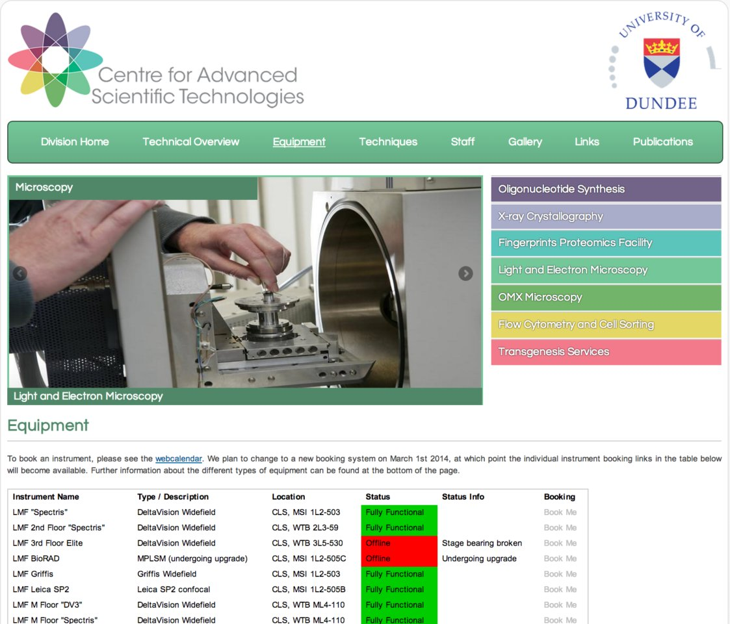
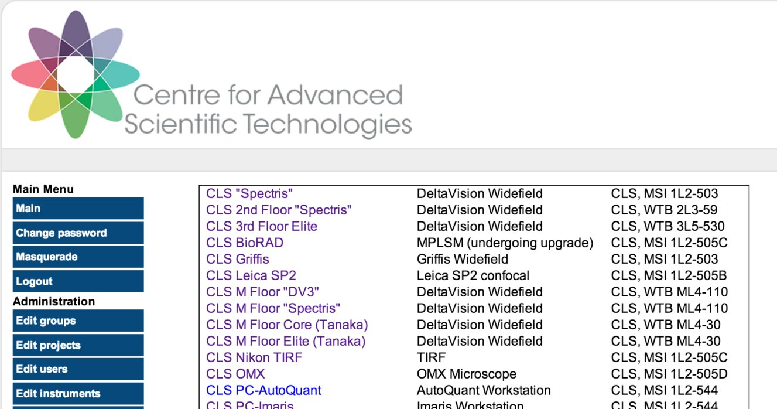
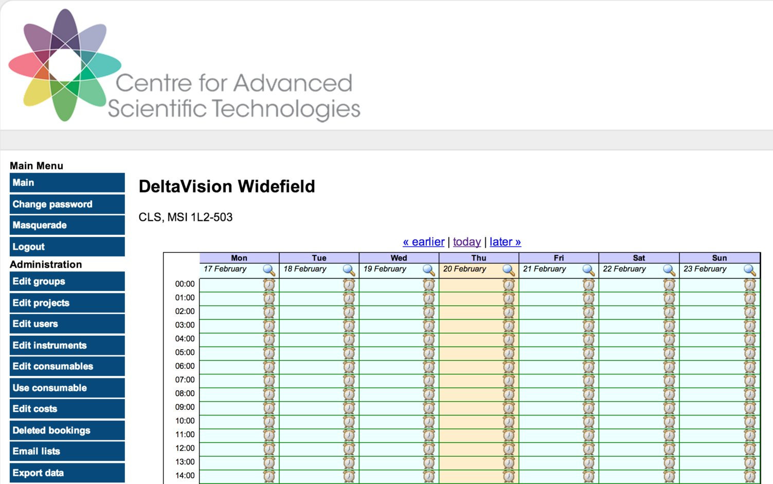
Have Set up Analysis Suite & Web / Booking
ImageJ Volocity softWoRx Imaris
CellProfiler MATLAB

Slide 12
Plan for Image Analysis Support
software & computing
advice
training & teaching
collaborations

Slide 13
Working with python API: Feedback
Documentation is better than it used to be
A lot of complexity (Ice, model), not well-hidden
Blitz gateway awkward / verbose to use (& lazy)
Eventually found useful bits & pieces outside Blitz:-
lib/python/omeroweb/webclient/controller/container.py
lib/python/omeroweb/webclient/webclient_gateway.py
lib/python/omero/util/script_utils.py
(often after writing the same things myself…)
No python client, just the whole server.

Slide 14
OMERO seems useful to me as…
Image repository: secure, viewable, searchable
Collaborative work tool: sharing data, comments, tags
Batch processor: non-interactive jobs, simple interface

Slide 15
Wish list / questions
Image repository: secure, viewable, searchable
Collaborative work tool: sharing data, comments, tags
Batch processor: non-interactive jobs, simple interface
1. Tidy the interface: find features in seconds, less clicks.
1. Share like Dropbox: *user* can search and add contacts
1. Run processing jobs on a node other than the server (√?)
2. Fix search: like google, search all (incl. filename, metadata).
2. Collaborative tagging (sets), comments (√), messages/inbox.
2. Improve python API / docs: simpler, higher level.
7. Export projects / desktop sync / revision history (!)
3. More content: protocols, references, figures.
3. Queue management functionality, job status.
For now, we will try to
achieve this by setting
up research groups and
a Public group

Slide 16
Finally,
Let the web app & insight diverge:
- web for collaborative, admin, job management
- insight for Desktop integration (e.g. IJ), sync?
Fiji update site?
Questions?

