Slide 1
Testing – Workshop for OMERO Team 2017
Petr Walczysko
University of Dundee
The OME Consortium
Notes:
Hello, I am Balaji Ramalingam. Am part of the Open Microscopy Environment Team.
The OME project is an International Open Source software consortium. It is run out of Prof.Jason Swedlow’s Lab in the School of Life Sciences at the University of Dundee.
And I will be talking about : The Biological Image Data Analysis with OMERO

Slide 2
Outline
Types of testing - overview of testing categories and misconceptions
How to test now
Dream system vs What we have now
  Big
  Fast
  Lasts “forever”
  Data
  Import (automatic & non-automatic, with metrics) (5 minutes)
  Access (to logs, via clients, to DB via psql, Managed Repo, configs)
  LDAP
  Apps
  Server-performance testing & tools
  Versioning (apps, server and dependencies)
  Continuous integration *
  Integration tests, robot tests*
  How others do it - Google CI workflow
Notes:
During the course of this talk, I would like to start by introducing the concept of “Life cycle of Data in Life Sciences”, and then introduce OMERO (as a software application) and highlight its role in the data life cycle. And then I will concentrate on one aspect of OMERO alone, which would be : Biological Image data analysis with OMERO.
----- Meeting Notes (17/09/2015 11:19) -----
Analysis with omero instead of extending omero.!

Slide 3
Types/methods of testing
Manual vs automation
  Recommended to run the manual testing first
  The automation should be approached only in certain cases, depending on costs
Black box vs White box
  https://www.tutorialspoint.com/software_testing/software_testing_methods.html
  Depending on the knowledge of the tester
  We are usually in the grey zone

Slide 4
Misconceptions
Testing is Too Expensive
Testing is Time-Consuming
Only Fully Developed Products are Tested
Complete Testing is Possible
A Tested Software is Bug-Free
Missed Defects are due to Testers
Testers are Responsible for Quality of Product
Test Automation should be used wherever possible to Reduce Time (manual first, must be stable, changing requirements make impossible)
Anyone can Test a Software Application
A Tester's only Task is to Find Bugs

Slide 5
How to test now – PR review
Check that the PR was included in the build, using https://github.com/snoopycrimecop/openmicroscopy
Use provided CI servers (e.g. eel) preferably over localhost (short tutorial about how to use eel)
Use real data over fake files
If forced to start from fresh DB, do not use root/system group for your manual test, create at least one group with one ”normal” user, or use https://github.com/openmicroscopy/management_tools/blob/master/ci/config/create_users script to have a decent complexity in your DB (download it and use “bin/omero load create_users” command)
Insist on developer putting some testing steps into the header of the PR, but try to think about other areas which the PR might influence and consult/test them
Write ”everything” down, mainly in cases where a second re-test on the same PR is probable (your setup and commands/clicks used during the test as well !)
try to be widespread in your testing
read the comments history on the PR
If clearly overburdened by the complexity, ask for the testing to be relisted and for other colleague to test the PR
If overburdened by the workload, do make a remark at the end of the day on the PR, indicating that you will do the testing tomorrow or that you are unable to manage the load (do not simply do nothing !)
Always check automatic tests failures – was this PR a culprit ?
Learn how to establish LDAP (using docker and scripts) which you can manipulate if necessary, see further slides

Slide 6
eel workflow
ssh your-lifesci-ldap-name@eel.openmicroscopy.org
cd /home/hudson/
ls
cd OMERO-DEV-merge-deploy/ # or other server as needed
eval $(bash /home/hudson/ice/ice-multi-config.sh ice35)
bin/omero login # should work now
bin/omero config get # to get the name of the DB and path to ManagedRepo
psql -U omero –l # to verify the DB list
psql -U omero OMERO-DEV-merge-deploy # or other DB as appropriate
SELECT….. etc. to use sql queries
#from another terminal, to copy logs to your local machine
scp -r your-lifesci-ldap-name@eel.openmicroscopy.org:/home/hudson/OMERO-DEV-merge-deploy/var/log .
#or, being inside eel, inspect the logs
cat var/log/Blitz-0.log | grep ERROR

Slide 7
How to test now – bigger testing
Study the testing sheet, especially “concentrate on” column
Double-check server address, and your supposed username and group you are supposed to work in
Write everything down, preferably into the new tab Tester’s report, giving as much detail and data links as possible
Store screenshots on squig
For load, stress and pressure testing, note also times when problems occurred

Slide 8
Prep of larger testing (using g.sheet)
Select the sheet nearest to your topic and setup from
A. G-drive > OME Docs > Testing or
B. G-drive > OME Docs > Testing > sprints
Example: https://docs.google.com/spreadsheets/d/1lrRaJ60utV_lHqXa_zxQhkz3RKNnbW6sw8B68xTYltA/edit#gid=1254367109
Being inside the g.doc folder containing the sheet, copy it by right-click > Copy
Open the copied sheet and save it under a new name which describes your testing topic
Exchange the links to the scenarios in “scenario name” column
Note https://docs.openmicroscopy.org/internal/testing_scenarios/index.html
Reformulate the “concentrate on” column (specifying whether or not the whole scenario is to be tested, or part, or some additional steps not included in scenario)
Specify the clients to use, OS and browser types
Specify the users and groups to be used during testing for each tester
Pick the names of the testers, checking their availability in the calendar
Try to speak to testers prior to testing, to make sure they are ready and capable of performing the testing with the prescribed setup

Slide 9
What to do when scenario/workflow is outdated/imprecise
As appropriate either/or, or both:
  Open a PR on https://github.com/openmicroscopy/ome-internal
  Improve the hints on https://trello.com/b/gUTby8cp/omero-release-template in OM|ERO: Release review column

Slide 10
Dream testing system
(OME Docs > Testing > Dream testing system)

Slide 11
Big
current reasonable research scales— ~1-100TB.
emerging (flagship) projects: 1-2 orders of magnitude more
In-place import : how far will it get us ?
eel has 150 GB ?

Slide 12
Fast
Not specified in numbers, but the current speed of nightshade server is acceptable, the current speed of eel server is not
When testing system is constantly slow, then any feedback on the “sudden slowing down” due to cause x is not possible

Slide 13
Long-lasting setups
Necessary for
  Repetitions and retests on the same data
  Building up systems with specific data (possibly imports take long, and the data in question are not contained in any DB yet)
  Catching bugs which appear only via long usage
  Catching performance issues connected with accumulation of unnecessary files in the ecosystem
  Lack of long-lasting setups typically results in (mis)using production servers for debugging
  Atm we are using nightshade and demo for these purposes

Slide 14
Data-flexible
Switching (switching DBs & original data at will)
Reverting (quickly getting DB and original data into a state before experiment)
Merging (missing feature in OMERO, merging 2 DBs)
Snapshotting (capture the state of the DB quickly just after experiment)
Duration (see previous slide)
Searching (missing search for Metadata in OMERO, hard to search for metadata in a filesystem)
What we have now:
Atm we have the CI widget enabling to switch DBs and purge data, e.g. https://ci.openmicroscopy.org/job/OMERO-DEV-merge-deploy/build?delay=0sec ,See screenshot on next slide
DBs are stored (OME Docs > Testing > CI setups and DB structures)

Slide 15
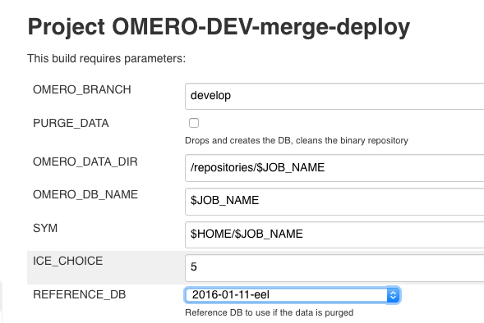

Slide 16
Import
Automatic
Non-automatic
Metrics on import
Atm we have the IDR import machinery (we learn more in Screen importing workshop)
Atm we have the script of Josh for minimal automatic import of selected files to OMERO
Atm we have Balaji’s script in Matlab ? (for metrics on import)

Slide 17
Access
Via clients
Logs
Managed Repo
Config
Atm we have some access on eel
Atm we have possible access to the dockers, but need to find out during training how

Slide 18
LDAP
LDAP is almost a default with our users. But atm we have no LDAP server in our hands.
Docker training should reinforce the workflow about how to establish our own LDAP server (but some basic workflow is going to be given here)
Permissions on beluga (running docker on beluga) unclear -> computational resources workshop
https://github.com/openmicroscopy/apacheds-docker#installation
1- start an ApacheDS Docker container on localhost (in future, minke/beluga/xxx -> need to clarify docker perms on those servers) with the correct port-forwarding
2- use the scripts to create your LDAP tree on this LDAP server https://docs.openmicroscopy.org/internal/instructions/ldap-dev-configuration.html
3- set up your OMERO to point at this LDAP

Slide 19
LDAP for OMERO via docker setup example
docker pull openmicroscopy/apacheds
docker run --name test_ldap -d -p 10389:10389 openmicroscopy/apacheds
cd /management_tools #cd to the cloned mngmt tools repo on your machine to be able to run scripts
export LDAPHOST=localhost
./search
./initialize
./user user-1 add # note: the users will have the usual pwd, just like on eel
./group group1 add
./user user-1 in group1
# check the results using jxplorer UI software

Slide 20
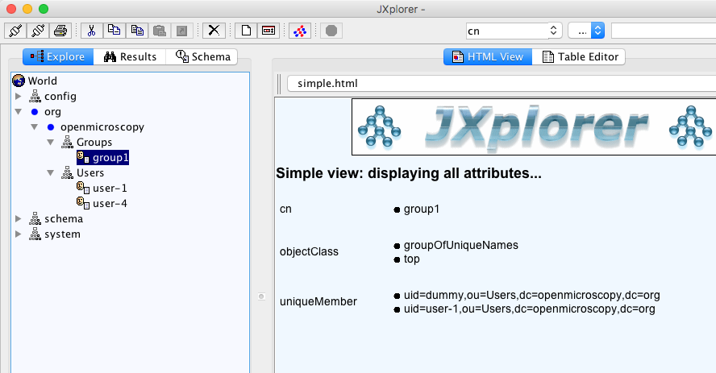
JXPlorer view of LDAP DB

Slide 21
Connect your LDAP to OMERO
https://github.com/openmicroscopy/management_tools/blob/master/ci/config/common/devldap.omero # configure your omero server to point to the LDAP – exchange “minke…” to localhost as appropriate and use bin/omero load <filename>
bin/omero load ~/ldap.omero # replace ”ldap.omero” with correct filename
bin/omero user list
bin/omero ldap create user-1
bin/omero user list
bin/omero group list # group should be synced as well because user-1 is a member of group1 in ldap

Slide 22
Apps
Installation
Versioning
Performance (of the app but also burden on server)
Atm we have https://github.com/openmicroscopy/management_tools/blob/master/ci/config/WEB-DEV-merge-deploy/requirements.txt

Slide 23
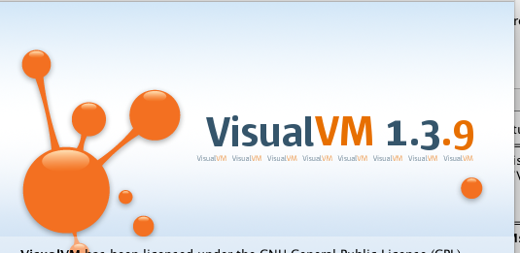
Server-performance testing
1. general performance numbers (speed and CPU utilisation numbers)
2. identification of classes and methods responsible for performance changes
Used tools ad 1:
  CLI + ”time” command run manually + bash scripts run locally
  Docker images spun up on a remote server + bash scripts run automatically https://gist.github.com/joshmoore/b4e69fa232e9d769dd77b6ad202232e3
  Check_MK monitoring tool for demo server (CPU utilisation)
Used tools ad 2:
  Eclipse plugin: JVM Explorer (splits things into Threads, no way around it)
  VisualVM (does summary, better tool, still, the output is complex, as differences are asked for)

Slide 24
Versioning
Apps
Server
Dependencies
Atm…
1. We need a widget or a more simple way to find out what versions of the whole stack we are working at any given time.
2. We need a way to deploy any set of versions we like (keeping in mind the “microservices” approach will make this even more complex than now).

Slide 25
Continuous integration
Server – merge
Server – latest
Web
Apps – merge, latest ?

Slide 26
Automatic tests
Integration tests (why so flaky ? See google example next slide)
Robot tests (flaky and low coverage)
What else could we use ? The following tools can be used for automation testing:
HP Quick Test Professional
Selenium
IBM Rational Functional Tester
SilkTest
TestComplete
Testing Anywhere
WinRunner
LaodRunner
Visual Studio Test Professional
WATIR

Slide 27
Google CI
https://testing.googleblog.com/2011/06/testing-at-speed-and-scale-of-google.html
Do not run all the tests every time
Have a schema defined -> graph which enables tracing which tests are influenced by a particular change
Run only the influenced tests. Run the tests immediately after a PR is opened (or otherwise the change in code occurs)
Helps to spare time – no need to “get the build green” with no clear sign from where the problem comes

Slide 28
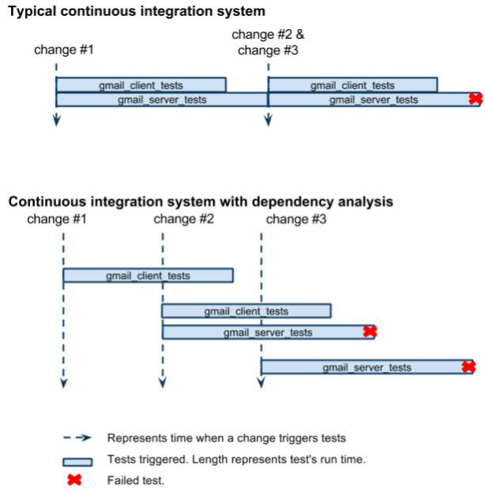
Compare typical and Google’s CI
From https://testing.googleblog.com/2011/06/testing-at-speed-and-scale-of-google.html

Slide 29





Thank to Funders
Notes:
And as always a big thank you to our funders.

Slide 30
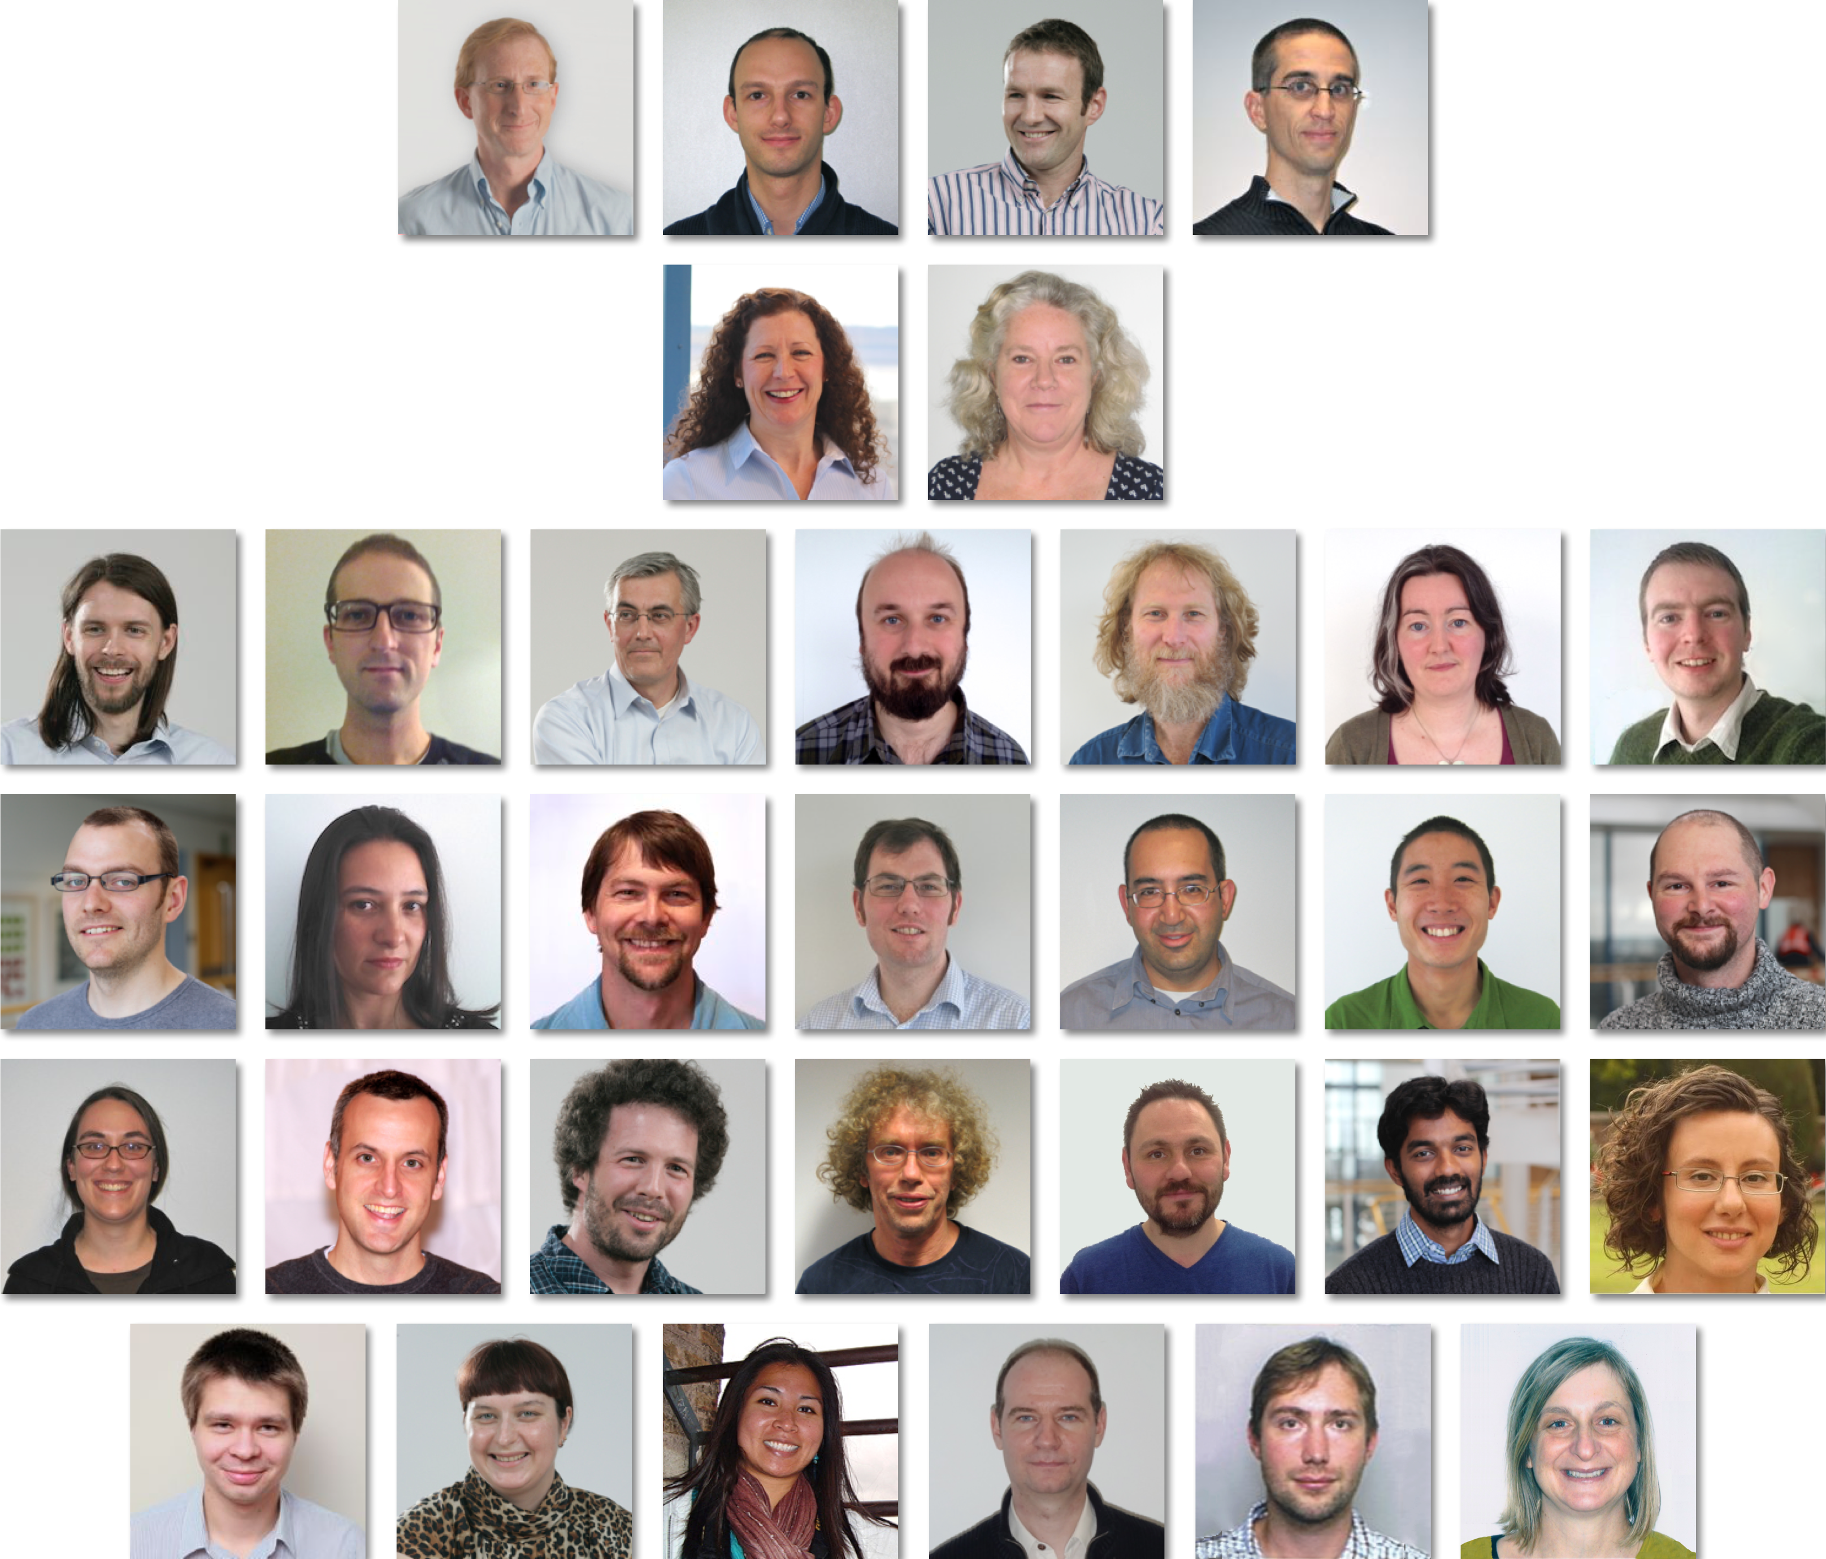
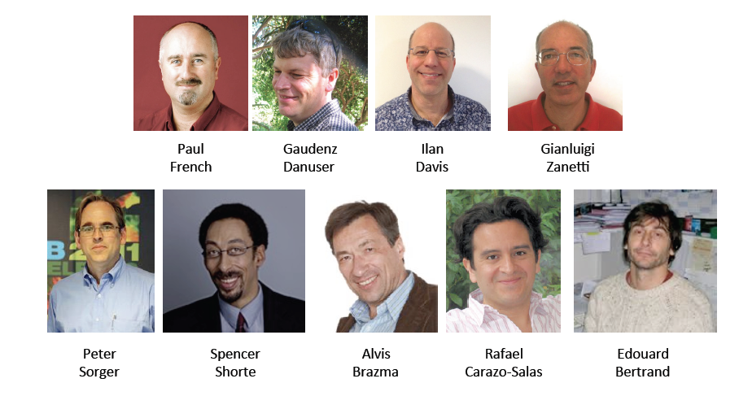
OME Consortium
Notes:
And The consortium members as well. I have just touched upon the tip of the iceberg. There is of course more granularity to this story, but in the interest of time I’ll leave you guys with that and am open for questions.
Thank you.

