Slide 1
IDR submission workflow
Eleanor Williams
8th November 2017

Slide 2
Over view of the work flow
Initial Contact – is it a reference data set?
yes
Obtain raw images
Get metadata
no
Load images into idr-testing
Tell them to submit to BioStudies
Add annotations to images in idr-testing
Switch idr-next to be production idr.openmicroscopy.org and publicise
Get DOI
Repeat in idr-next

Slide 3
idr-testing, idr-next and idr production
idr-testing
Test import images and annotations
Try out rendering settings
Test other IDR changes e.g. Omero version, changes to Jupyter
idr-next
Import images and annotations ready for next release
idr
This is the live, public IDR
Only small changes occur here e.g. update PubMed ID or add data DOI
If testing ok and data ready for release
Idr-next becomes idr at next release

Slide 4
What is a reference dataset?
have value beyond simply supporting an original publication
Guidance from EuroBioimaging. See http://www.eurobioimaging.eu/sites/default/files/Euro-BioImaging_Elixir_Image_Data_Strategy_0.pdf
Criteria we use (see our submission help page) are:
Datasets associated with an existing or upcoming publication
Complete datasets - not just images supporting one figure in the publication
Datasets whose metadata can be integrated with other datasets via identifiers from well-known biomolecular resources (Ensembl, NCBI Entrez Gene, RefSeq, PubChem, ChEBI etc)
Datasets generated using new imaging methods or new analysis methods
Datasets that are likely to be re-analysed or incorporated into other studies or integrated with other imaging datasets

Slide 5
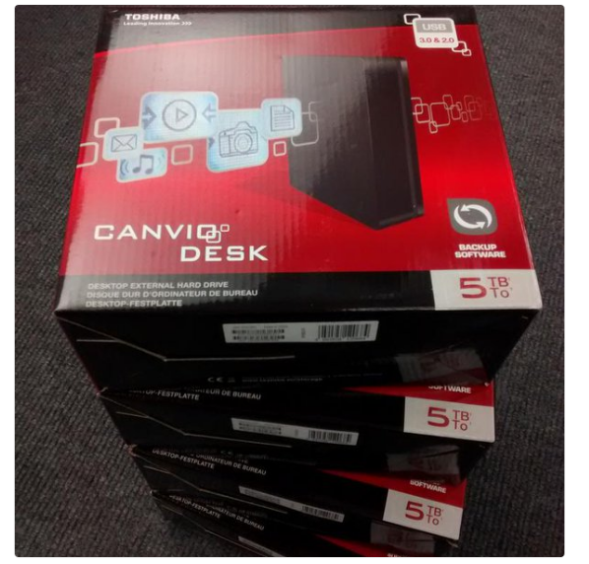
Obtain raw image data and experimental metadata
Raw images – send them a hard drive by post if over 500 Gb. If less than 500 Gb then we are going to set up an FTP transfer.
Image credit: Simon Li
Experimental metadata – ask them to fill out metadata templates – link on https://idr.openmicroscopy.org/about/submission.html

Slide 6
Experimental metadata files
High Content Screen | Non-screen study
Study file - mandatory | Study file - mandatory
Library file - mandatory | Assay file - mandatory
Processed data file - optional | Processed data file - optional
Feature data, tracking data - optional | Feature data, tracking data - optional
Lots of examples in https://github.com/IDR/idr-metadata

Slide 7
Study file
Title, description
Contact info
Publication info
License
Library info for HCS
Experimental Conditions
Protocols
Phenotypes + CMPO mappings
Links to library/assay and processed files
Library info for HCS
Experimental Conditions
Protocols
Phenotypes + CMPO mappings
Links to library/assay and processed files
Appears only once for each study
Repeated block for each screen or experiment
e.g. screenA, experimentA
Repeated block for each screen or experiment
e.g. screenB, experimentB
Notes:
Show idr0005 in idr and github

Slide 8
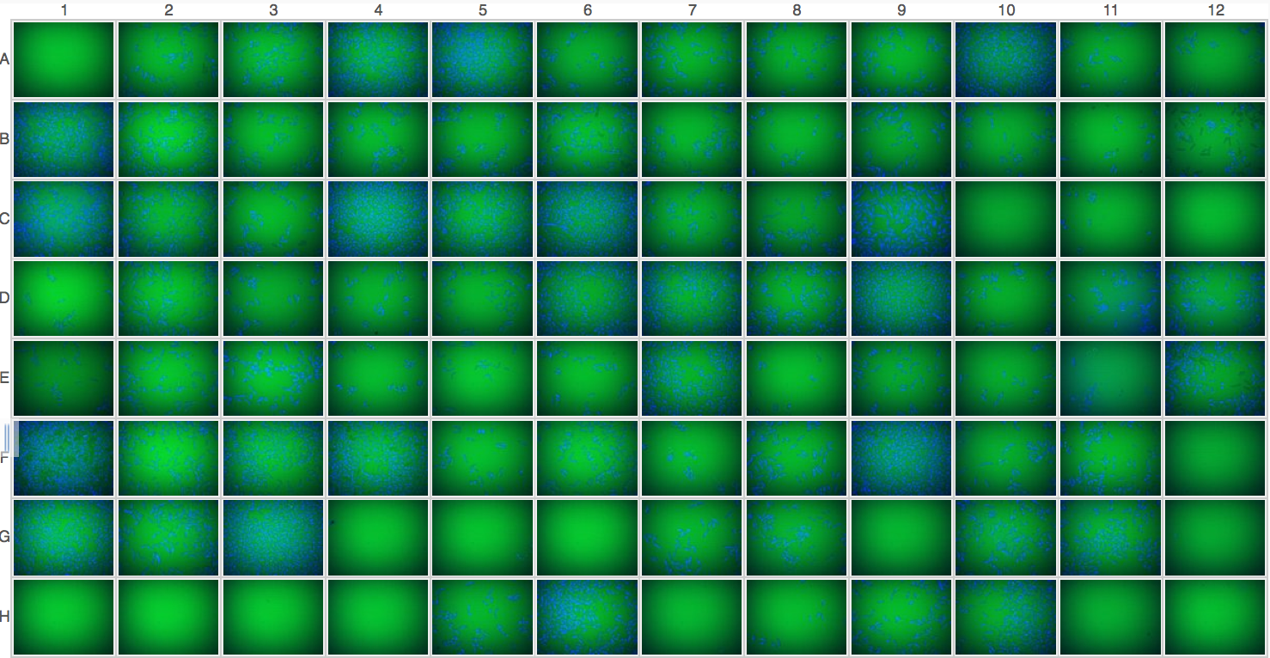
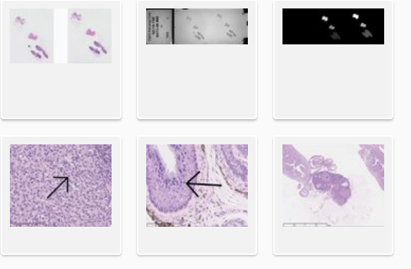
Library and Assay files
Library file
Assays file
One row for each plate + well
Describe the sample in the well e.g. species, cell line
Describe treatment to the sample e.g. siRNA use, compound treatment, different media used to grow the cells
Which are control wells – positive control – expect an effect, negative control – don’t expect an effect
Quality control – any wells rejected by authors e.g. out of focus, too few cells
Channels – label and what is labeled e.g. DAPI:nucleus
One row for image file
Describe the sample in the image e.g. species, cell line
Describe treatment to the sample e.g. siRNA use, compound treatment, different media used to grow the cells
List the protocols applied
Group into Datasets
Specify if raw or processed image
Channels – label and what is labeled e.g. DAPI:nucleus
Links to processed files

Slide 9
Example library file – idr0013-screenA
Plate and Well
Sample information
Treatment to sample
Experimental/ analysis controls
Channel information

Slide 10
Example assay file – idr0032-experimentA
Protocols describing treatment of sample and imaging
Name of the image
Treatment to sample
Name of the assay
Name of the dataset
Analysis info
Sample information
Channel info

Slide 11
Assays file – grouping into datasets
Sample | Experimental conditions | Assay | Dataset | Image File
sample1 | Localization of protein X | assay1 | proteinXlocalization | 1.tiff
sample1 | Localization of protein X | assay1 | proteinXlocalization | 2.tiff
sample2 | Localization of protein Y | assay2 | proteinYlocalization | 1.tiff
sample2 | Localization of protein Y | assay2 | proteinYlocalization | 2.tiff
idr0032
Sample | Experimental Conditions | Assay | Dataset | Image File
sample1 | Embryonic kidney + localization of protein X | assay1 | proteinXlocalization | 1.czi
sample2 | Kidney organoid + localization of protein X | assay2 | proteinXlocalization | 2.czi
sample3 | Embryonic kidney + localization of protein Y | assay3 | proteinYlocalization | 3.czi
sample4 | Kidney organoid + localization of protein Y | assay4 | proteinYlocalization | 4.czi
idr0038
Notes:
First case, example is idr0032
Second case, example is idr0038

Slide 12
Processed data files
Summary results and phenotypes
Must be able to link to library file or assay file in some way – link specified in the study file
Link to library file
Study file

Slide 13
Other files that might be submitted
Feature level data files + ROI/masks
Tracking files
Listed in study file but only attached to screen/assay if simple to do currently
idr0028-screenA

Slide 14
Files needed to load data into IDR
Images
Raw images – on EBI file system but also copied to Dundee file system
Plates.tsv or FilePaths.tsv
Bulk.yml
Annotation.csv
Bulkmap-config.yml
Annotations

Slide 15
Plates.tsv/FilePath.tsv
 | Column1 | Column2
screens | Plate name | Path to directory with images or .screen files
non-screens | Dataset name | Path to image file
idr0002-screenA-plates.tsv
idr0033-screenA-plates.tsv
idr0032-experimentA-filePaths.tsv

Slide 16
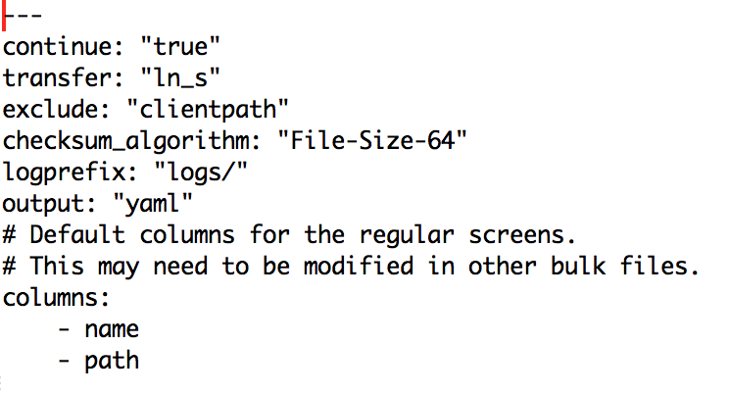
Screen or assay bulk.yml
A yaml format file that allows bulk import of all the images on the command line
idr0002-screenA-bulk.yml
idr0032-experimentA-bulk.yml
There is a higher level yaml file (idr-metadata/bulk.yml) file that sets some overall parameters about import

Slide 17
Annotation.csv and bulkmap-config.yml
Annotation.csv
A single annotation file is created for importing an hd5 table into IDR
Contains metadata from the library or assay file, plus data in the processed file, plus phenotype to CMPO mappings from the study file
All column headings must be unique
Created from study, library and processed file for screens using perl script and manually for non-screens
create_bulk_annotations_file_using_studyfile.pl –s study.txt –l library.txt –p processed.txt –n screenNumber
From library file
From processed file
From study file
idr0002-screenA-annotation.csv

Slide 18
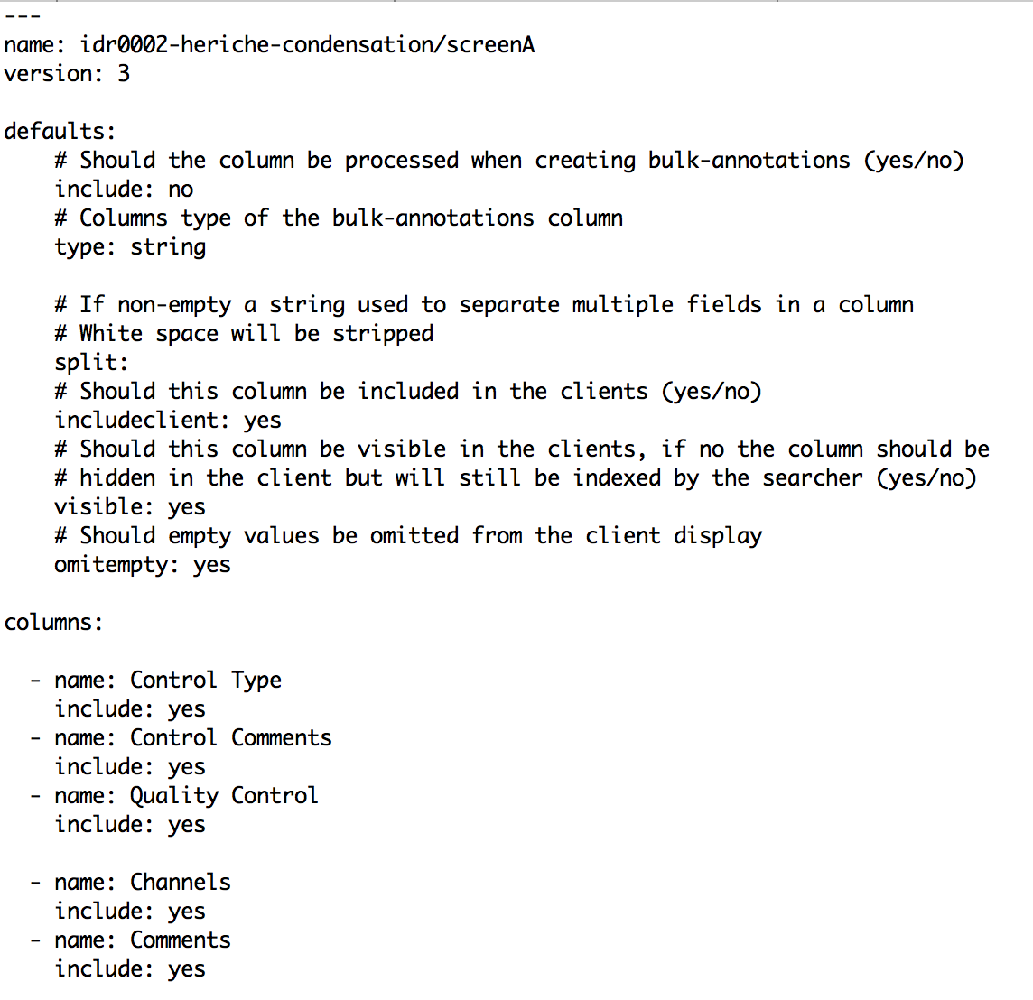
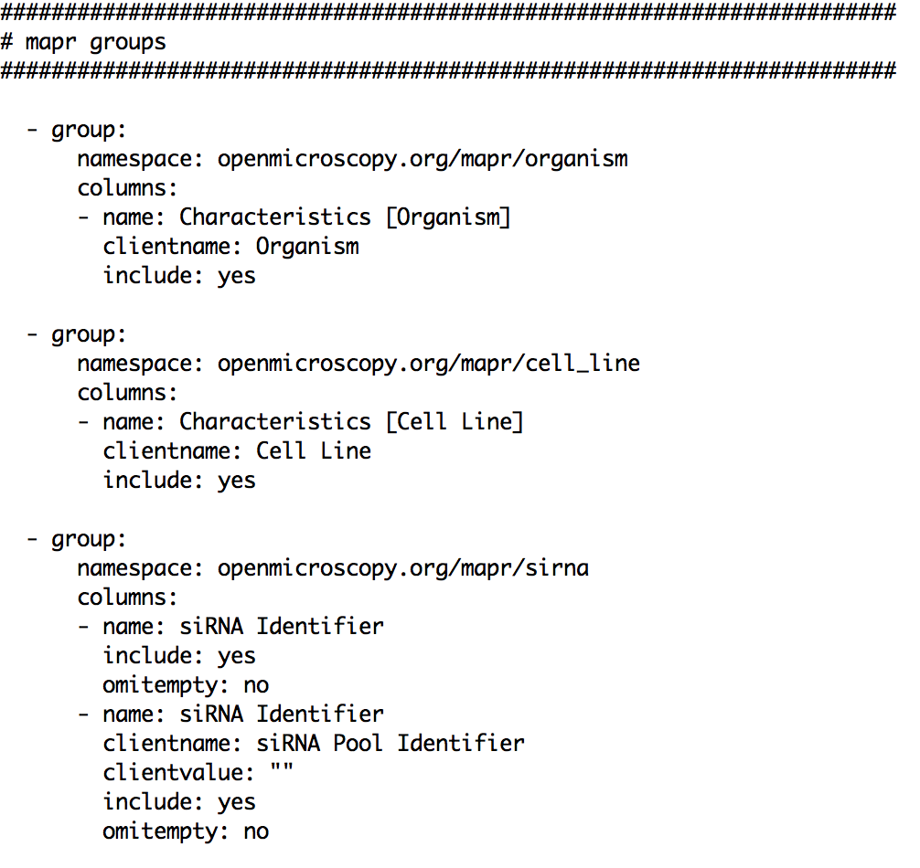
Annotation.csv and bulkmap-config.yml
Bulkmap-config.yml
A yaml file that says what columns from annotation.csv to create map annotations from and how to display them
idr0002-screenA-bulkmap-config.yml

Slide 19
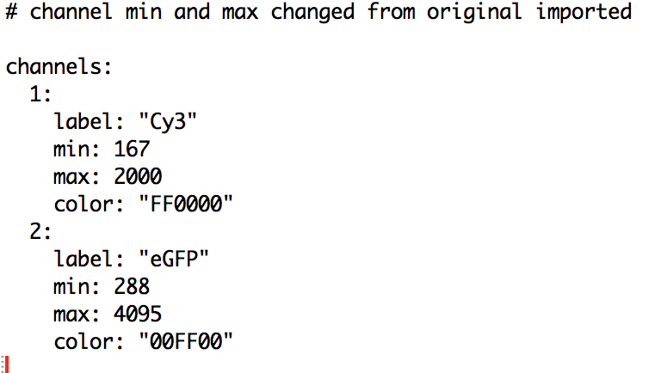
Renderdef.yml
A yaml file that allows you to specify the channel labels, colour, min and max intensity
Can be applied to an image, plate, screen (don’t think dataset)
Idr0002-screenA-renderdef.yml

Slide 20
Git workflow
Create all input files for a study
Commit to a branch on your own forked version of https://github.com/IDR/idr-metadata/
Create a PR against https://github.com/IDR/idr-metadata/
Create a merge build using “MASTER-push” in Jenkins
On idr-testing server clone the merge build
Test files
If ok, then PR can be merged and https://github.com/IDR/idr-metadata/ can be used on idr-next.

Slide 21
Import of images
Screens
omero import --bulk idr0030-screenA-bulk.yml
Will create a screen with the name specified in the bulk.yml file
Non-screen projects
omero import --bulk idr0032-experimentA-bulk.yml
Creates datasets that are specified in the filePaths.tsv file but you have to create the project manually via the Web UI

Slide 22
Adding annotations
Can be done directly or via shell scripts
In both, first add the annotation.csv file then create map annotations from the value in the bulk annotations table
Directly
omero metadata populate --file idr0002-screenA-annotation.csv Screen:102
omero metadata populate --context bulkmap --cfg idr0002-screenA-bulkmap-config.yml Screen:102
Via shell scripts in https:/github.com/IDR/idr-metadata/scripts
./bulk.sh prod37_input_bulk.txt
./annotate.sh prod37_input.txt

Slide 23
Applying rendering settings
omero render edit Plate:1203 idr0019-screenA-renderdef.yml
omero render edit Screen:1203 idr0019-screenA-renderdef.yml
omero render edit Image:3427370 idr0038-experimentA-wtFK-cleared-Wt1-Pax2-renderdef.yml
Note: omero render edit --copy Screen:1203 idr0019-screenA-renderdef.yml will copy the min and max from the first well to all images in the screen even if we are just specifying channel names in the renderdef.yml file

Slide 24
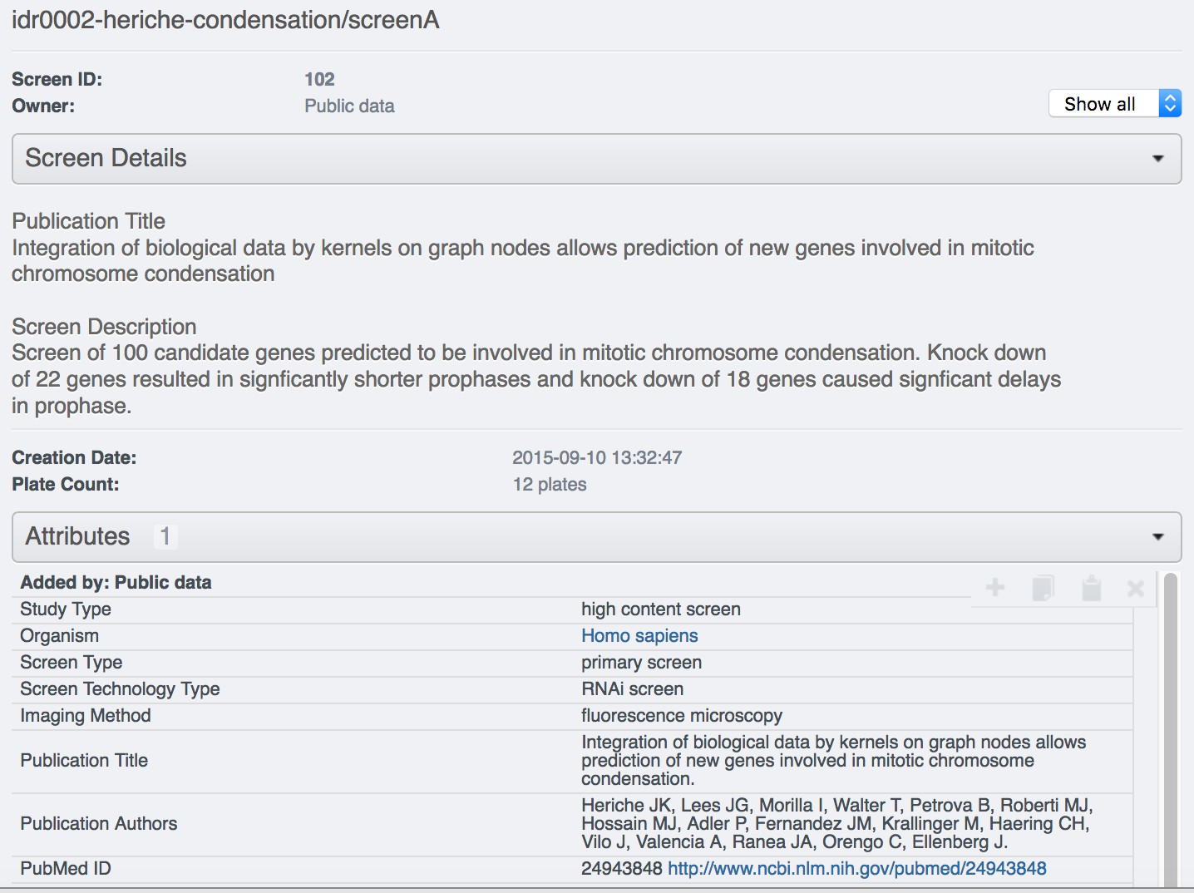
Adding study/screen/experiment level information
ssh idr-next.openmicroscopy.org -L 12345:test44-omeroreadwrite:80
Login via private window in browser and edit the right hand panel

Slide 25
Get DOI for screen/project
Arranged through discovery@dundee.ac.uk and Philippa Sterlini in the library
Minted through DataCite
Can reserve DOI once complete in idr-next but not activated until study in idr.openmicroscopy.org
Submitter fills out short Excel template with info about dataset - description, creators, keywords, license
Signed depositor agreement returned to library, study goes into production IDR and DOI is activated
Library reserve DOI, send us depositor agreement to pass on to submitter
Can create single DOI for a screen/project or parent and child DOIs e.g. idr0028 with a ‘study level’ parent DOI and 4 child DOIs for the 4 screens

Slide 26
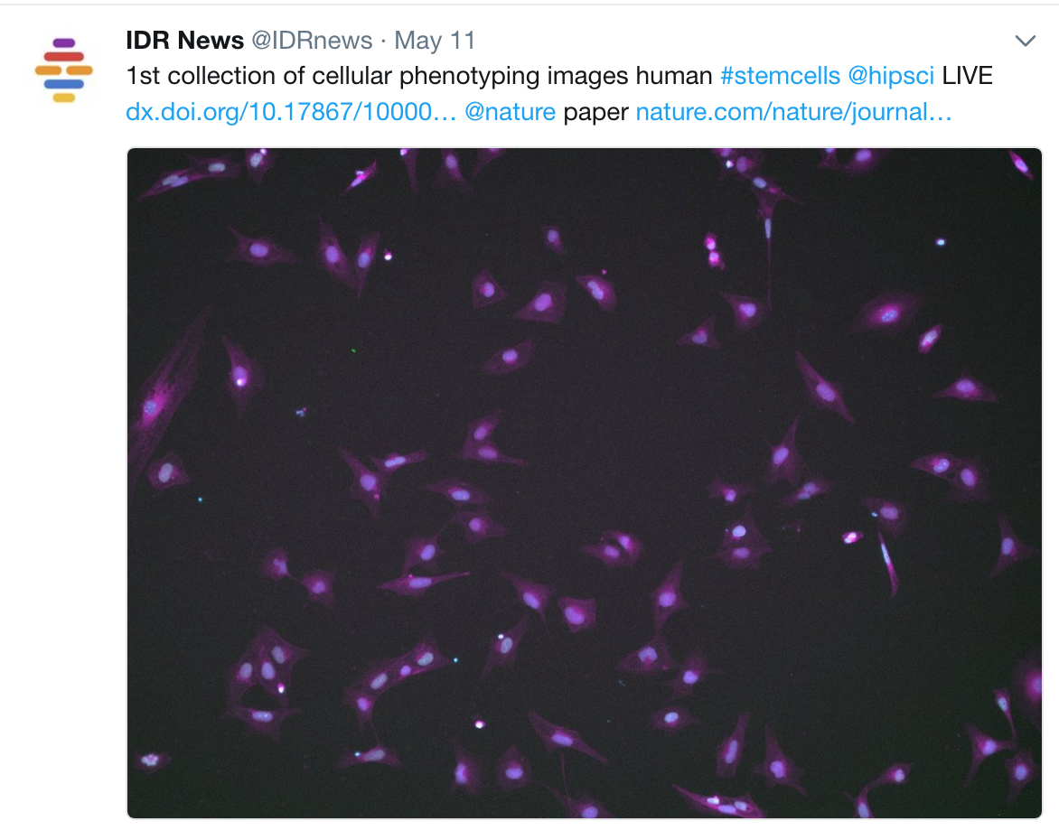
Publicize using @IDRnews on Twitter

Slide 27
Detailed notes
Detailed notes about every step are being written at https://docs.google.com/a/openmicroscopy.org/document/d/1TmBZ43_yhiO3AOua8oMk4mPWKWJtpeYNc2KLP17h-1I/edit?usp=sharing

