Slide 1
OMERO
Users Training day
Cambridge, December 2017
Petr Walczysko, Will Moore, Balaji Ramalingam
University of Dundee
The OME Consortium
Notes:
Hello, I am Petr Walczysko. Am part of the Open Microscopy Environment Team.
The OME project is an International Open Source software consortium. It is run out of Prof.Jason Swedlow’s Lab in the School of Life Sciences at the University of Dundee.
And I will be talking about : OMERO (Which is a software application)

Slide 2
Programme of the day
Short introduction to OMERO
Managing images (Workflow 1 – z stacks)
Coffee
Viewing, analyzing and publishing images using OMERO plugins (OMERO.iviewer, FPBioimage, OMERO.figure Workflow 1 – z stacks continued)
Lunch
Filtering and data search, analysis using Fiji features (OMERO.insight plugin for Fiji, Workflow 2 – timelapse images)
Coffee
Publishing with OMERO (OMERO.figure – in depth, Workflow 2 – timelapse continued)
Notes:
During the course of this talk, I would like to explain the classical "Scientific data paradigm" to start with, and then slowly introduce and walk you through OMERO and a few of its functionalities.
I will particularly highlight the Sharing, Publishing and analysis workflows, to emphasize how a Software like OMERO might be useful in the everyday workflows of a scientist
----- Meeting Notes (17/09/2015 11:19) -----
Analysis with omero instead of extending omero.!

Slide 3
Outline
Scientific Data paradigm
What is OMERO
Analyzing with OMERO
Sharing data with OMERO
Publishing with OMERO
Questions
Notes:
During the course of this talk, I would like to explain the classical "Scientific data paradigm" to start with, and then slowly introduce and walk you through OMERO and a few of its functionalities.
I will particularly highlight the Sharing, Publishing and analysis workflows, to emphasize how a Software like OMERO might be useful in the everyday workflows of a graduate student.
----- Meeting Notes (17/09/2015 11:19) -----
Analysis with omero instead of extending omero.!

Slide 4
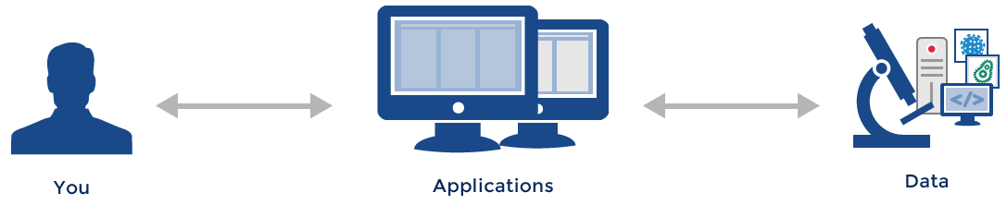
The Standard Paradigm
Notes:
Let me start with standard paradigm, which involves the user :The data and the applications which allow you to interact with the data.
And during the course of a graduate program the student uses multiple acquisition sources (microscopes) to generate data, and will need to use appropriate software’s (in certain cases proprietary ones ) to view and analyze the data.
This minimalistic diagram depicts the standard workflow in most labs and it works perfectly.
Although ……
----- Meeting Notes (17/09/2015 11:19) -----
not only graduate students. You have your own way of organizing your data....
----- Meeting Notes (17/09/2015 16:09) -----
replace graduate students with sciencists.

Slide 5
What about
Organizing your data?
Sharing data with coworkers and colleagues?
Analyzing data?
Publishing data?
Notes:
There are a few questions that one needs to consider and a graduate student might not envision these at the start of their program:
Organizing your data: How big/complex is the data going to be? For instance: How many microscopic techniques are you going to be using during the course of your phd?
And in terms of Sharing : How do you plan on sharing day to day experiments with your Supervisor/others? And how do you manage this interaction space over time?
3) In terms of Analysis and publications as well : are you going to be reinventing the wheel? Or be dependent on proprietary software's in some cases?
To be honest:
Its really hard/rather impossible to have an answer in a few of these cases.
But it worth looking at the bigger picture.!
----- Meeting Notes (17/09/2015 11:19) -----
Publishing data : Change font...!
----- Meeting Notes (17/09/2015 16:09) -----
fix the font for publishing data.

Slide 6
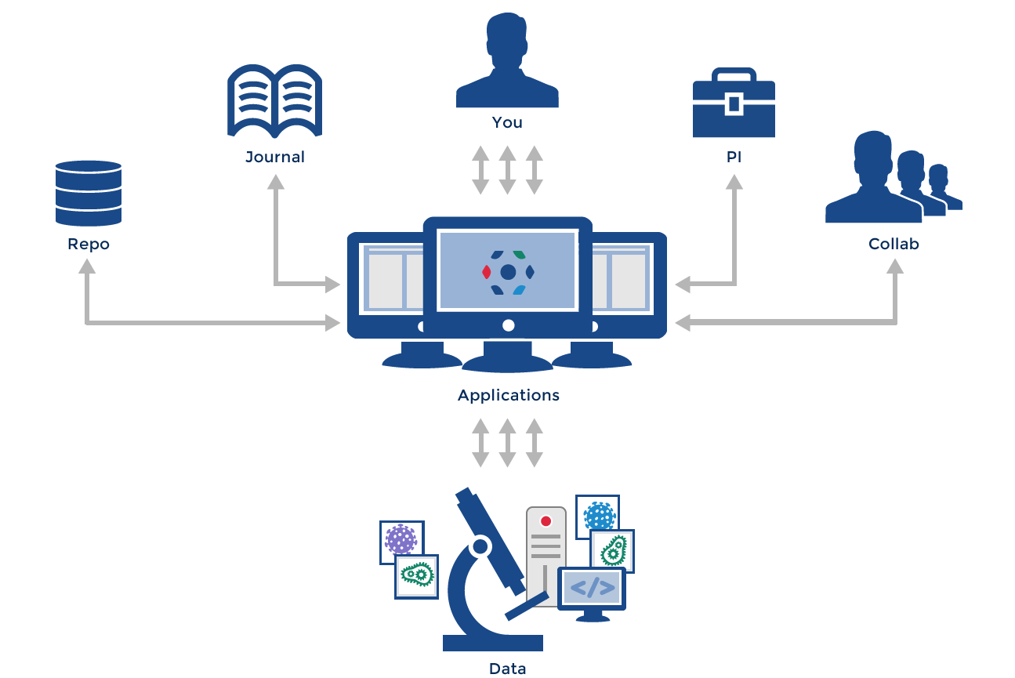
The “Scientific Data” Paradigm
Gray et al, 2005, Scientific Data Management in the Coming Decade, Microsoft Research
Notes:
Which brings us to this screenshot, which highlights our two clients.
As you can see they look very similar to each other.!
These allow the user to actively view, annotate, rate or comment on the data.! (If not more…)
- The developers strive to reach convergence between the two applications and new functionality is being added in parallel.
There are a few functionalities which are specific to one client/other.
They runs on all Platforms(Operating systems).
In summary:
These applications basically allow you to access your data from anywhere , and in few geeky cases on your phones as well.!
There will be presentation of Insight first because it has importer and Measurement Tool whereas Web does not but they do otherwise basically the same.
That is why I wil start with Insight.
----- Meeting Notes (17/09/2015 11:19) -----
you can move easily from one to the other..!
----- Meeting Notes (17/09/2015 16:09) -----
running between the applications seemlessly,
Will show an example which is available in the web alone.

Slide 7
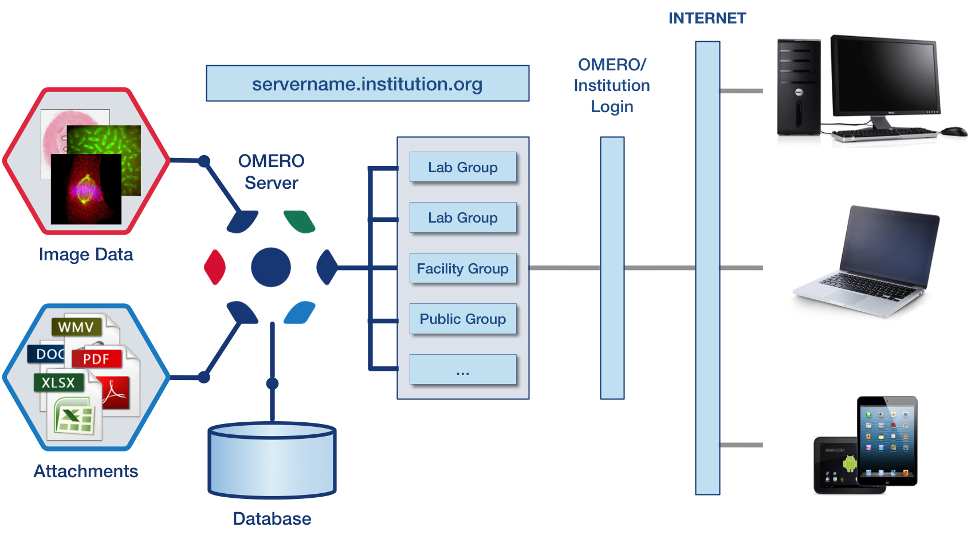
OMERO setup
Notes:
Which brings us to this screenshot, which highlights our two clients.
As you can see they look very similar to each other.!
These allow the user to actively view, annotate, rate or comment on the data.! (If not more…)
- The developers strive to reach convergence between the two applications and new functionality is being added in parallel.
There are a few functionalities which are specific to one client/other.
They runs on all Platforms(Operating systems).
In summary:
These applications basically allow you to access your data from anywhere , and in few geeky cases on your phones as well.!
There will be presentation of Insight first because it has importer and Measurement Tool whereas Web does not but they do otherwise basically the same.
That is why I wil start with Insight.
----- Meeting Notes (17/09/2015 11:19) -----
you can move easily from one to the other..!
----- Meeting Notes (17/09/2015 16:09) -----
running between the applications seemlessly,
Will show an example which is available in the web alone.

Slide 8
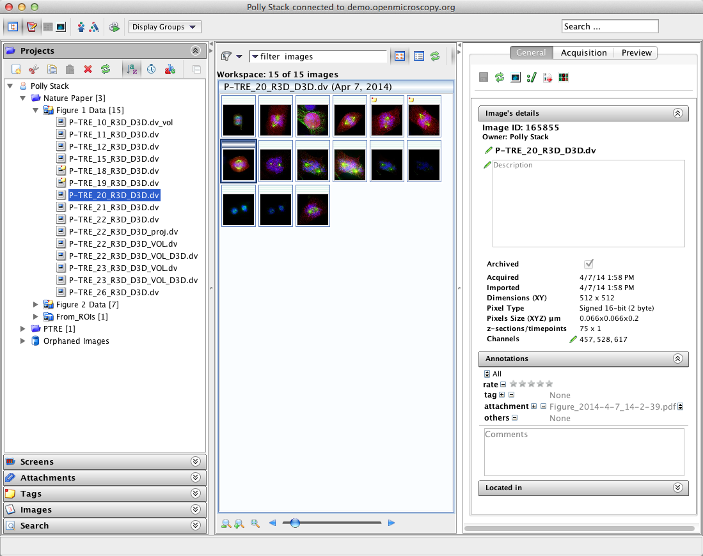
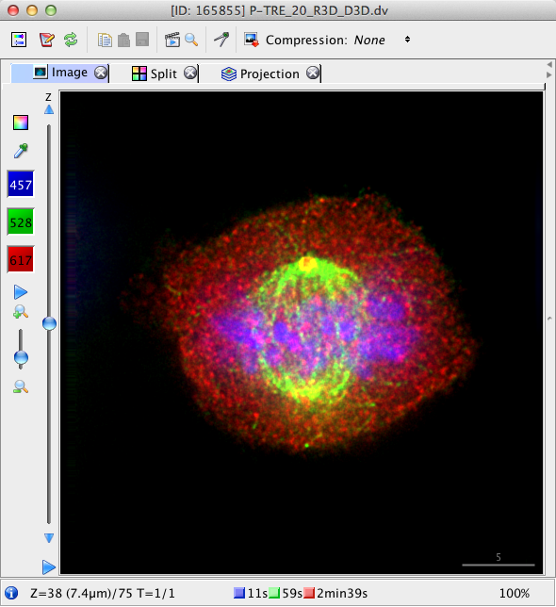
OMERO.insight: Desktop Based Application
Notes:
Which brings us to this screenshot, which highlights our two clients.
As you can see they look very similar to each other.!
These allow the user to actively view, annotate, rate or comment on the data.! (If not more…)
- The developers strive to reach convergence between the two applications and new functionality is being added in parallel.
There are a few functionalities which are specific to one client/other.
They runs on all Platforms(Operating systems).
In summary:
These applications basically allow you to access your data from anywhere , and in few geeky cases on your phones as well.!
There will be presentation of Insight first because it has importer and Measurement Tool whereas Web does not but they do otherwise basically the same.
That is why I wil start with Insight.
----- Meeting Notes (17/09/2015 11:19) -----
you can move easily from one to the other..!
----- Meeting Notes (17/09/2015 16:09) -----
running between the applications seemlessly,
Will show an example which is available in the web alone.

Slide 9
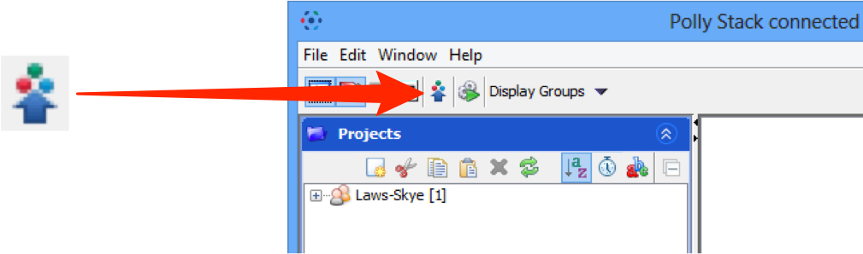
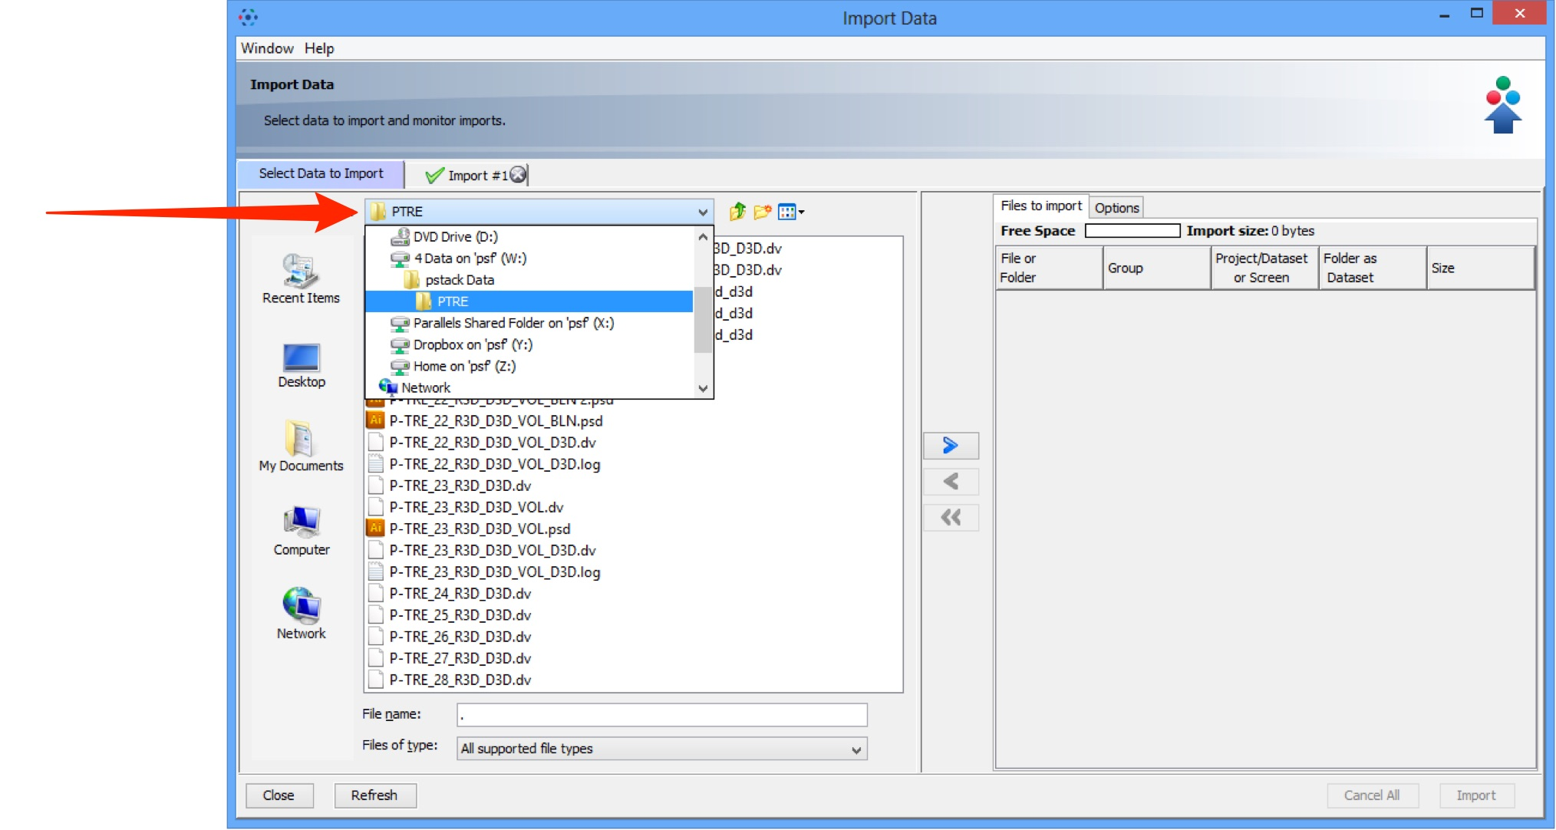
Import Image Data into OMERO

Slide 10
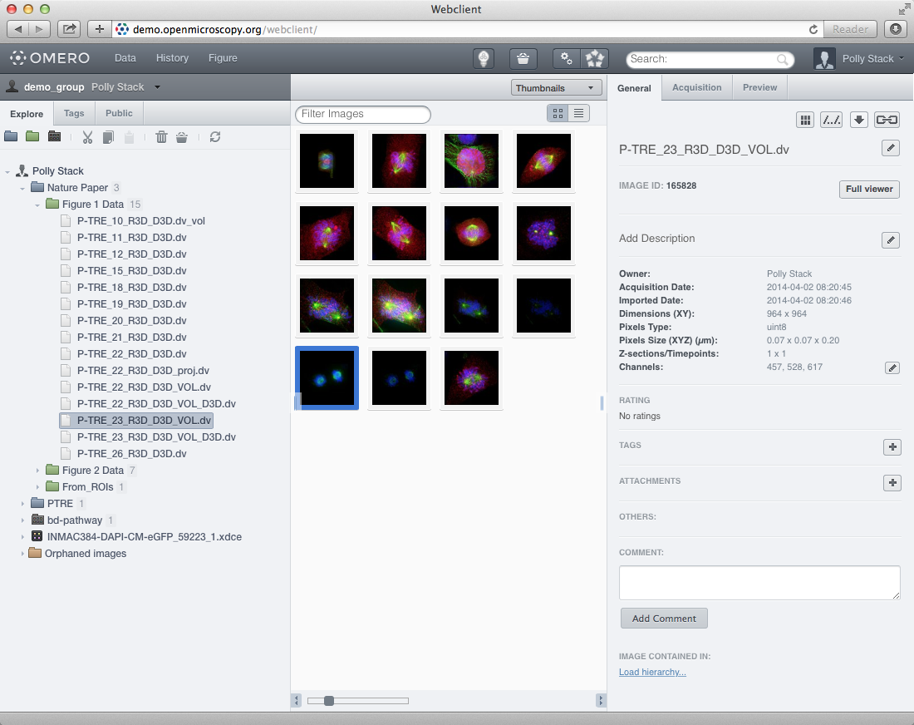
OMERO.web: Web Based Application
Notes:
Which brings us to this screenshot, which highlights our two clients.
As you can see they look very similar to each other.!
These allow the user to actively view, annotate, rate or comment on the data.! (If not more…)
- The developers strive to reach convergence between the two applications and new functionality is being added in parallel.
There are a few functionalities which are specific to one client/other.
They runs on all Platforms(Operating systems).
In summary:
These applications basically allow you to access your data from anywhere , and in few geeky cases on your phones as well.!
There will be presentation of Insight first because it has importer and Measurement Tool whereas Web does not but they do otherwise basically the same.
That is why I wil start with Insight.
----- Meeting Notes (17/09/2015 11:19) -----
you can move easily from one to the other..!
----- Meeting Notes (17/09/2015 16:09) -----
running between the applications seemlessly,
Will show an example which is available in the web alone.

Slide 11
Analysis with OMERO
Notes:
Having viewed all the images in a qualitative sense, let me expose the quantitative capabilities of OMERO. And how the modular nature of OMERO helps in this case:
----- Meeting Notes (17/09/2015 11:19) -----
Call this analysis with OMERO.

Slide 12
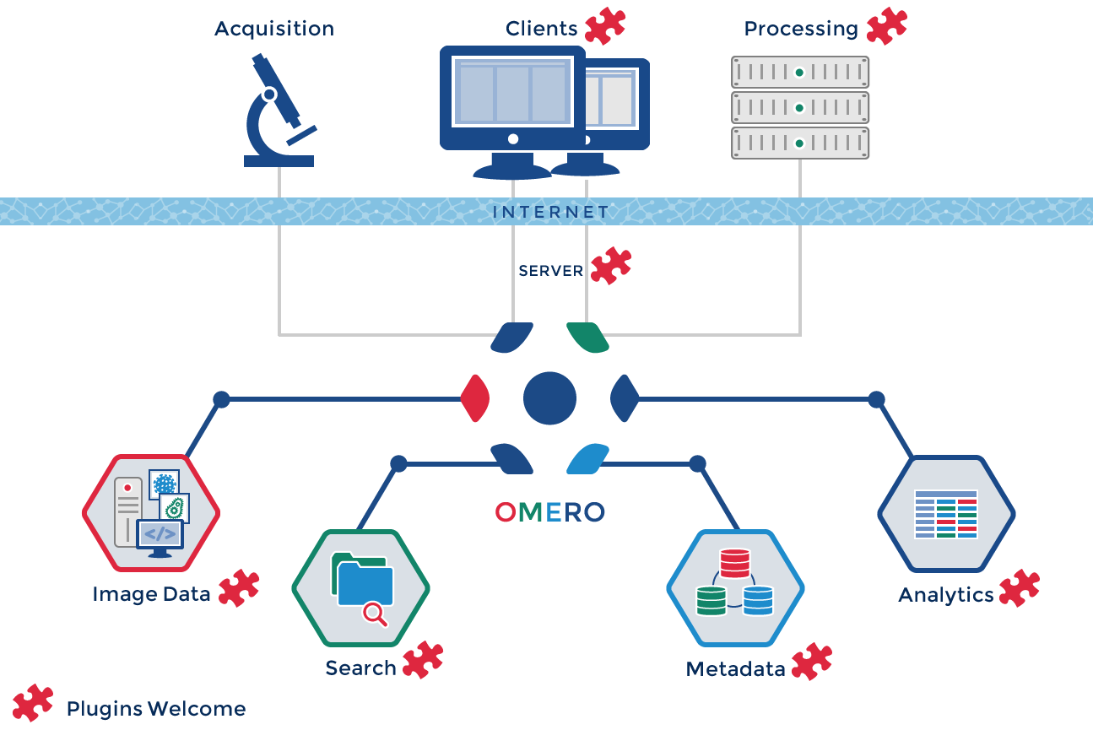
The Extensible OMERO Platform
Notes:
As usage shows that extensibility was key to such platforms, the entire client/server infrastructure has been built with the idea of extensibility.
The various elements in this diagram being either server-side or client-side have been designed so that they could be extended by plugins of various sorts.
Acquisition can also been “extended”

Slide 13
Examples of Analysis Integration
OMERO.iviewer – plugin for viewing and
ImageJ/Fiji, Icy– Pluggable, desktop Image processing tools (Java)
FPBioimage – 3D viewer from Cambridge
R – statistical analysis software
CellProfiler– HCS segmentation and features (Python)
mTools– Otsu, basic segmentation (Matlab)
ORBIT – Image analysis, specialized on pathology images
WND-CHRM-- weighted nearest neighbor machine learning (Python)
ThunderSTORM and PALMSiever– Localisation SRM (ImageJ, Matlab)
OMERO2CV– LSFM Multi-View Reconstruction (C++, OpenCV, ITK)
Columbus Acapella®-- commercial Big Data processing…
Notes:
Examples of such plugins or integration have been particularly present at the level of the analysis over the last few years.

Slide 14
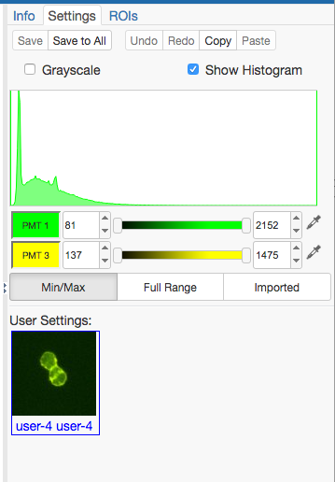
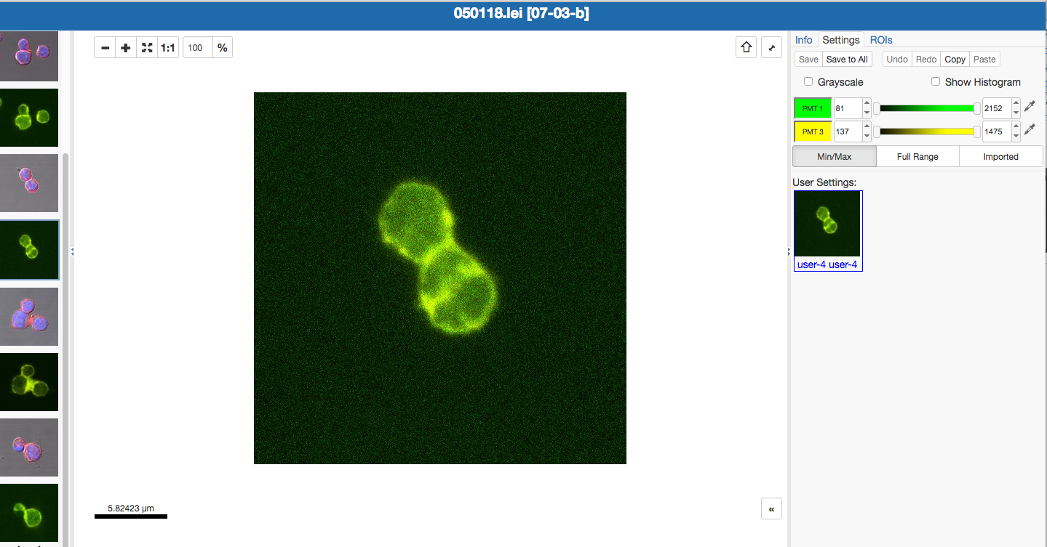
Viewing and analyzing Images – OMERO.iviewer
Google for OMERO.iviewer
Go to YouTube and search for OMERO.iviewer
See also Workshop OMERO.web

Slide 15

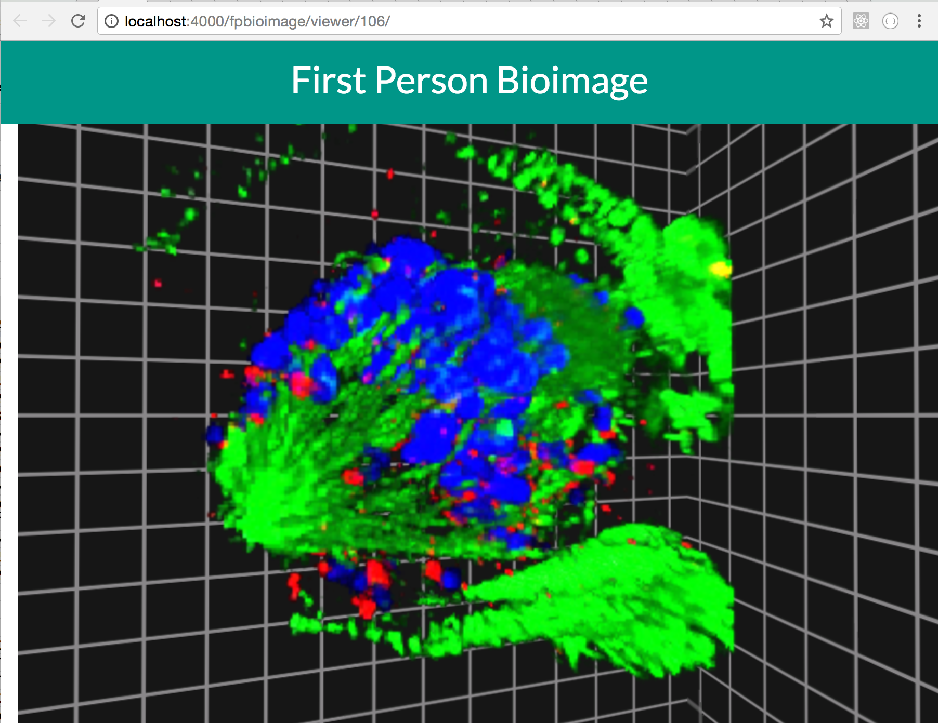
First Person Bioimage – 3D viewer from Cambridge, now in OMERO.web

Slide 16
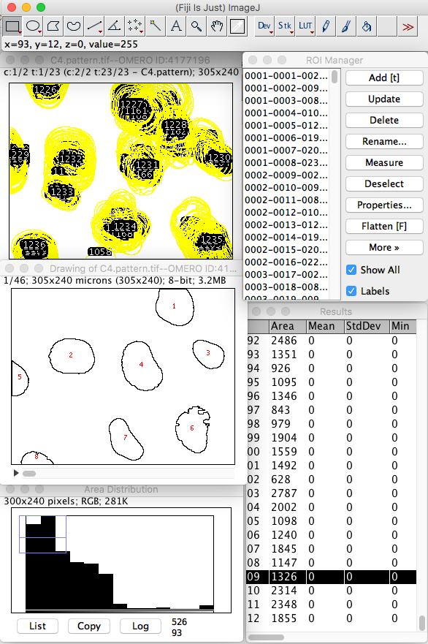
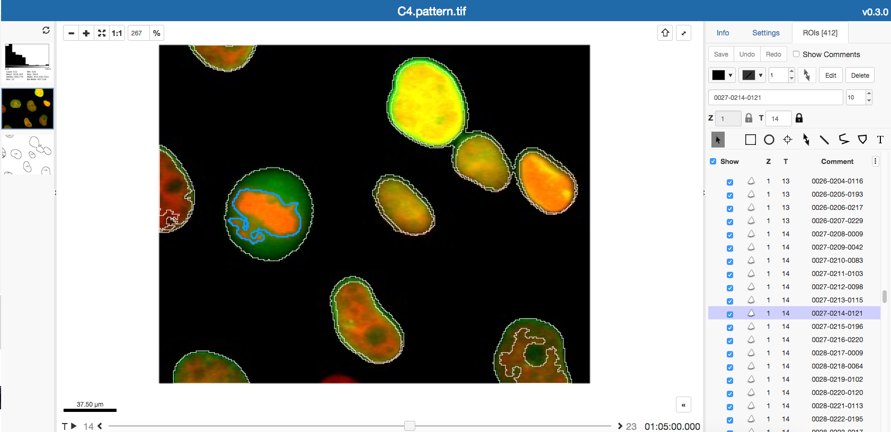

ImageJ and OMERO
Notes:
To start with:
Omero comes with set of basic tools to draw ROI’s , and get some basic intensity measurements done.
Along with that,
OMERO comes packaged with a set of scripts, which vary from simple kymograph generators to complex image processing scripts, all of which can be run on a group of images. (which is often referred to as batch processing)
The above example : which is a kymograph script is a classic example of a script used by many biologists who study kinetics of their molecules, and was initially requested by one of users in the OME-forums.
----- Meeting Notes (17/09/2015 11:19) -----
Introduce the basic tools like ROI Manager.,etc..
The diversity of file formats...
Instead of batch, run operations on lots of images in one go..! The burden is not on your computer...

Slide 17
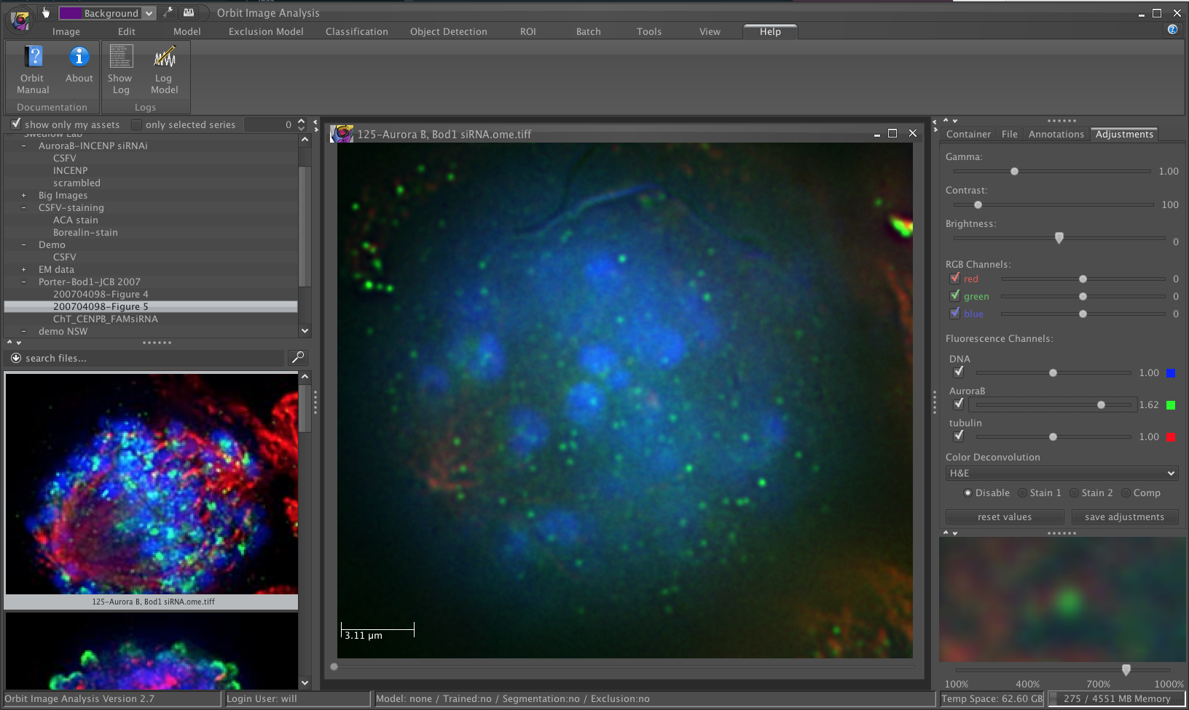
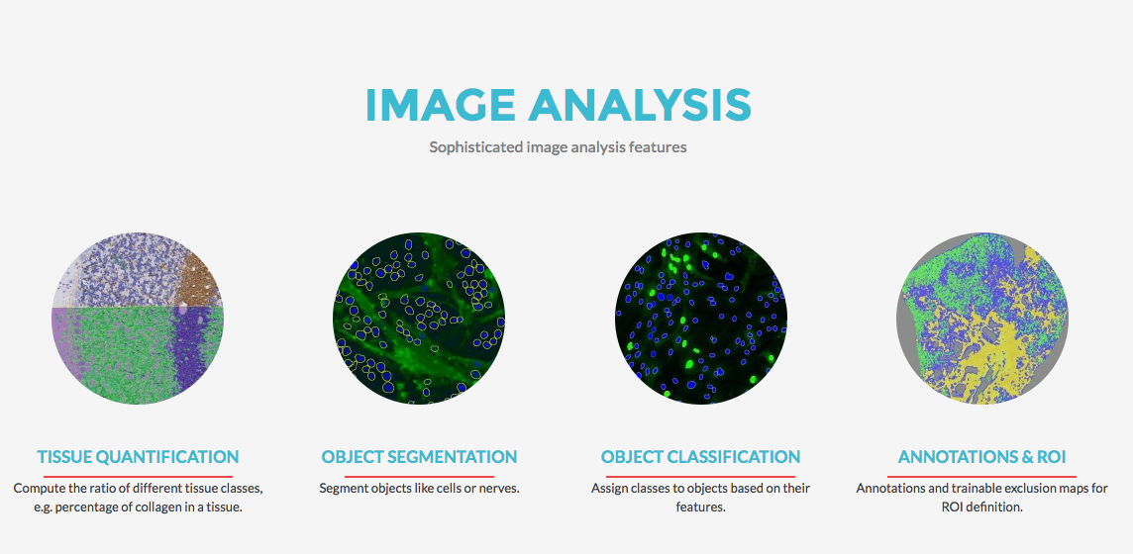
ORBIT
ORBIT IMAGE ANALYSIS
http://www.orbit.bio/
Compatible with OMERO 5.4.0
Notes:
To start with:
Omero comes with set of basic tools to draw ROI’s , and get some basic intensity measurements done.
Along with that,
OMERO comes packaged with a set of scripts, which vary from simple kymograph generators to complex image processing scripts, all of which can be run on a group of images. (which is often referred to as batch processing)
The above example : which is a kymograph script is a classic example of a script used by many biologists who study kinetics of their molecules, and was initially requested by one of users in the OME-forums.
----- Meeting Notes (17/09/2015 11:19) -----
Introduce the basic tools like ROI Manager.,etc..
The diversity of file formats...
Instead of batch, run operations on lots of images in one go..! The burden is not on your computer...

Slide 18
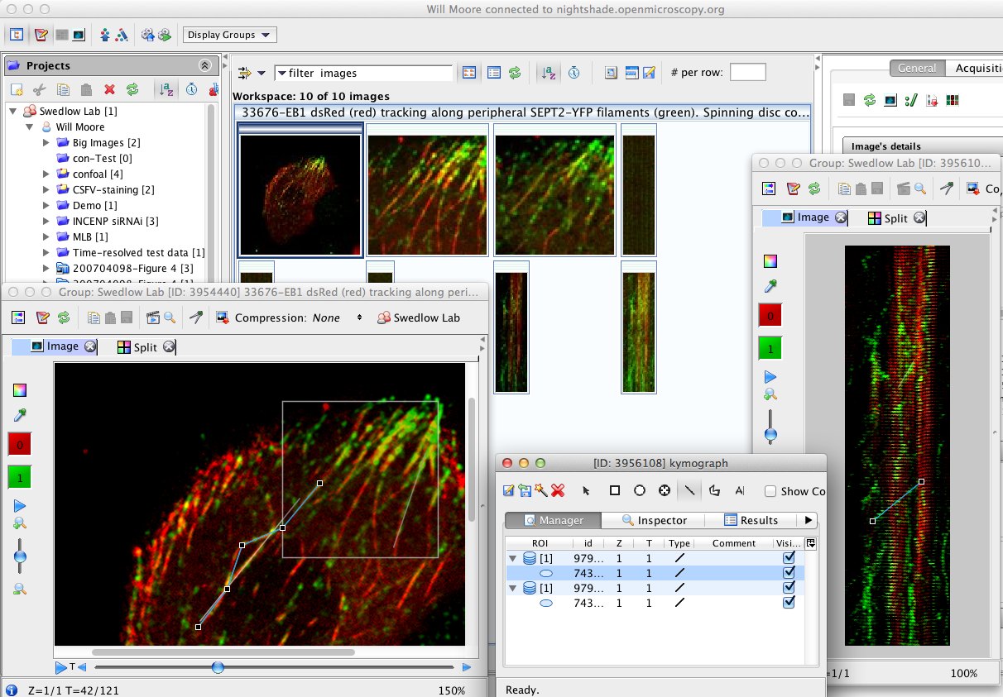
OMERO.scripts: Kymographs example
Image from Bowen et al. JCB 2011
Notes:
To start with:
Omero comes with set of basic tools to draw ROI’s , and get some basic intensity measurements done.
Along with that,
OMERO comes packaged with a set of scripts, which vary from simple kymograph generators to complex image processing scripts, all of which can be run on a group of images. (which is often referred to as batch processing)
The above example : which is a kymograph script is a classic example of a script used by many biologists who study kinetics of their molecules, and was initially requested by one of users in the OME-forums.
----- Meeting Notes (17/09/2015 11:19) -----
Introduce the basic tools like ROI Manager.,etc..
The diversity of file formats...
Instead of batch, run operations on lots of images in one go..! The burden is not on your computer...

Slide 19
Sharing data with OMERO
Notes:
Now getting back to the groups:
Given the right permissions you can not only access your own data but data from others within your lab , (or in cases of collaboration :) even access data from other labs as well.

Slide 20
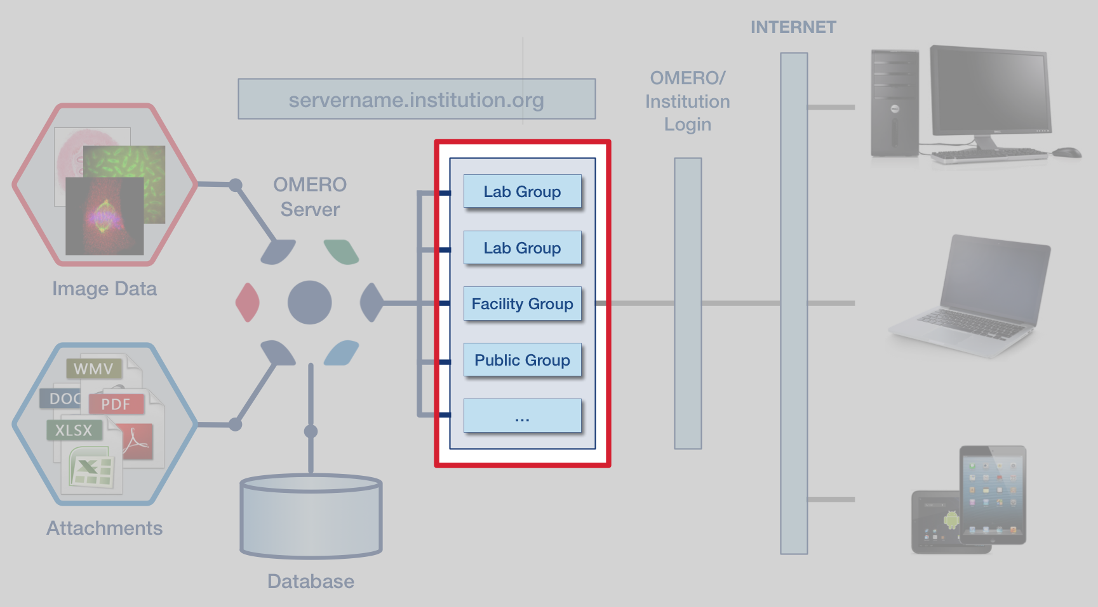
OMERO group and user system
Notes:
Given all this:
Lets see how OMERO works in the institutions: as in how the user interacts with their data with OMERO
Talk about Experiments, acquisition and data upload to OMERO.
1) The data (image/attachments) is uploaded onto the server (by yourself or your system admin).
2) attachments might include : Experimentation Protocols, Acquisition protocols, Results from analysis and etc.
This information can be accessed ffrom your laptops/desktops/phone’s or tablets, via the internet
Now you come across an organized layer of groups (Which is highlighting the lab you are part of). (which we discuss in a minute…..)
Now once you get access to the images:
The images can also be tagged, rated or annotated with key-value pairs or comments using our desktop or web applications. (By the yourself or others from your lab)
----- Meeting Notes (17/09/2015 11:19) -----
Rewrite this slide..
Usually data is organized by labs.
----- Meeting Notes (17/09/2015 16:09) -----
remove results and everything.
Efficient way of managing data..!
I will touch upon the organization of users within omero at a later stage.

Slide 21
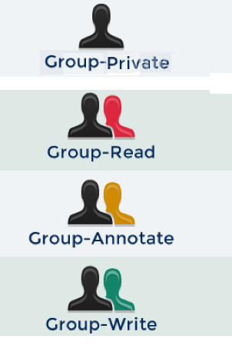
Security Model
Can only read your own data
Can read but not annotate others’ data
Can read and annotate others’ data
Can read and edit others’ data
20
Notes:
To start with:
Omero comes with set of basic tools to draw ROI’s , and get some basic intensity measurements done.
Along with that,
OMERO comes packaged with a set of scripts, which vary from simple kymograph generators to complex image processing scripts, all of which can be run on a group of images. (which is often referred to as batch processing)
The above example : which is a kymograph script is a classic example of a script used by many biologists who study kinetics of their molecules, and was initially requested by one of users in the OME-forums.
----- Meeting Notes (17/09/2015 11:19) -----
Introduce the basic tools like ROI Manager.,etc..
The diversity of file formats...
Instead of batch, run operations on lots of images in one go..! The burden is not on your computer...

Slide 22
Publishing with OMERO
Notes:
Since I touched upon the publication context in the previous slide,
Let me give you more details on this functionality as well….

Slide 23
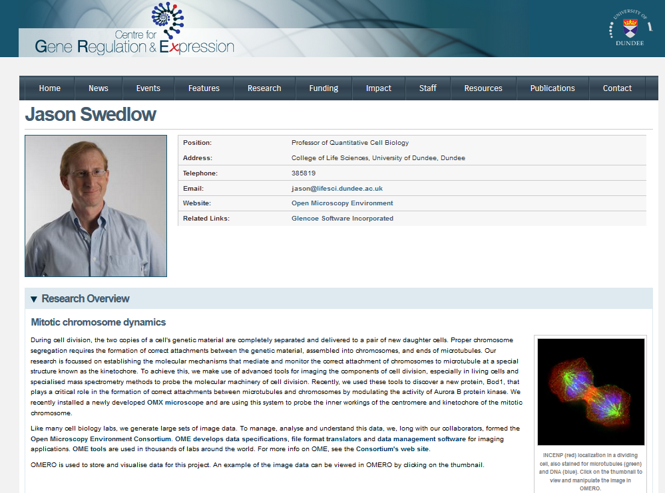
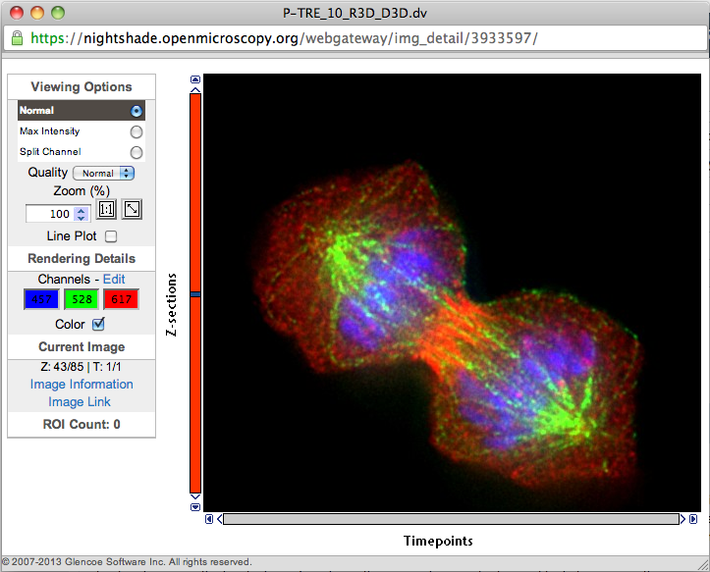
OMERO:
Data Publication – images on website
Notes:
To start with:
Omero comes with set of basic tools to draw ROI’s , and get some basic intensity measurements done.
Along with that,
OMERO comes packaged with a set of scripts, which vary from simple kymograph generators to complex image processing scripts, all of which can be run on a group of images. (which is often referred to as batch processing)
The above example : which is a kymograph script is a classic example of a script used by many biologists who study kinetics of their molecules, and was initially requested by one of users in the OME-forums.
----- Meeting Notes (17/09/2015 11:19) -----
Introduce the basic tools like ROI Manager.,etc..
The diversity of file formats...
Instead of batch, run operations on lots of images in one go..! The burden is not on your computer...

Slide 24
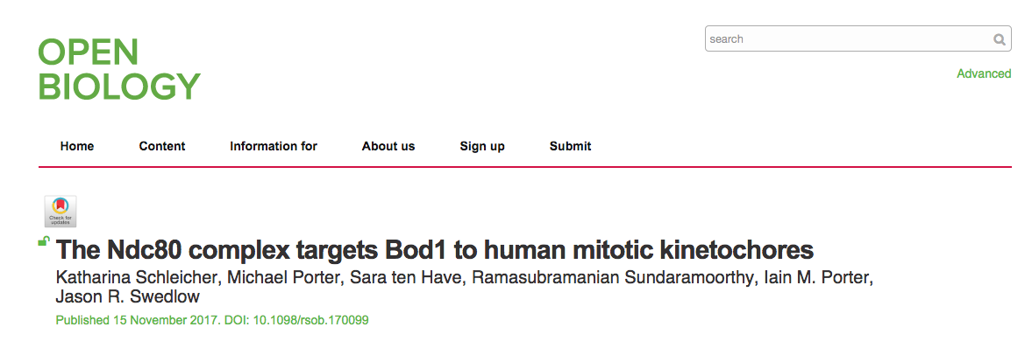
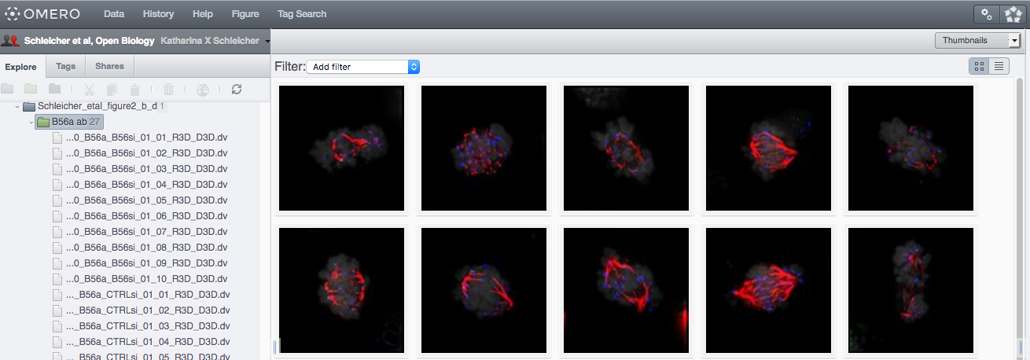
OMERO:
Data Publication – raw data
Notes:
To start with:
Omero comes with set of basic tools to draw ROI’s , and get some basic intensity measurements done.
Along with that,
OMERO comes packaged with a set of scripts, which vary from simple kymograph generators to complex image processing scripts, all of which can be run on a group of images. (which is often referred to as batch processing)
The above example : which is a kymograph script is a classic example of a script used by many biologists who study kinetics of their molecules, and was initially requested by one of users in the OME-forums.
----- Meeting Notes (17/09/2015 11:19) -----
Introduce the basic tools like ROI Manager.,etc..
The diversity of file formats...
Instead of batch, run operations on lots of images in one go..! The burden is not on your computer...

Slide 25
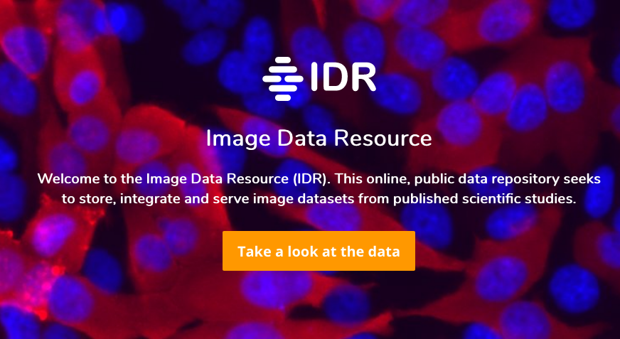
OMERO
Data Publication: Image Data Resource
Notes:
To start with:
Omero comes with set of basic tools to draw ROI’s , and get some basic intensity measurements done.
Along with that,
OMERO comes packaged with a set of scripts, which vary from simple kymograph generators to complex image processing scripts, all of which can be run on a group of images. (which is often referred to as batch processing)
The above example : which is a kymograph script is a classic example of a script used by many biologists who study kinetics of their molecules, and was initially requested by one of users in the OME-forums.
----- Meeting Notes (17/09/2015 11:19) -----
Introduce the basic tools like ROI Manager.,etc..
The diversity of file formats...
Instead of batch, run operations on lots of images in one go..! The burden is not on your computer...

Slide 26
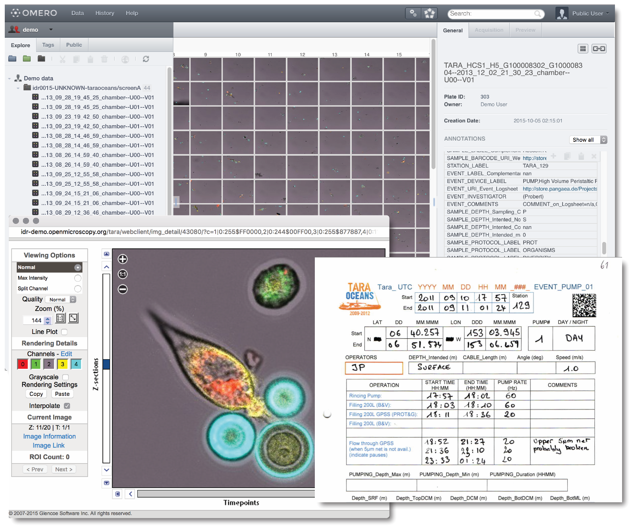
OMERO
Data Publication: Image Data Resource
Notes:
To start with:
Omero comes with set of basic tools to draw ROI’s , and get some basic intensity measurements done.
Along with that,
OMERO comes packaged with a set of scripts, which vary from simple kymograph generators to complex image processing scripts, all of which can be run on a group of images. (which is often referred to as batch processing)
The above example : which is a kymograph script is a classic example of a script used by many biologists who study kinetics of their molecules, and was initially requested by one of users in the OME-forums.
----- Meeting Notes (17/09/2015 11:19) -----
Introduce the basic tools like ROI Manager.,etc..
The diversity of file formats...
Instead of batch, run operations on lots of images in one go..! The burden is not on your computer...

Slide 27
OMERO.figure
Winner of the SLS innovator of the Year
Notes:
To start with:
Omero comes with set of basic tools to draw ROI’s , and get some basic intensity measurements done.
Along with that,
OMERO comes packaged with a set of scripts, which vary from simple kymograph generators to complex image processing scripts, all of which can be run on a group of images. (which is often referred to as batch processing)
The above example : which is a kymograph script is a classic example of a script used by many biologists who study kinetics of their molecules, and was initially requested by one of users in the OME-forums.
----- Meeting Notes (17/09/2015 11:19) -----
Introduce the basic tools like ROI Manager.,etc..
The diversity of file formats...
Instead of batch, run operations on lots of images in one go..! The burden is not on your computer...

Slide 28
Some useful links
OMERO Downloads:
  https://downloads.openmicroscopy.org/omero/
OMERO Help Pages:
  http://help.openmicroscopy.org/
OMERO Forums:
  https://www.openmicroscopy.org/community/
OMERO demo server:
  http://help.openmicroscopy.org/demo-server.html
Notes:
You can download our software from the downloads page: (as I said before : its open source and free to use), and can access our help pages to get started with using OMERO.
Given that you are part of the SLS: You can start playing around with the server in SLS, all you need to do is to use your university of dundee login credentials to access the server.
And if you cant find something that you’re looking for: Come see us in CTIR or write to our Forums. We do conduct workshops and training programs on a regular basis, and we do handle specific requests from labs as well, to help them get started with using our software. Feel free to get in touch with us if you want one scheduled for your lab/group.
----- Meeting Notes (17/09/2015 16:09) -----
remove the forums context..! G
To avoid reinvent the wheel, please write to us on the OME-forums or come meet one of our team members in the 1st floor of the new CTIR building.
We might point you at one of stable 3rd party integrations which might solve your issue

Slide 29





Thank to Funders
Notes:
And as always a big thank you to our funders.

Slide 30
Programme of the day
Short introduction to OMERO
Managing images (Workflow 1 – z stacks)
Coffee
Viewing, analyzing and publishing images using OMERO plugins (OMERO.iviewer, FPBioimage, OMERO.figure Workflow 1 – z stacks continued)
Lunch
Filtering and data search, analysis using Fiji features (OMERO.insight plugin for Fiji, Workflow 2 – timelapse images)
Coffee
Publishing with OMERO (OMERO.figure – in depth, Workflow 2 – timelapse continued)
Notes:
During the course of this talk, I would like to explain the classical "Scientific data paradigm" to start with, and then slowly introduce and walk you through OMERO and a few of its functionalities.
I will particularly highlight the Sharing, Publishing and analysis workflows, to emphasize how a Software like OMERO might be useful in the everyday workflows of a scientist
----- Meeting Notes (17/09/2015 11:19) -----
Analysis with omero instead of extending omero.!

