Slide 1
User Experience Team
The Open Microscopy Environment
Using and Adapting the OMERO Training Materials
Gus Ferguson

Slide 2
SCOPE

Slide 3
OMERO: Desktop and Web clients
Notes:
The OMERO training materials and Help website focus on the two GUI clients, the desktop client, OMERO.insight and the browser-based client, OMERO.web, but they also cover additional apps including OMERO.figure, OMERO and ImageJ/Fiji and the Virtual Microscope.

Slide 4
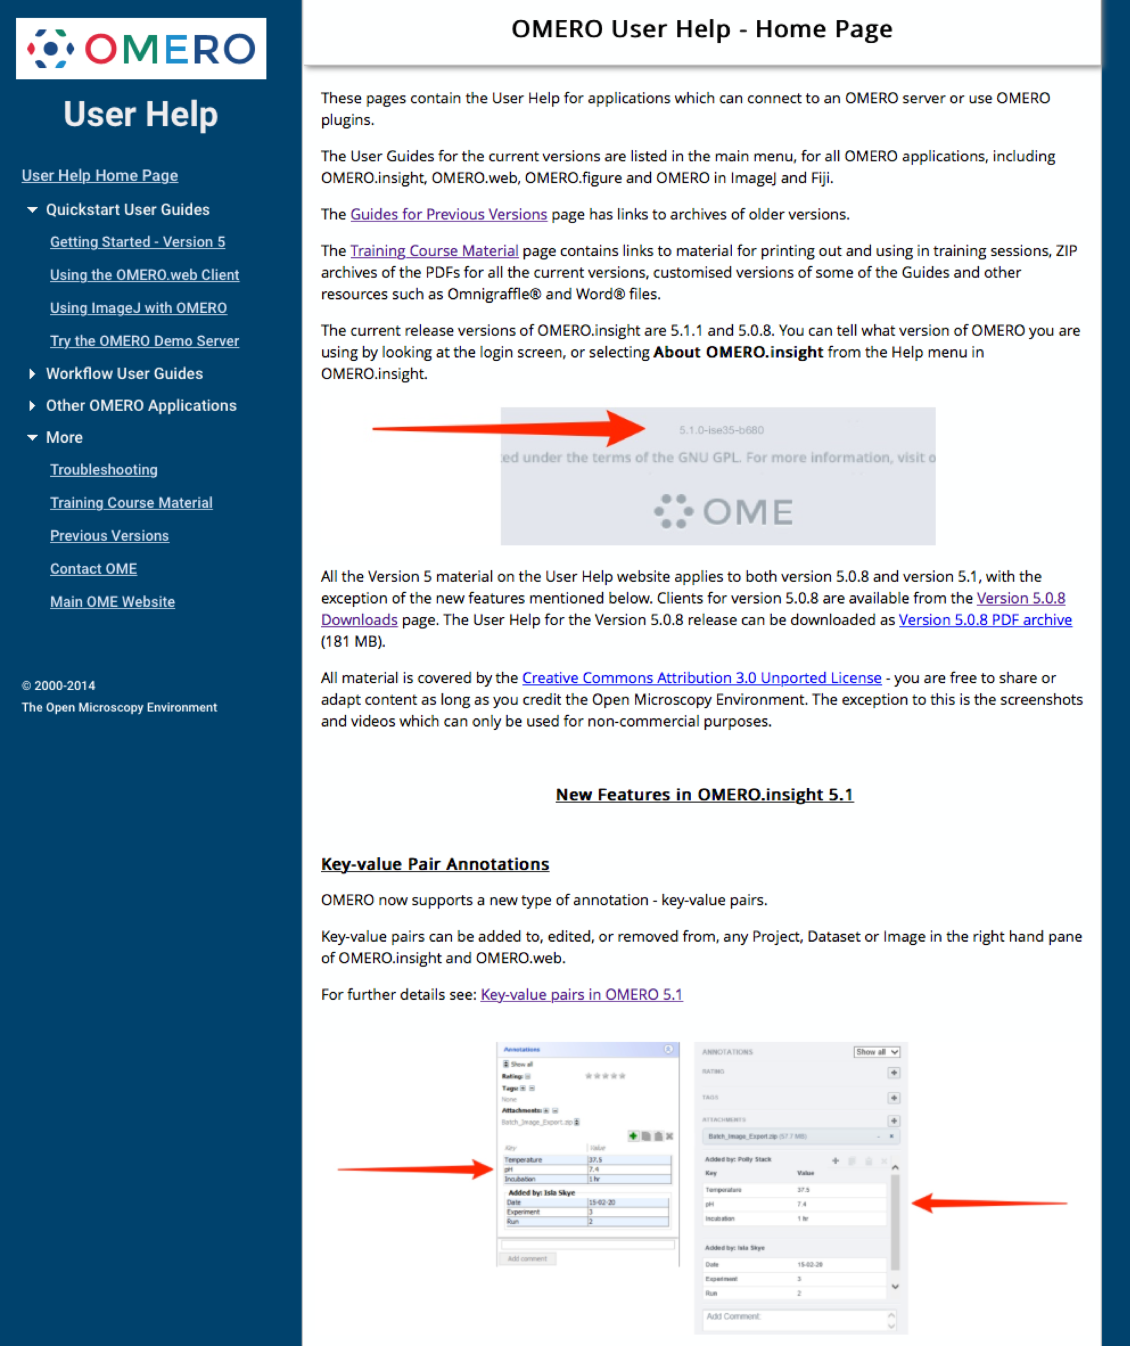
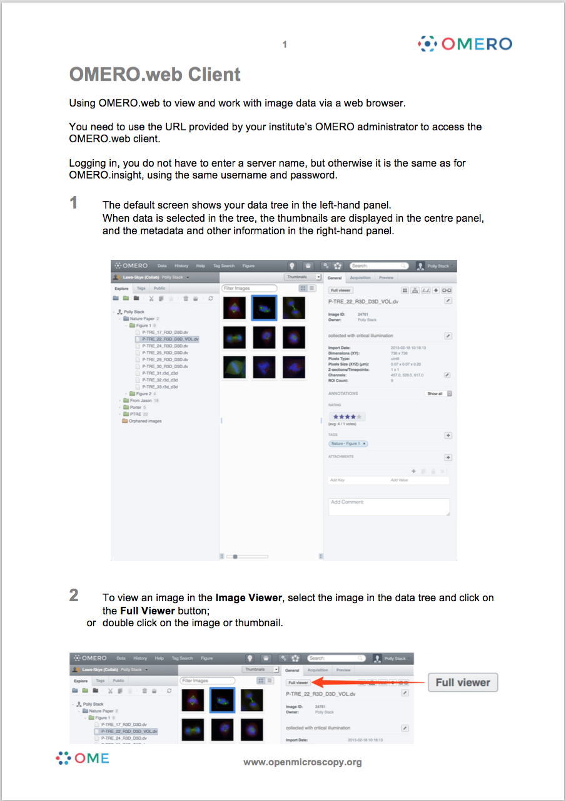
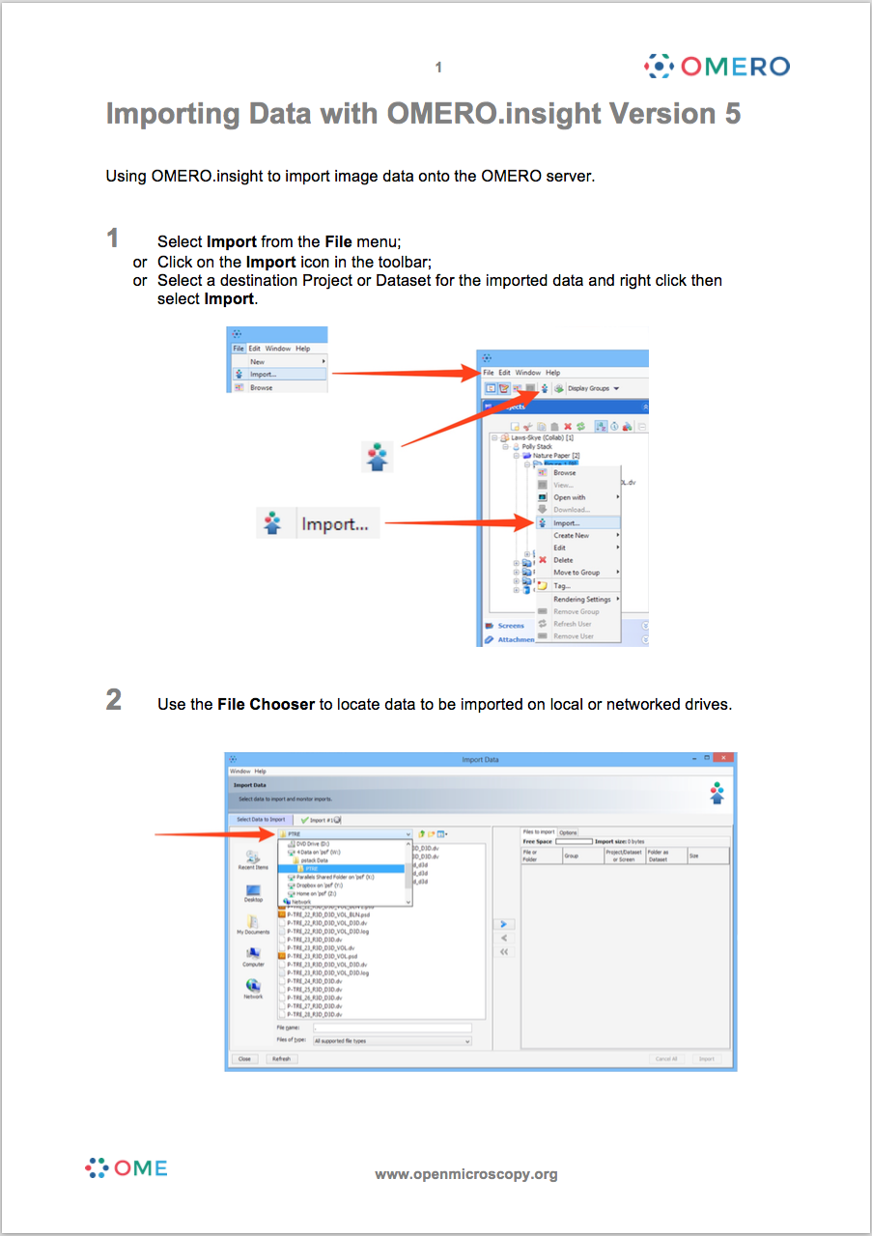
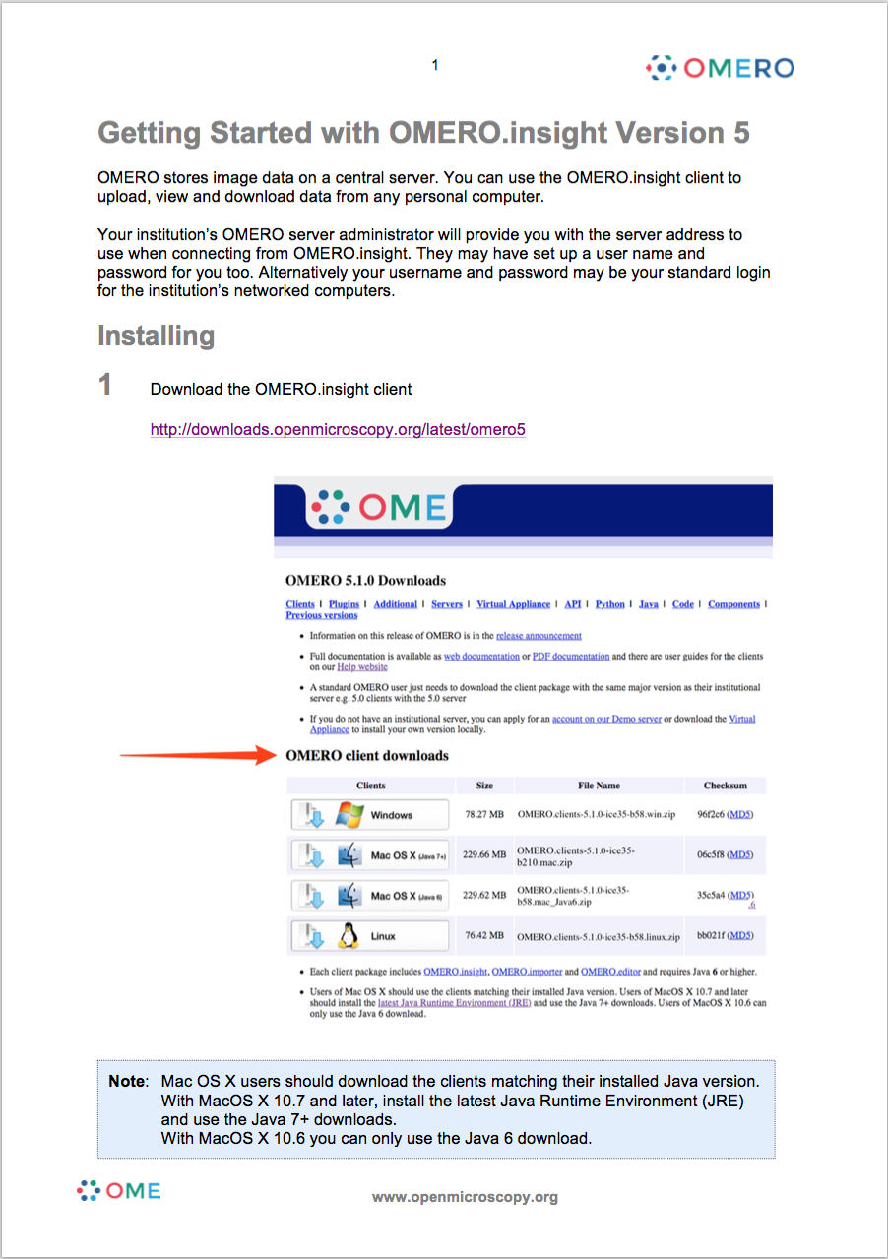
OMERO User Help and Training Materials
Notes:
The Help website is the HTML form of the material, with downloadable PDF versions for all the pages.

Slide 5
Website

Slide 6
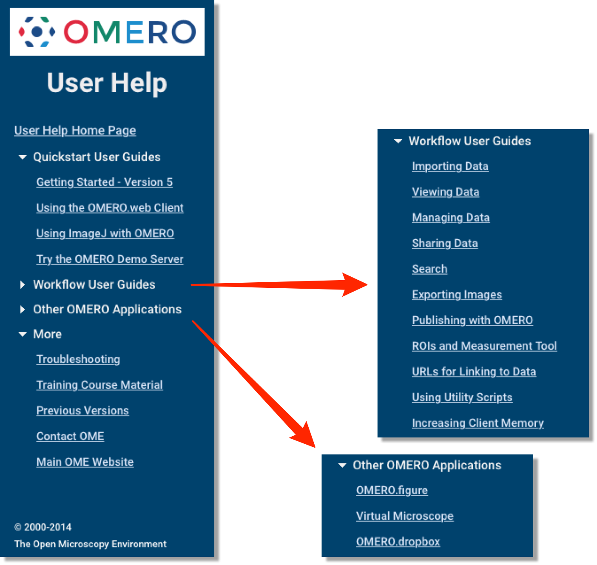
OMERO User Help
help.openmicroscopy.org
Notes:
There are getting started guides for for OMERO.insight, OMERO.web and using OMERO with ImageJ/Fiji and then workflow guides for OMERO.figure and OMERO Virtual Microscope.

Slide 7
OMERO Training Materials
Notes:
The most convenient way to download the PDFs for all the chapters is form the link on the Training Materials page. Individual chapter PDFs can be downloaded from the PDF link at the top right of each page.

Slide 8
WORKFLOW

Slide 9
Training Materials Workflow
Workflow based
“Minimal Manual” style (sort of)
Version controlled
Part of OME software CI workflow
Notes:
My workflow is fairly individual as I use apps that I like working with.

Slide 10
Training Materials Workflow
Notes:
Screen captures are edited and the arrows and annotations added in Omnigraffle. The final image is output as a JPEG.

Slide 11
Training Materials Workflow
Notes:
The text and image layout is done in Word and a PDF generated for printing as training material.

Slide 12
Training Materials Workflow
Notes:
The text from the Word document is converted to text and marked up in HTML.

Slide 13
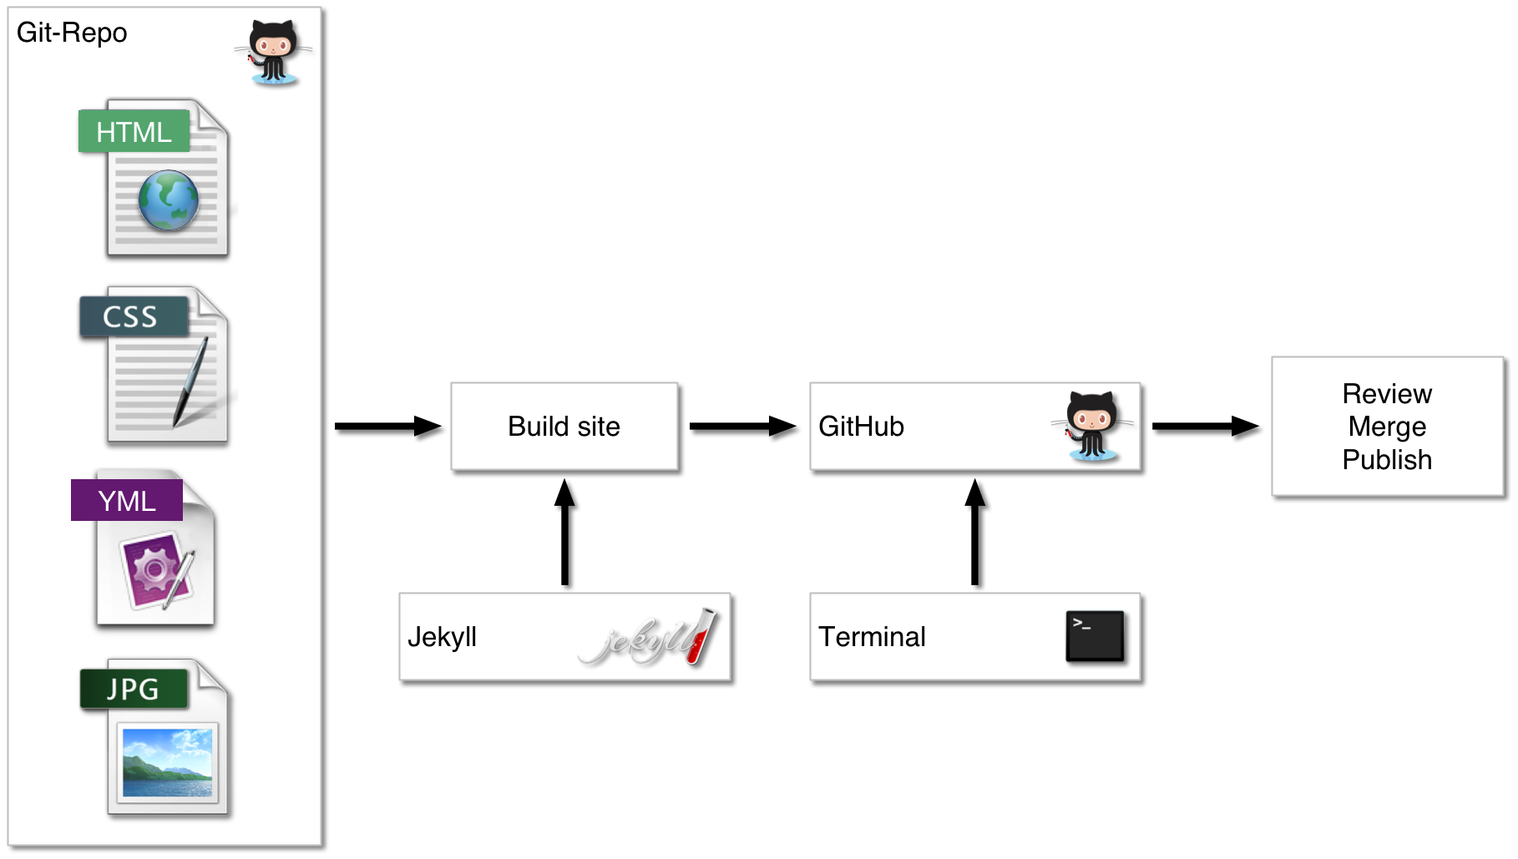
Training Materials Workflow
Notes:
The website is built and maintained using Jekyll and Github. Edits are made locally and then pushed to Github where they are build, reviewed then merged and deployed as the active Help website.

Slide 14
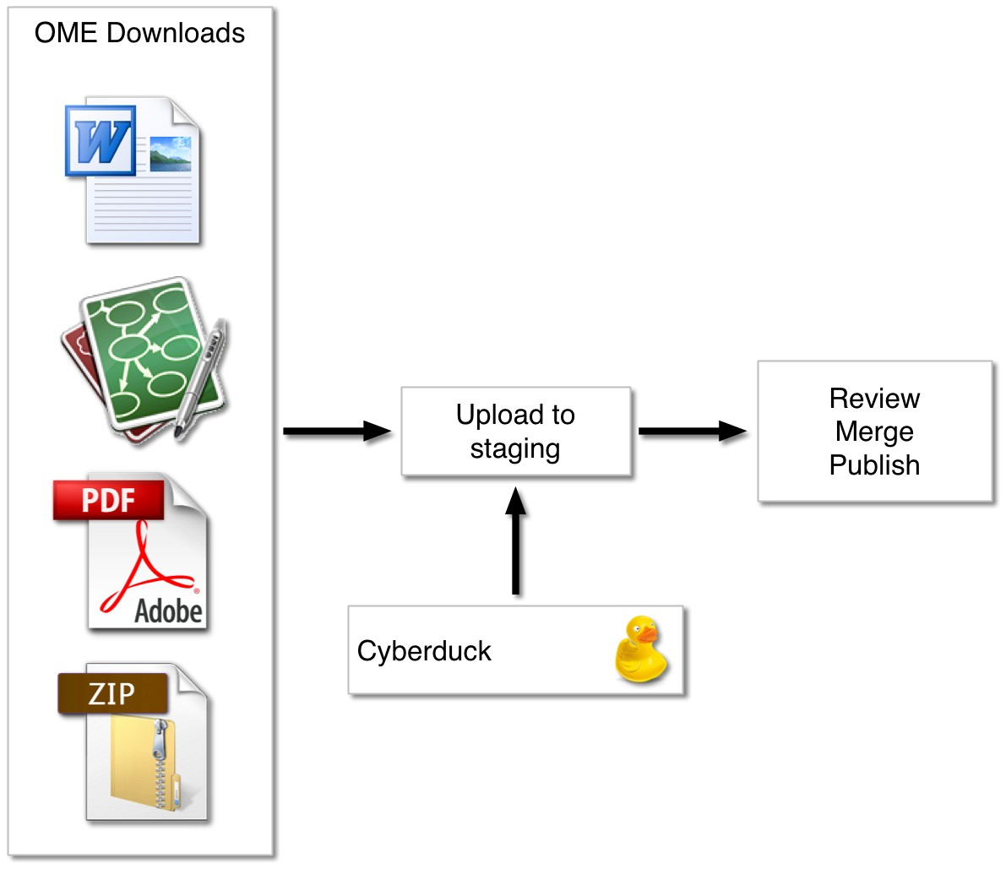
Training Materials Workflow
Notes:
The resources in the shape of the Word and Omnigraffle and the PDFs and archives of PDFs for each version are uploaded to the downloads staging site. Once reviewed in conjunction with the website changes, they are made live on the OME Downloads site.

Slide 15
RESOURCES
Notes:
Our approach ...

Slide 16
PDF Archive
http://help.openmicroscopy.org/resources.html
Notes:
As mentioned previously, the simplest way to use the training materials is to download the zipped PDFs and print off the ones you want to use for the session.

Slide 17
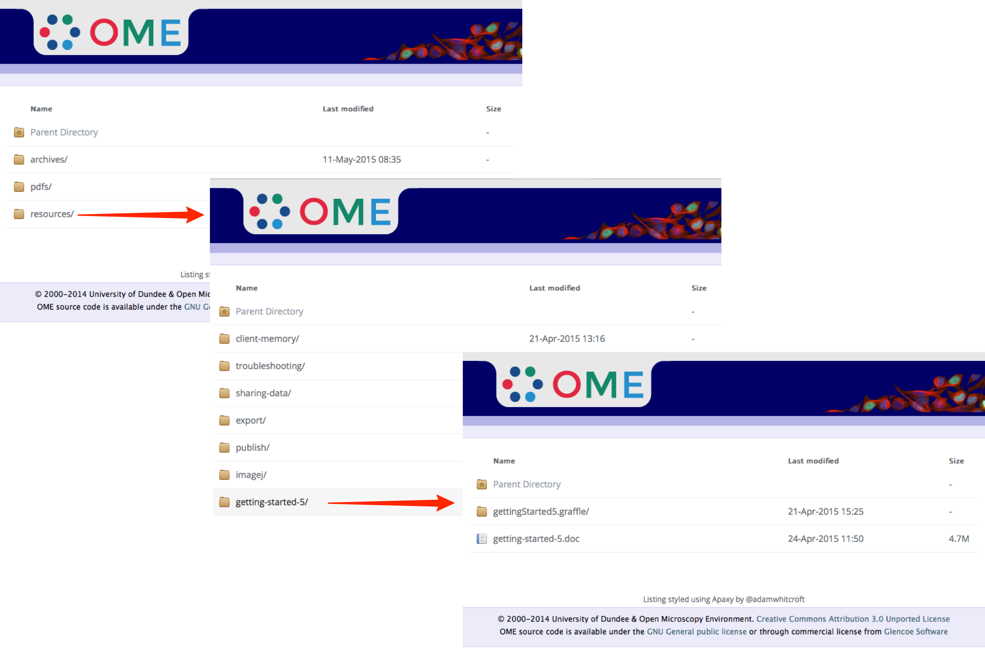
OME Downloads Site
downloads.openmicroscopy.org/help/
Notes:
If you would like to customise or edit the training material, the original Word documents are available for download. The Help directory in the OME Downloads site contains the archive, pdf and resources directories. The Omnigraffle files contain the images used to create the images and the svs files which allow them to be used in programs other than Omnigraffle.

Slide 18
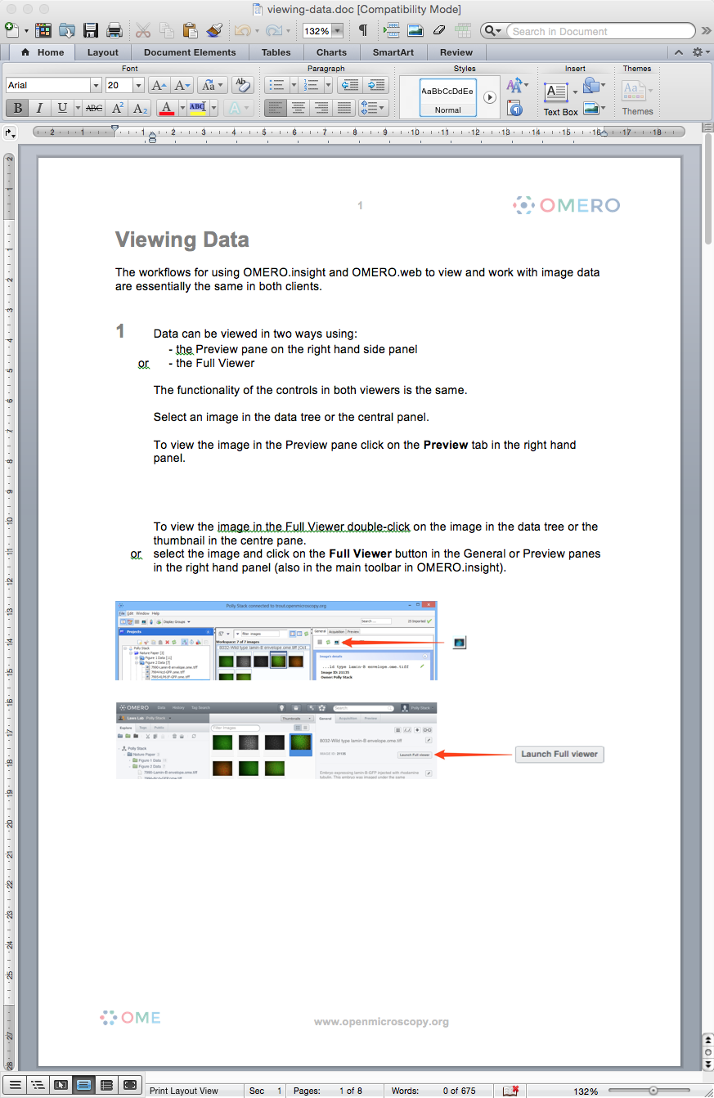
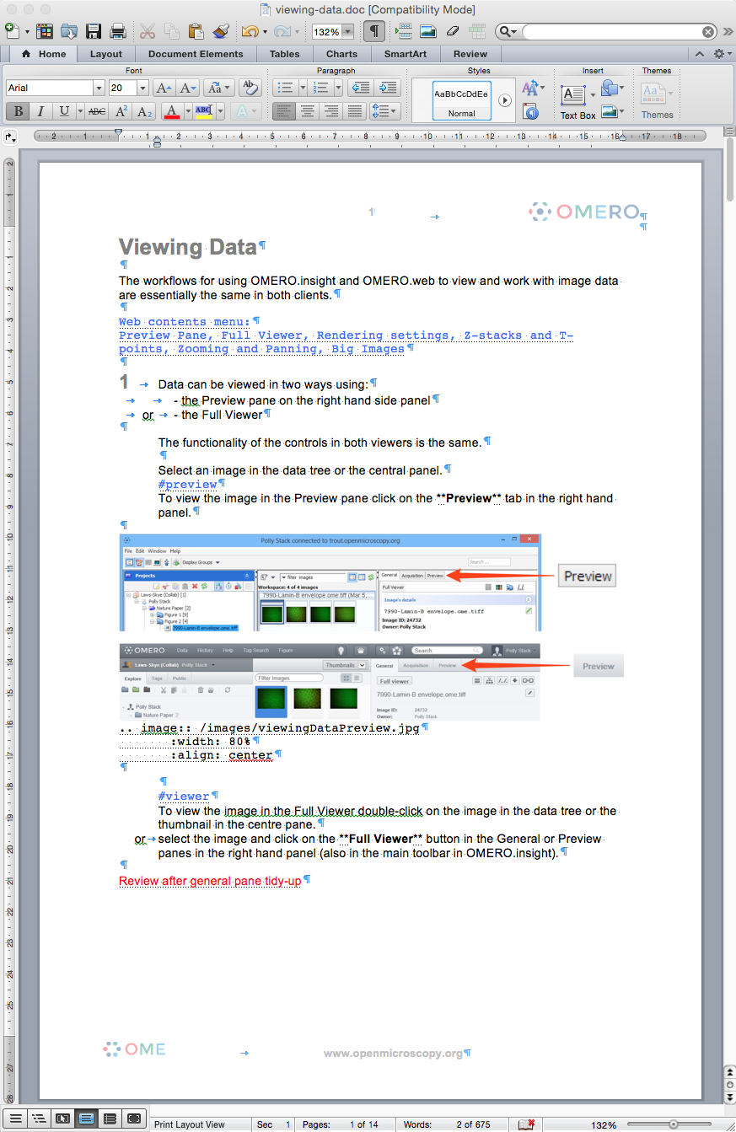
Word - Hidden Text
Notes:
If you use the Word documents, be aware that there is hidden text in them. This is used to make notes and record details such as the image names of the annotated screenshots to make the conversion to the HTML version easier. As you can see I also use it to give myself reminders for updates etc. Tip to the wise: turn off hidden text before you render the PDFs or you can get some layout weirdness.

Slide 19
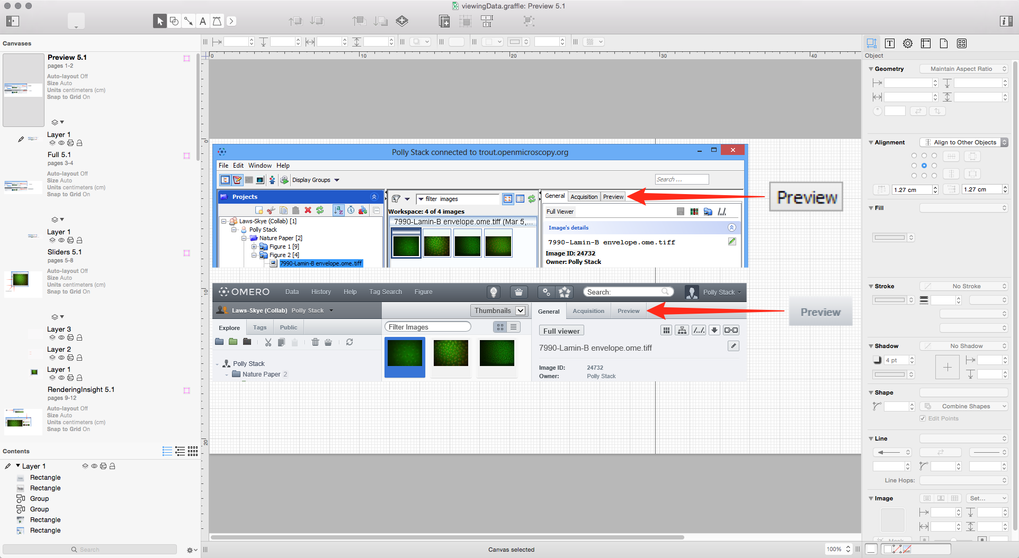
Image Naming Convention
Notes:
A naming convention is used for the image names. The Omnigraffle file for the section is named for the section, using camel syntax and then each image is created on a separate canvas and that is named logically. When exported, the image name is a concatenation of the Omnigraffle file name and the canvas name. So this is the first image in the Viewing Data section and it will be named viewingDataPreview.jpg. In this example I have happen to have added a suffix of the version number to the canvas name just to remind me which it is, but version names do not appear in the image name. In this way it is easy to update the image with a new screen capture and then exported, no URLs are broken in the HTML version.

Slide 20
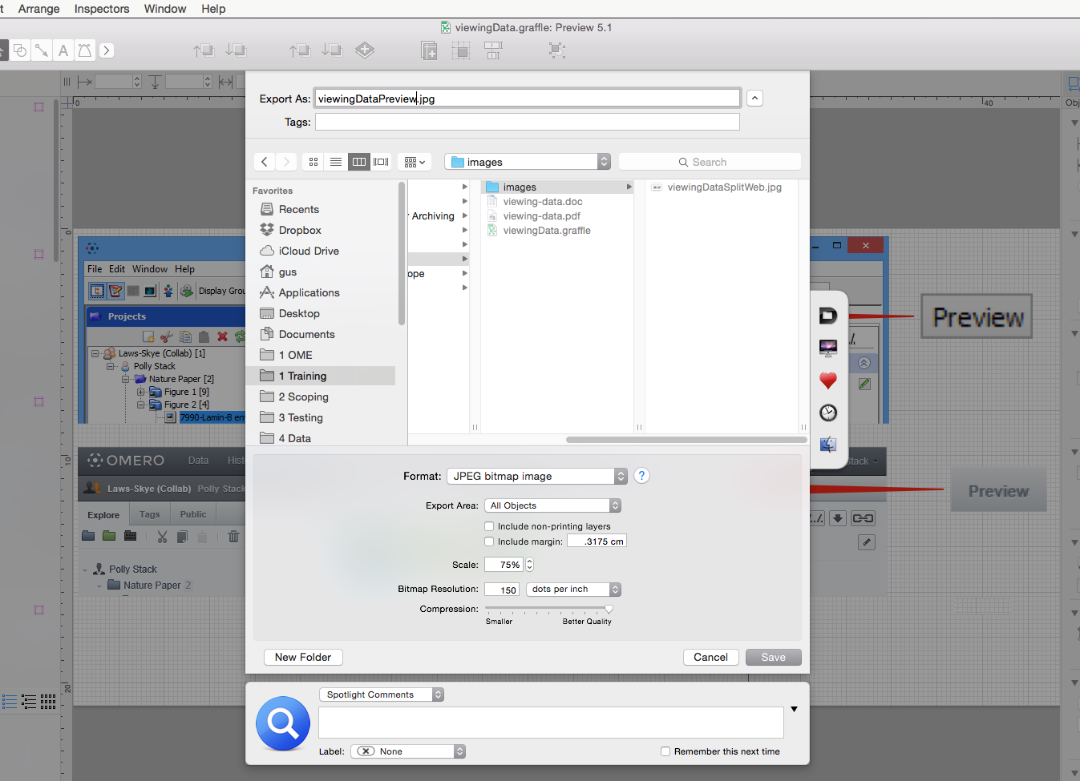
Exporting Images
Notes:
These canvases are exported as high quality JPEGs at 75% scale which gives good size and quality trade-off for both print and HTML versions.

Slide 21
Adapting the Help Website
Uses Jekyll – very easy to learn
Clone the Github repository
https://github.com/openmicroscopy/ome-help
Notes:
If you are feeling adventurous you can build your own version of the User Help website. It is built with Jekyll which is very easy to get your head around. Just fork the code from the Github repository and you are away.

Slide 22
License and Re-use
All material is covered by the
Creative Commons Attribution 3.0 Unported License
you are free to share or adapt content as long as you credit the Open Microscopy Environment
the exception to this is the screenshots and videos which can only be used for non-commercial purposes.
Notes:
You are free to use and adapt the material as you wish as long as OME is credited.

Slide 23
Thanks
Jason Swedlow
Helen Flynn, Petr Walczysko
OME Team
Our funders:
Notes:
Thanks as always to Jason, and to Helen and Petr who bear the brunt of the reviewing, the OME team who all input into the materials and also thanks to Wellcome Trust and BBSRC who fund the OME project.

