Slide 1
OME and OMERO
ImageJ conference, Madison 2015
Petr Walczysko
University of Dundee
The OME Consortium

Slide 2
Outline
Brief Overview
Scientific Data paradigm
What is OME
What is OMERO
ImageJ and OMERO
Questions

Slide 3
Brief Overview
Founded in 2000
Funded by Wellcome Trust, BBSRC, EPSRC
International consortium of software development sites
Open Source (mainly GPL)

Slide 4
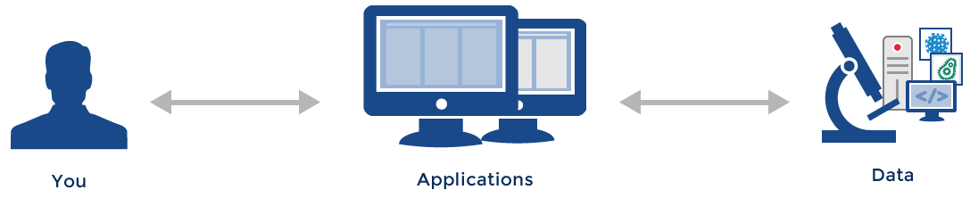
The Standard Paradigm

Slide 5
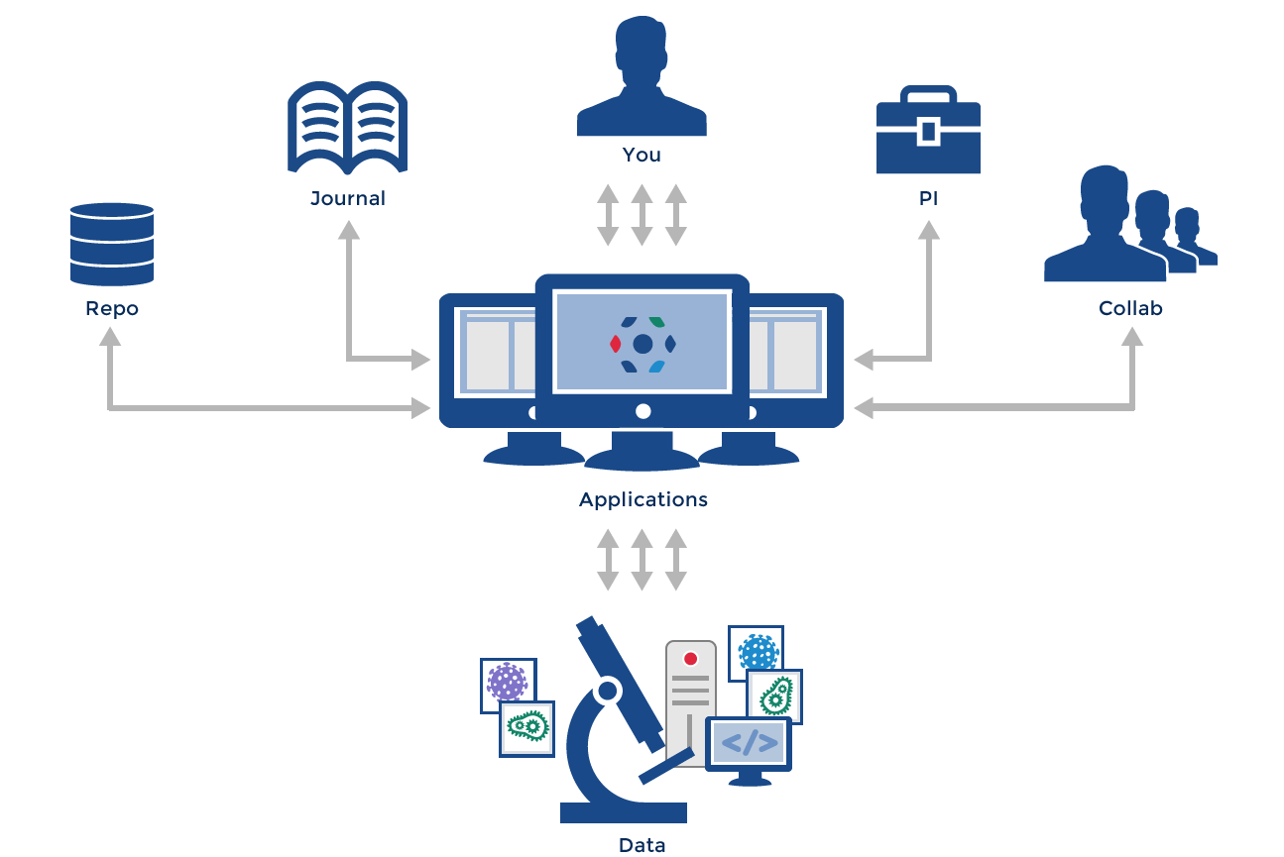
The “Scientific Data” Paradigm
Gray et al, 2005, Scientific Data Management in the Coming Decade, Microsoft Research

Slide 6
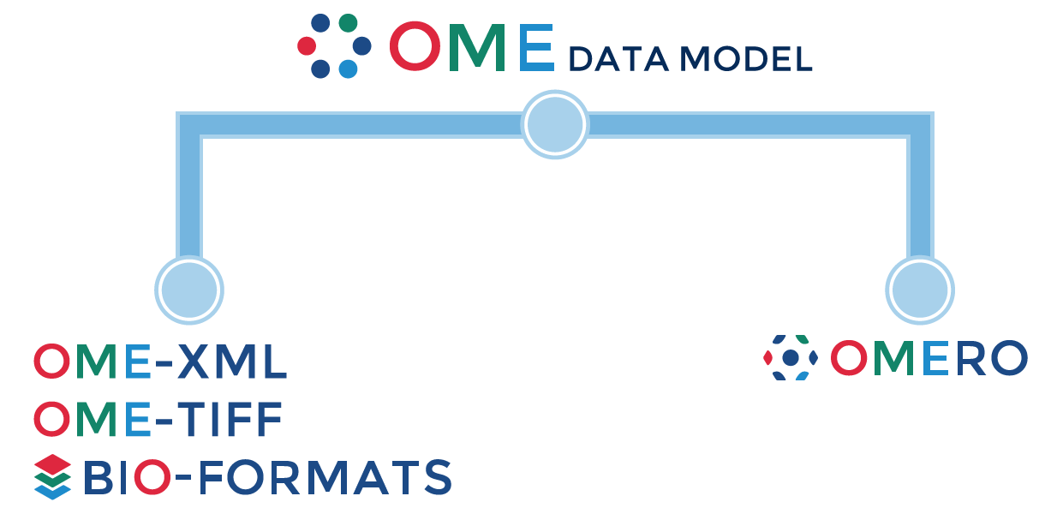
OME : What We Do
Open Image
Management Platform
Open, exchangeable file formats

Slide 7
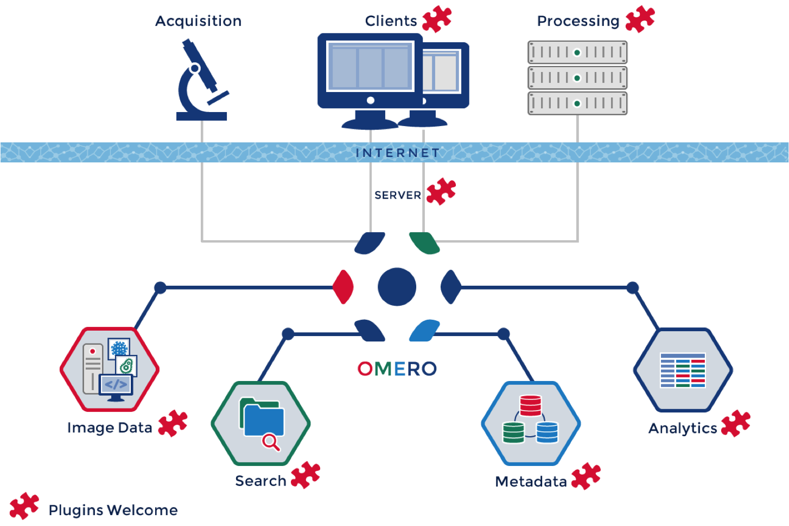
The Extensible OMERO platform

Slide 8
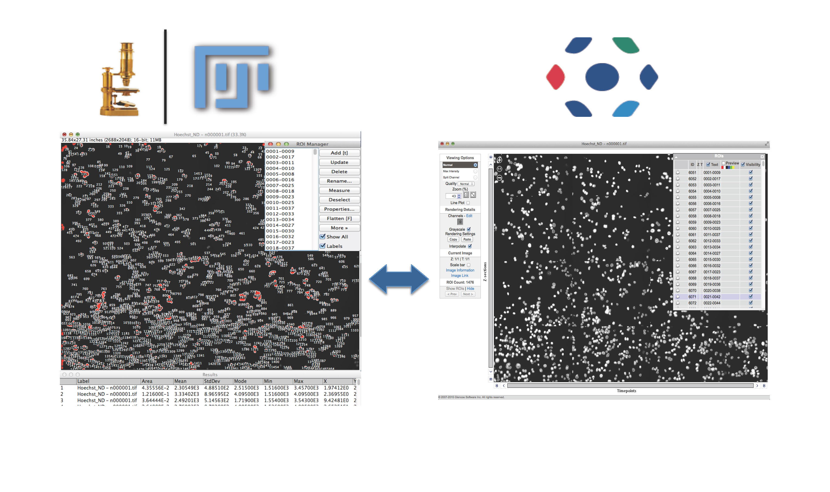
ImageJ and OMERO

Slide 9
OMERO and ImageJ: next steps
Java gateway (available in v5.2)
Re-usable UI components
ImageJ2: Server side integration (started by C. Rueden)

Slide 10



Thank you

Slide 11


OME Consortium
Dundee – Jason Swedlow, Colin Blackburn, Jean-Marie Burel, Mark Carroll, Gus Ferguson, Helen Flynn, Kenny Gillen, Roger Leigh, Simon Li, Dominik Lindner, Josh Moore, Will Moore, Balaji Ramalingam, Aleksandra Tarkowska, Petr Walczysko
University of Wisconsin, Madison (LOCI) - Kevin Eliceiri, Curtis Rueden, Mark Hiner
UT Southwestern – Gaudenz Danuser, Sebastian Besson
Oxford – Ilan Davis, Douglas Russell
CRS4 - Gianuigi Zanetti, Gianmauro Cucurru, Simone Leo, Luca Lianas
Edinburgh – Richard Baldock, Bill Hill, Jianguo Rao
Carnegie-Mellon – Robert Murphy, BK Cho, Ivan Cao-Berg
Imperial – Paul French, Chris Dunsby, Ian Munro, Yuriy Alexandrov
NIA, NIH – Ilya Goldberg, Chris Coletta
Pasteur – Spencer Shorte, Sebastien Simard, Anne Danckaert
EBI – Gerard Kleywegt, Ardan Patwardhan, Ingvar Lagerstedt
Glencoe Software – Chris Allan, Joshua Ballanco, Andreas Knab, Melissa Linkert,
Chris MacLeod, Josh Moore, Emil Rozbicki, Liza Unson, Rebecca Walker, Wilma Woudenberg

