Slide 1



Continuous Integration

Slide 2
Continuous Integration

Slide 3
Plan
Why OME needs Continuous Integration?
  OME Deliverables and Releases
  OME source code management
  Continuous Integration
OME Continuous Integration servers
  Introduction
  Travis CI
  Jenkins CI
CI documentation

Slide 4
OME releases: Deliverables
OMERO.server / OMERO.clients
  Windows, Linux, Mac OS X
  Ice (3,3, 3.4, 3.5)
Tools/plugins
  OMERO.imagej,
  OMERO.matlab,
  OMERO.py
OMERO Virtual appliance
Documentation
  API documentation
  Sphinx documentation
Java ARchives (JAR)
  loci_tools.jar
  ome_tools.jar
  ….
Bio-Formats Tools
  Command-line tools
  MATLAB toolbox
Documentation
  API documentation
  Sphinx documentation

Slide 5
OME releases
OME 4.4.x series (June 2012 – Jan 2014)
  12 releases in 19 months (1 major, 11 minor)
  3 emergency releases (4.4.1, 4.4.3, 4.4.8)
Quality Assurance
  Ensure quality standards are being met
  Robustness/stability
  Catching bugs early
Every code change must be tested and reviewed

Slide 6
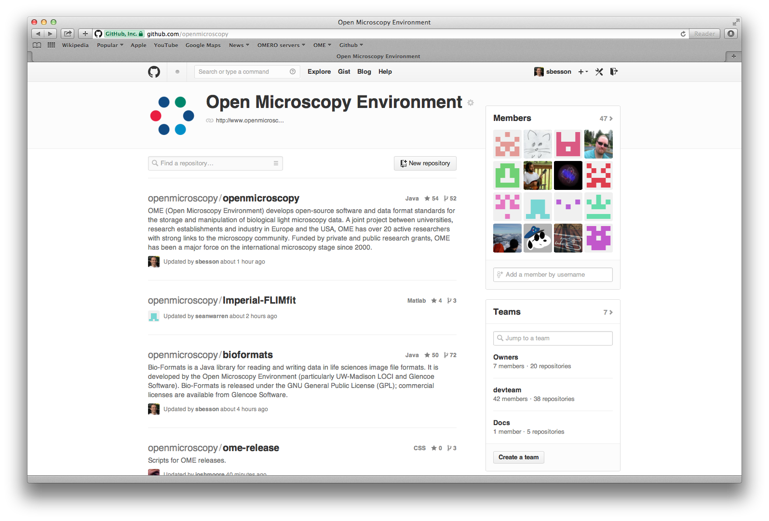
Source code management

Slide 7
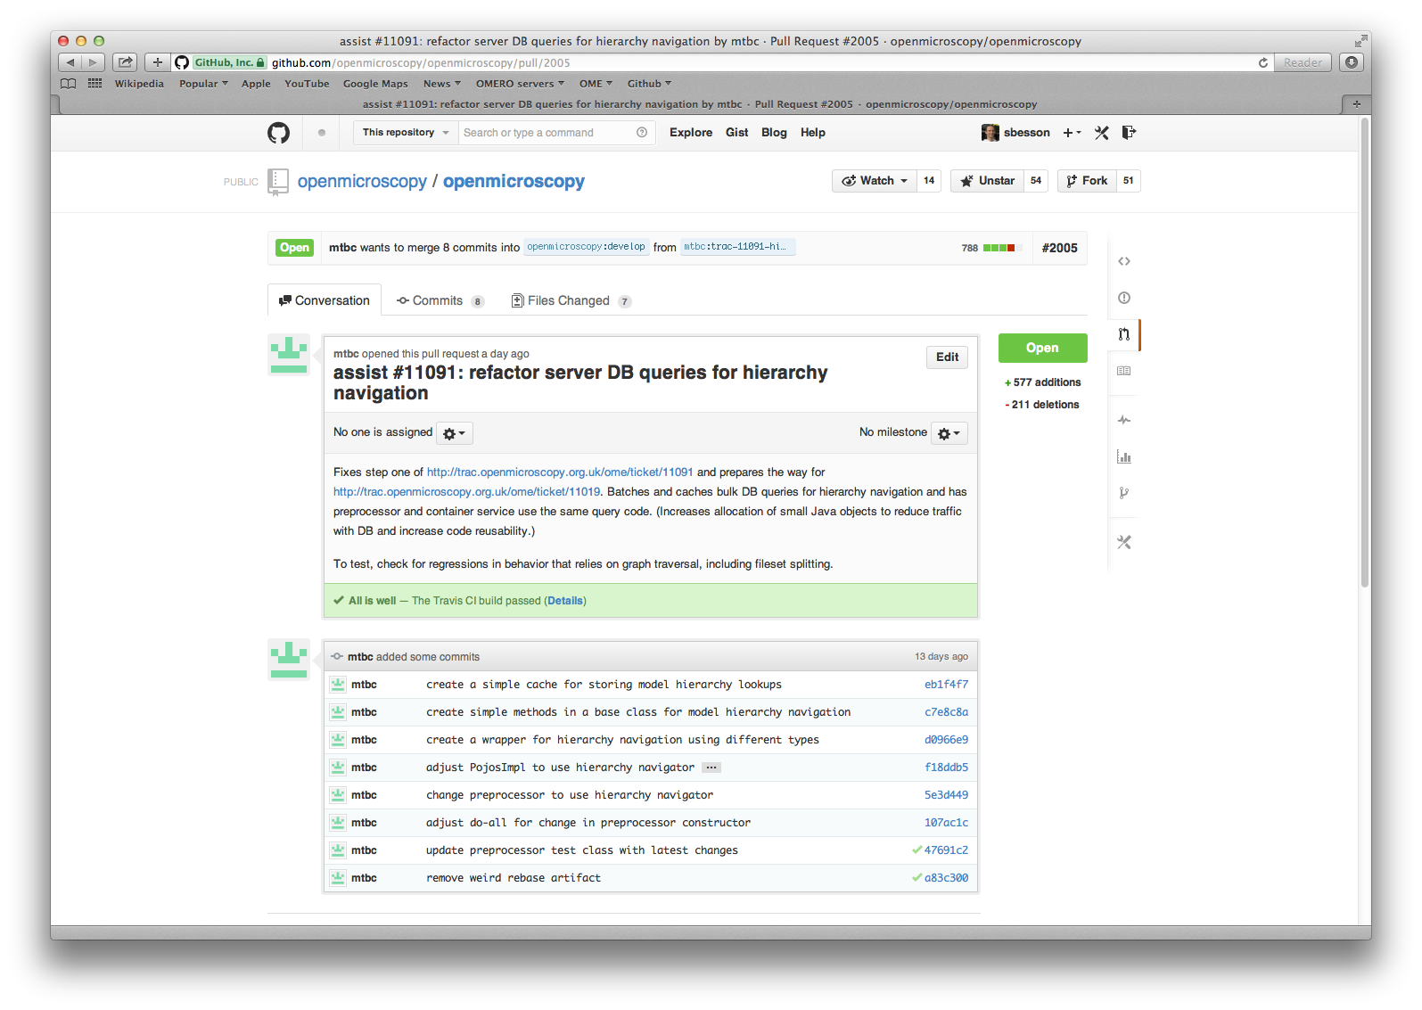
Source code: Pull Requests

Slide 8
Source code: changes frequency
 | OMERO | Bio-Formats | Documentation | Scripts
Number of commits | 5502 | 3033 | 1375 | 111
Number of merged Pull Requests | 812 | 366 | 254 | 23
Number of unique authors | 25 | 26 | 26 | 7
Number of merged Pull Requests/day | 2 | 1 | 1 | <1
Number of commits/day | 11 | 6 | 3 | <1
  Changes on dev_5_0 branch between 25 Sept 2012 and 20 Jan 2014

Slide 9
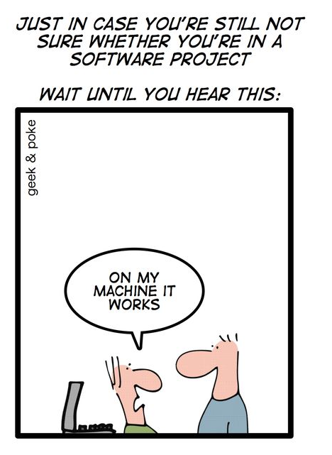
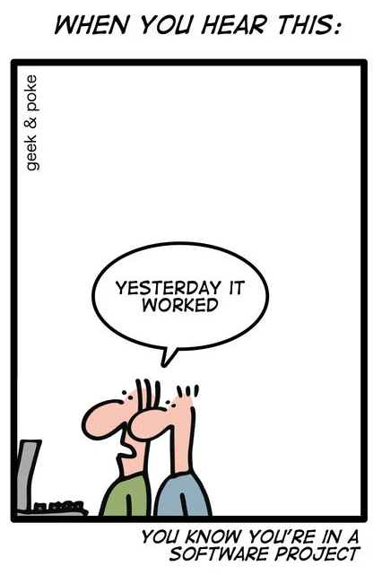
The problem
http://geekandpoke.typepad.com

Slide 10
Continuous integration
Continuous integration: perform software integration frequently
Automate the build
  OMERO suite (server, clients…), Bio-Formats suite
  OME Consortium products
Automate the tests
  Run Bio-Formats automated tests against the data repository
  Run the OMERO.server integration tests of the OMERO.server
Automate the deployment
  Deploy all deliverables for PR review/ QA release
  Deploy the latest version of the documentation

Slide 11
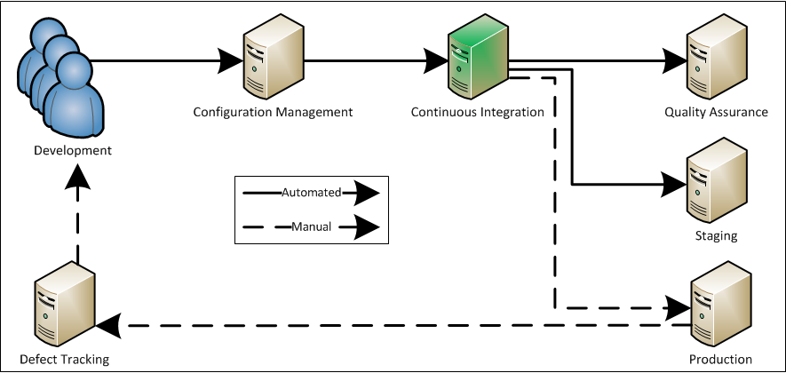
Continuous integration server
Source: http://www.appfoundation.com/ci/

Slide 12
Continuous integration server
BENEFITS
Automation (build, test, deployment)
Integration with SCM
Easy access to daily deliverables
Time trigger/change polling
Build history
COSTS
Writing/maintenance of CI automated scripts
Team resources
  Server setup
  Server maintenance
  Individual job setup
Team communication

Slide 13
OME CI servers
http://about.travis-ci.org
Externally hosted
Integration with GitHub
Support Java, Python, C+
Matrix jobs
Setup in .travis.yml
Build queues/ 50 min timeout
http://jenkins-ci.org
Hosted by OME team
Integration via scc tools
Node-specific languages
Chained jobs
Build system (ant, build.py)
Control over node number/throttling/time

Slide 14



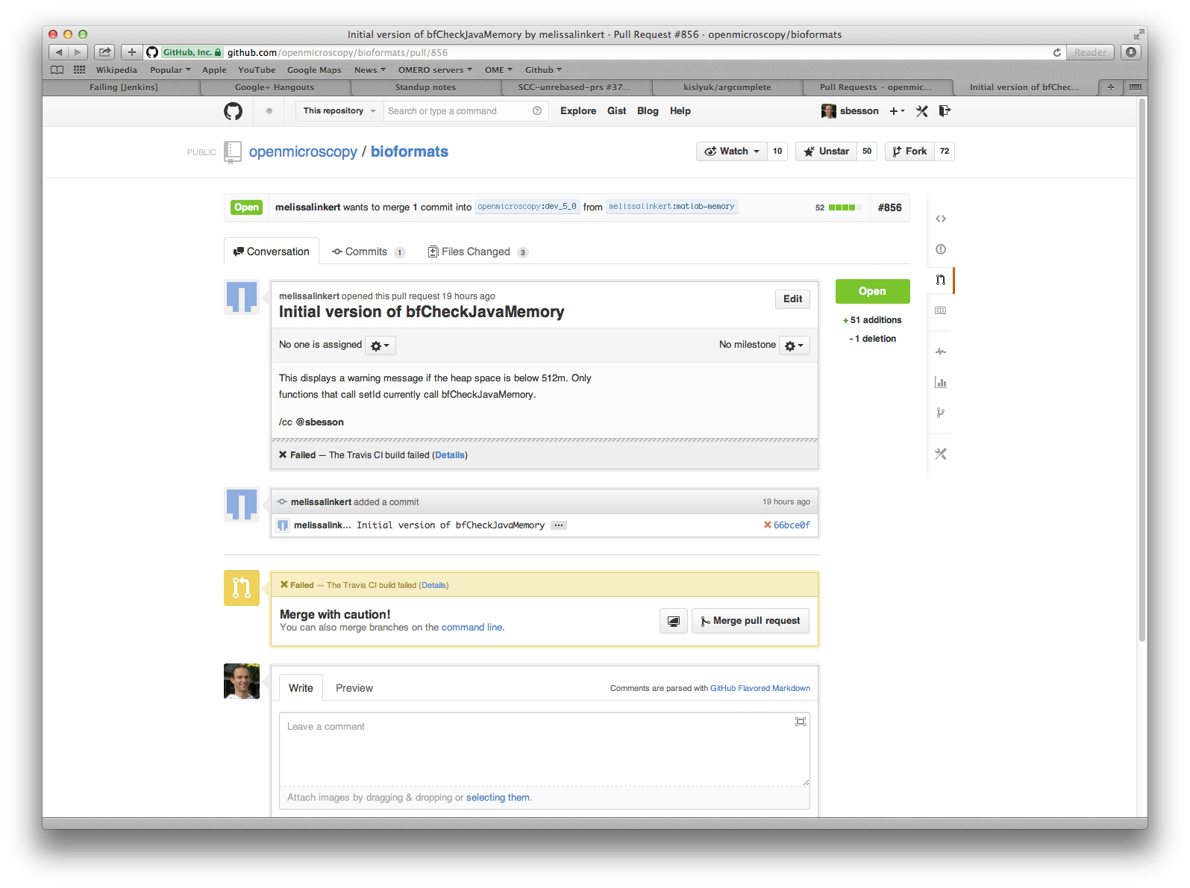


Typical CI workflow

Slide 15
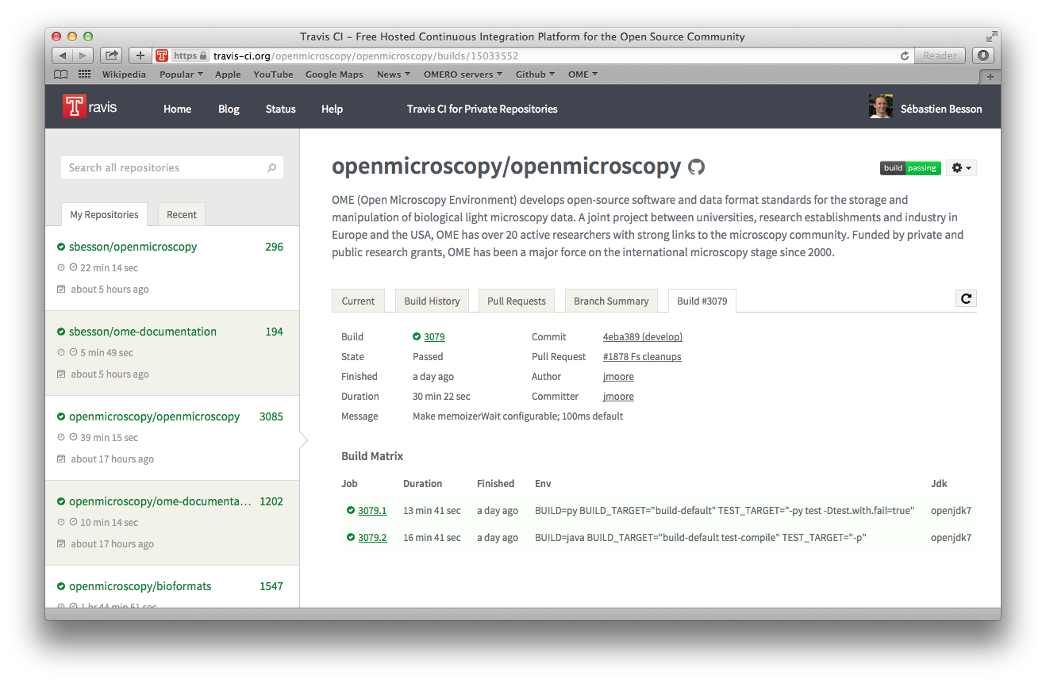
Travis CI : introduction
Activated for core OME source code repositories

Slide 16
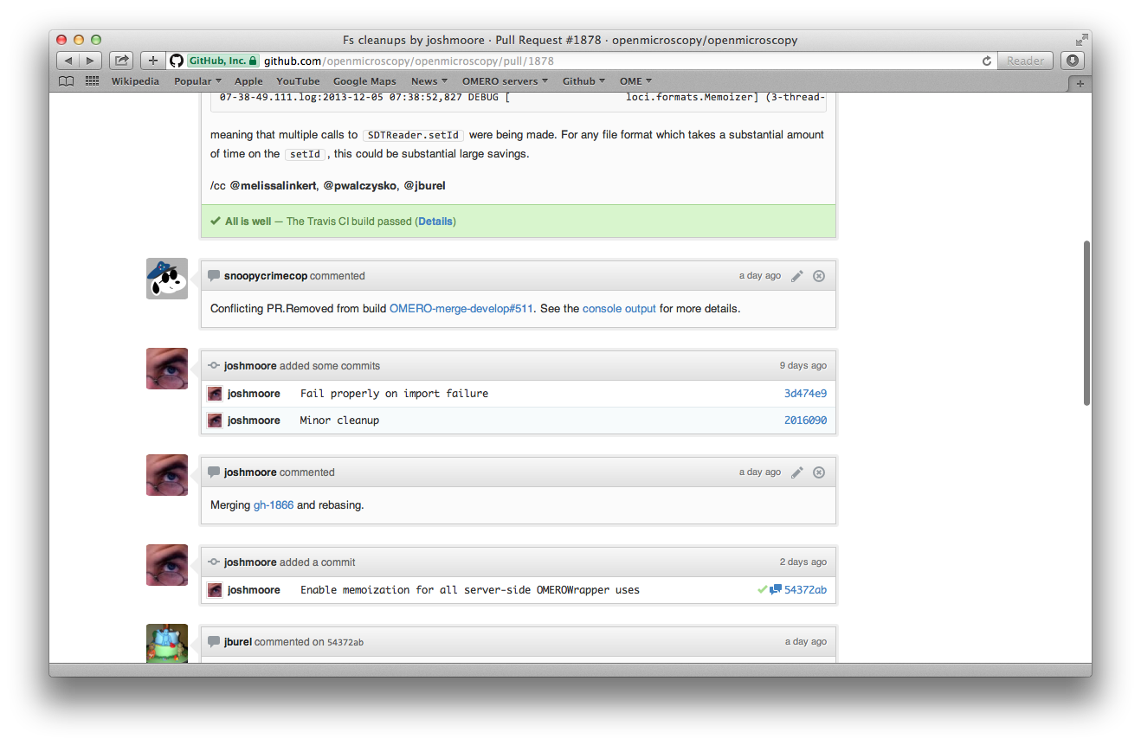
Travis CI: GitHub integration

Slide 17
Travis CI: OME usage
 |  | Code validation | Build | Test
OMERO | py | flake8 | ./build.py build-default | ./build.py -py test
 | java |  | ./build.py build-default test-compile
Bio-Formats | maven |  | mvn
 | cpp |  | cmake + make
 | cppwrap |  | mvn + cmake + make
 | sphinx |  | make clean html latexpdf
Documentation |  |  | make clean html latexpdf
Scripts |  | flake8
Source: .travis.yml

Slide 18
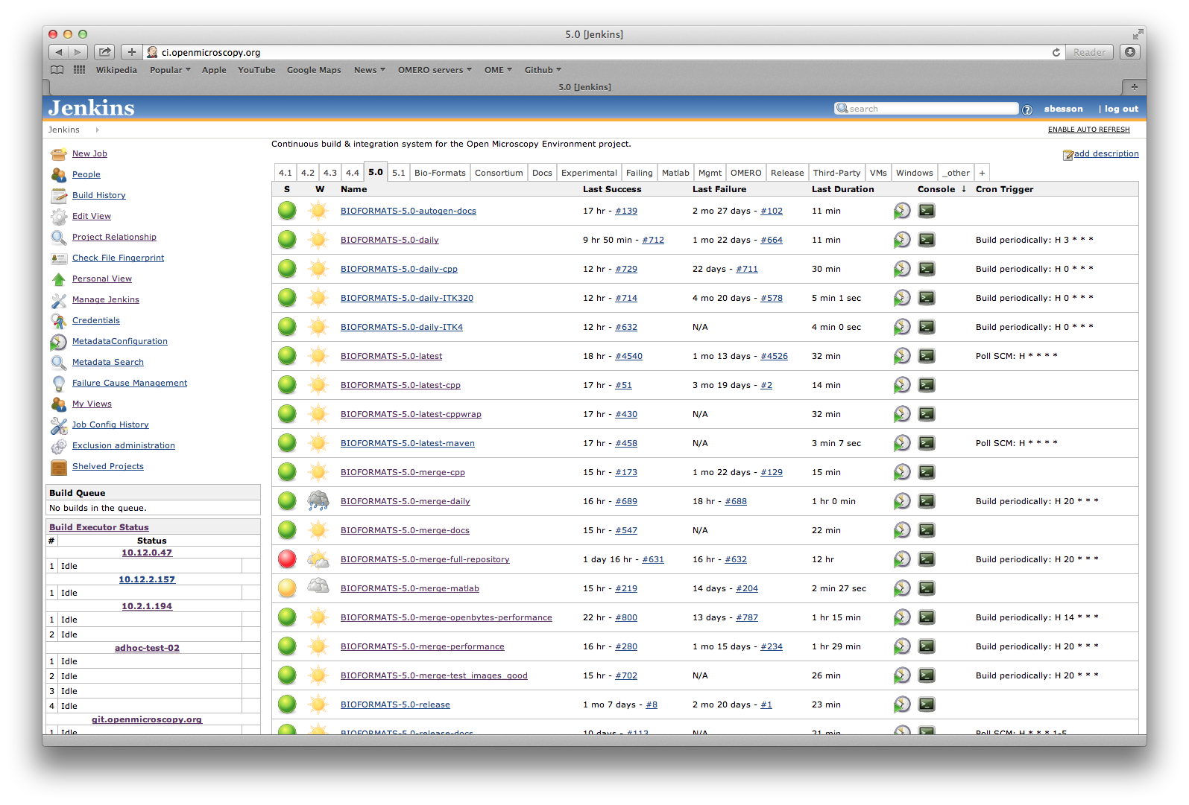
OME Jenkins CI: main view
http://ci.openmicroscopy.org

Slide 19
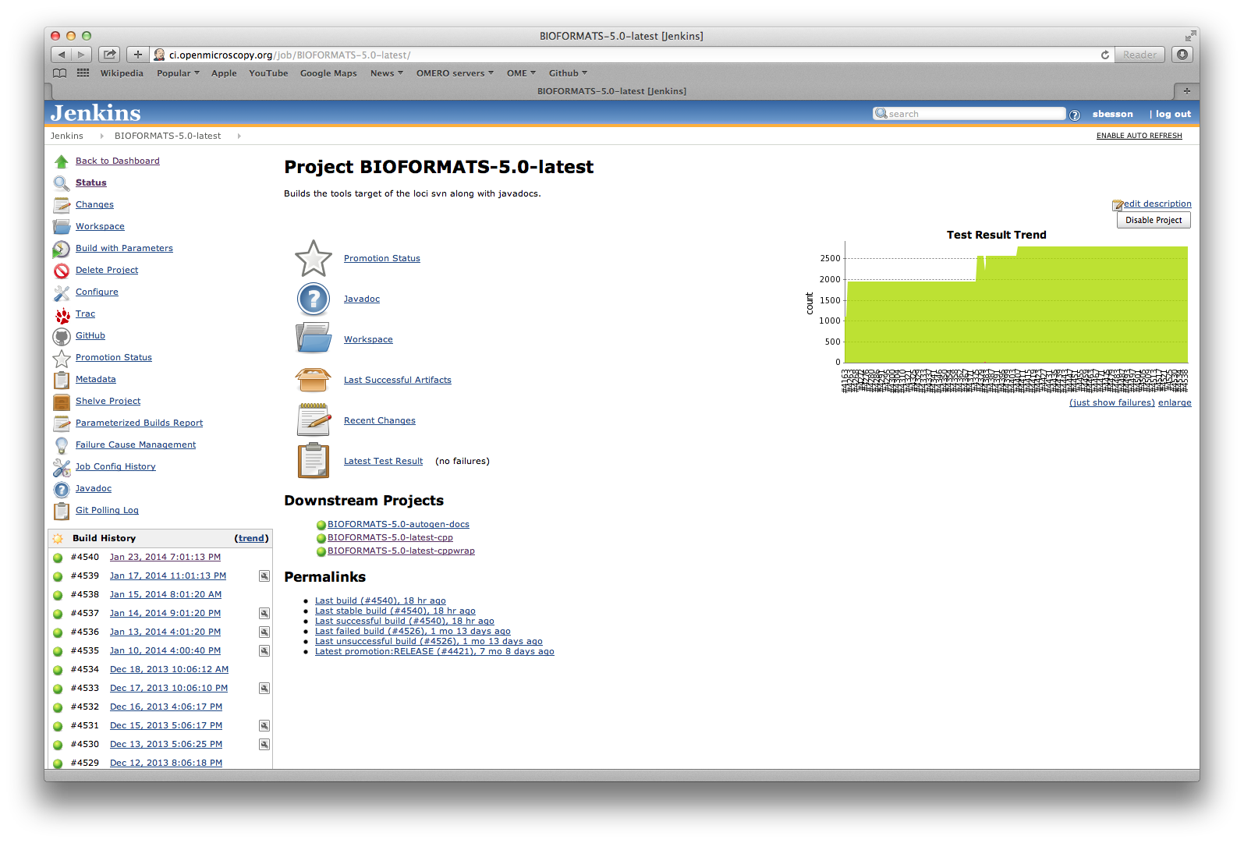
OME Jenkins CI: build view
http://ci.openmicroscopy.org/job/JOBNAME

Slide 20
Jenkins CI: job naming scheme
$COMPONENT-$VERSION-$TYPE-$DESCRIPTION,
e.g. OMERO-5.0-merge-integration
COMPONENT: deliverable name
  OMERO, BIOFORMATS, Consortium or third-party deliverable
VERSION: version number e.g. 5.0
TYPE: usually merge, latest, release
DESCRIPTION:
  Short description (2-3 words max)
  Allows to create personal views http://ci.openmicroscopy.org/pview/

Slide 21
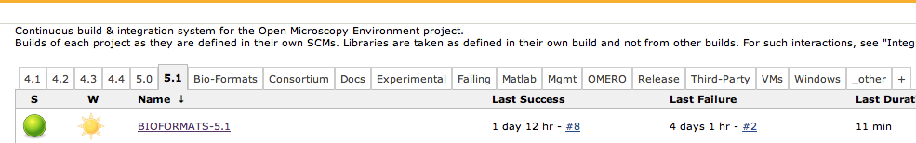
Jenkins CI: views
Versions
  4.4, 5.0, 5.1: for OME main products (OMERO, Bio-Formats)
Components
  OMERO/Bio-Formats
  Consortium
  Third Party (Pytables, ITK, Zlib,…)
  Mgmt
Experimental
Failing
  all non-Experimental jobs with failing/unstable status

Slide 22

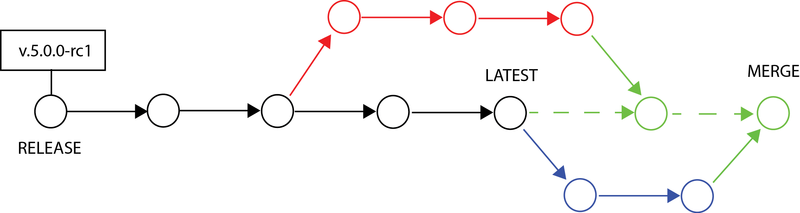
Jenkins CI: job types
LATEST jobs
built from the HEAD of the development branch, i.e. origin/dev_5_0
MERGE jobs
built from the HEAD of a development branch with Pull Requests merged in, i.e. snoopycrimecop/merge/dev_5_0/latest
RELEASE jobs
associated with a tag, e.g. 5.0.0-rc1

Slide 23
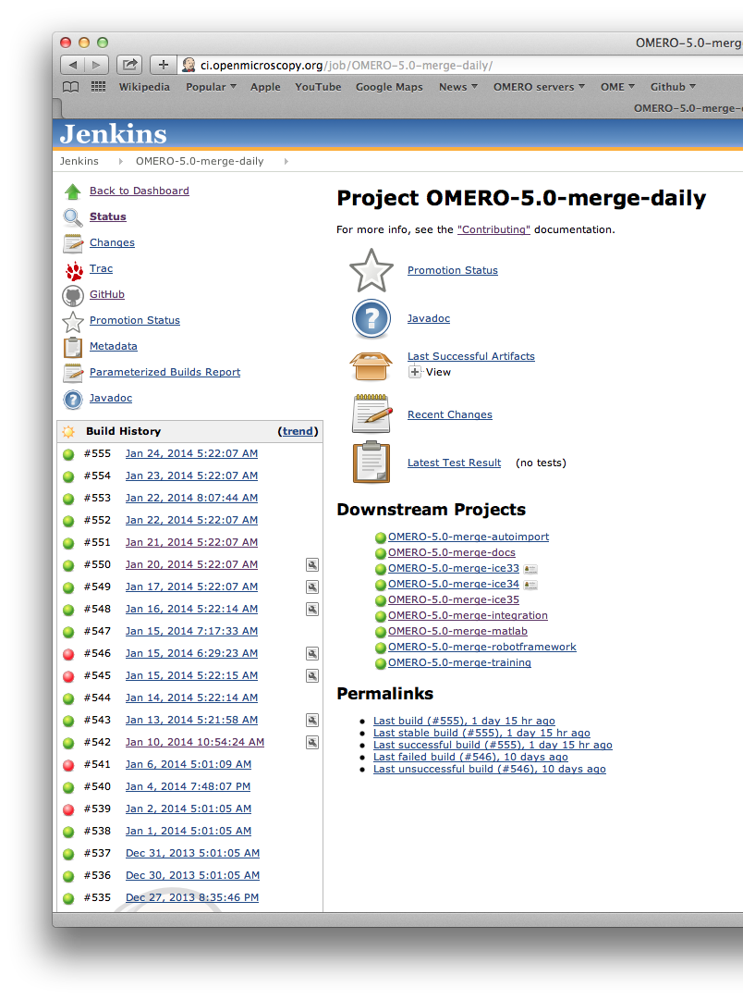
Jenkins CI: chained jobs
Morning jobs
  merge Pull Requests
  build artifacts
  deploy merge server
  import data
  run integration tests
  build and deploy staging documentation

Slide 24
Jenkins CI: deployment servers
Series | Development branch | Server name
4.4.x | dev_4_4 | howe.openmicroscopy.org.uk
5.0.x | dev_5_0 | gretzky.openmicroscopy.org.uk
5.1.x | develop | trout.openmicroscopy.org
One node associated to each development branch
Multiple OMERO instances running on different ports
  4064: merge server for PR review
  14064: latest server
  24064: integration server for integration tests

Slide 25
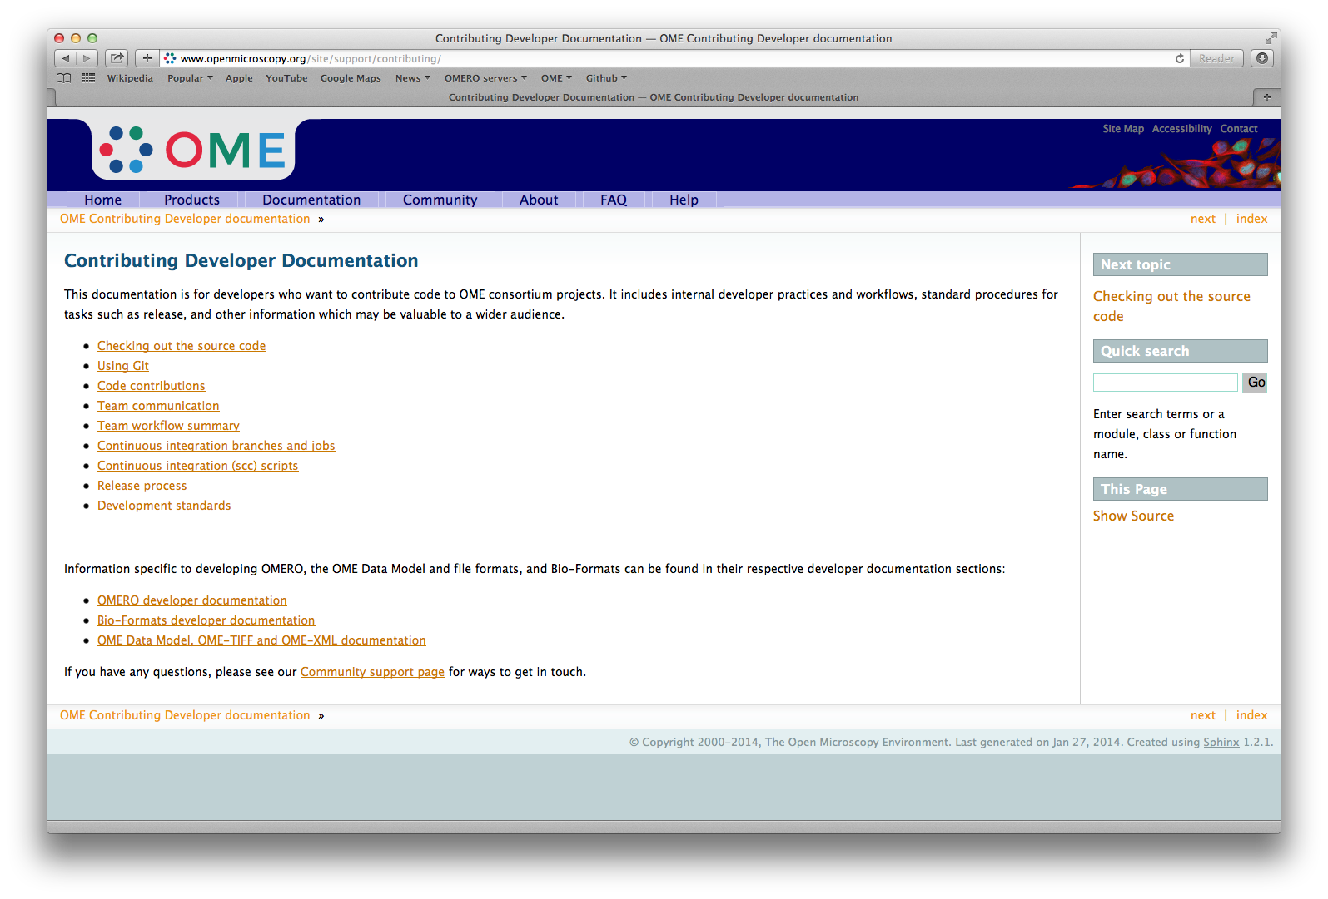
Continuous integration documentation

Slide 26
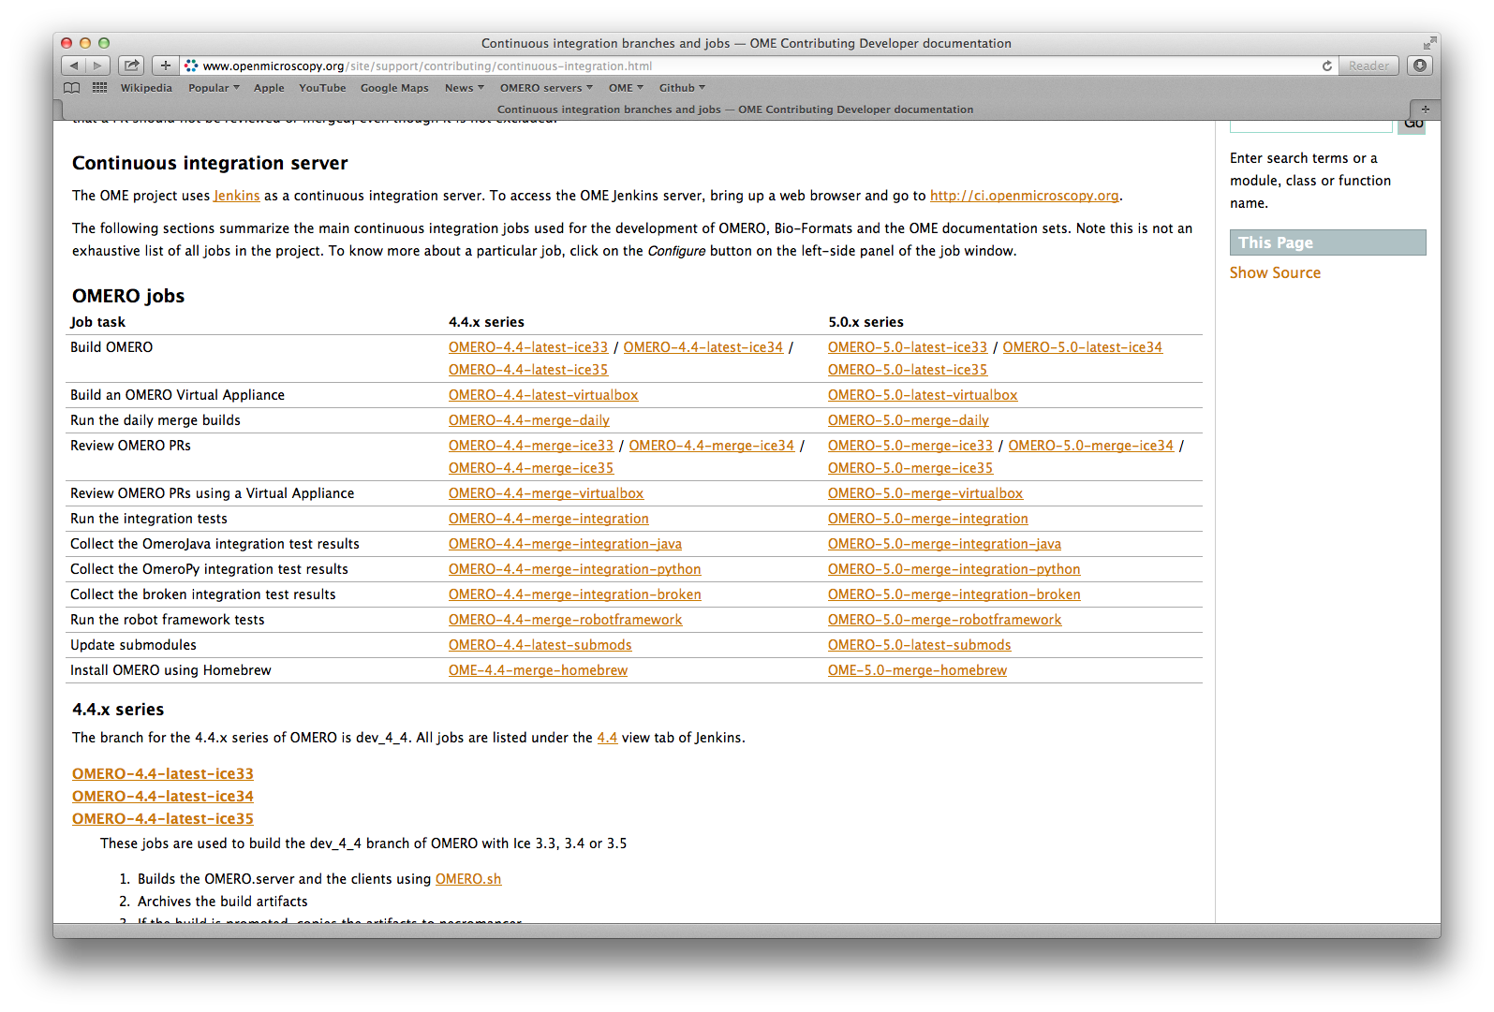
Continuous integration documentation

Slide 27
Continuous Integration: future directions
Lots of progress in the last 6 months
  Cleanup of the job (integration tests)
  Server maintenance and stabilization
  Rationalization/organization
Future steps
  Refactoring of Consortium projects
  Integration tests in Travis build
  Maintenance/improvements of the CI documentation
  Refactoring of the 5.0 jobs using new 5.1 jobs

Slide 28
CI Agent: Snoopy Crime Cop
GitHub user
  https://github.com/openmicroscopy/snoopycrimecop
  Member of openmicroscopy and ome organizations
Perform actions
  Performs local PR merging using GitHub API
  Open PRs for submodule bumps
  Push merge/branches release tags to his forks
Forks of main repositories
  see https://github.com/snoopycrimecop/openmicroscopy
  used for pushing merge branches/ staging release tags

